Slide 1
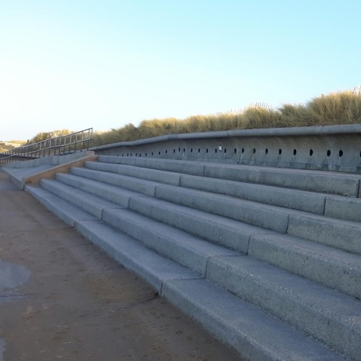
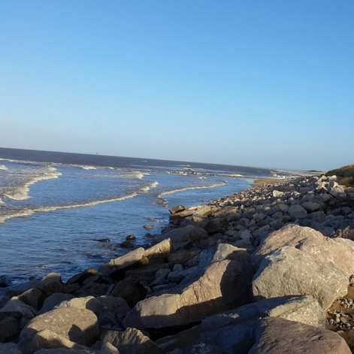
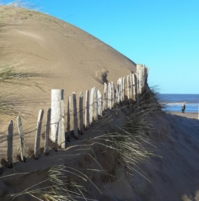



Integrating Professional River Study Techniques into School Fieldwork
Project 1:
Contrasting Approaches to Coastal Defence
Notes:
Images:
(all) Coastal defences (Point of Ayr & Prestatyn). Images courtesy of RGS-IBG. Image licence: CC-BY-SA 4.0

Slide 2
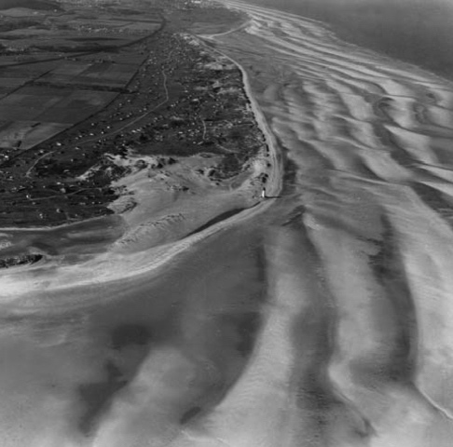
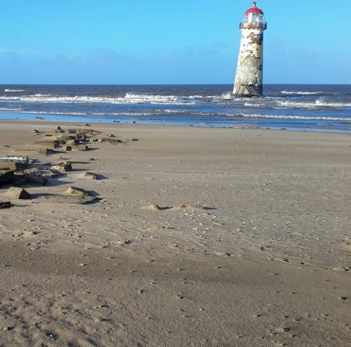
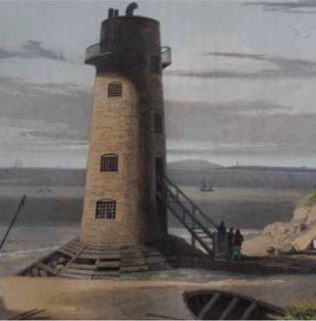
Background & Introduction
Coastal defence is of critical concern for coastal communities & governments
Coastal areas are a high-value asset for numerous (often competing) sectors and services
Coastal defence has been performed for millennia, but the best approaches remain a subject of debate
Hard engineering (e.g., sea walls, groynes) effectively protects coastal areas, but disturbs natural coastal processes and habitats
Soft engineering (e.g., dune stabilisation with plants) is generally more sustainable and environmentally friendly, but can require greater long-term investment
Global climate change poses a serious challenge for coastal managers
In practice, coastal defences reflect: the social, economic, and political climate; local, regional, and national stakeholders; technological advancements; etc.)
Notes:
Images:
(top) Talacre Beach and Lighthouse in 1955 (with the dunes close by). Image courtesy of Environmental Resource Management (ERM)
(Centre) Talacre Beach Lighthouse in 2018 (dunes out of shot behind photographer). Image courtesy of Tornillo Scientific. Image licence: CC-BY-SA 4.0
(bottom) 1815 William Daniel painting of the Talacre Lighthouse (with the dunes directly adjacent). Image courtesy of Environmental Resource Management (ERM)

Slide 3
‘Real-world’ Examples
Professional coastal surveys often use stringent methodological protocols and expensive, high-tech equipment (e.g., remote sensing)
2017 study in India that used analytical modelling and remote sensing to assess the impacts of seawall construction. Investigators were able to estimate longshore material transport and landward erosion up to a kilometre down-coast of a seawall over a multi-year period.
BUT
Many basic coastal analysis approaches available to GCSE and A Level students are the same or directly comparable to those used by ‘real-world’ practitioners
2003 Cromer Coastal Defence Strategy Study, which, among other factors, considered local habitats, sediment transport and longshore drift, local infrastructure, and local sites of commercial, residential, industrial, historical and environmental importance
2009 European consortium study that considered the impacts of coastal defence structures
2002 EU-funded report on coastal erosion indicators, which provides guidance for practitioners
Notes:
Links to examples:
https://www.north-norfolk.gov.uk/media/3084/cromer-coastal-strategy-study.pdf
https://qsr2010.ospar.org/media/assessments/p00435_Coastal_defence.pdf
https://www.eea.europa.eu/data-and-maps/data/hydrodynamics-and-sea-level-rise/coastal-erosion-indicators-study/coastal-erosion-indicators-study/
http://journals.sagepub.com/doi/full/10.1177/1759313117712180

Slide 4
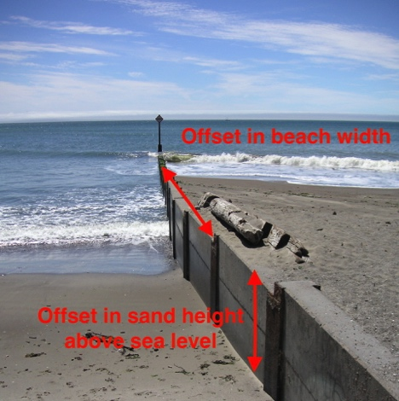
Pre-Fieldwork Activities
Research Questions & Hypotheses
Research should be framed around scientific questions & hypotheses
For example:
The nature of coastal evolution as a function of hard vs. soft engineering
Coastal erosion rates as a function of managed intervention vs. no intervention
Changes in coastline morphology and sediment conditions above and below coastal defences
Notes:
Images:
(left) Hard coastal defences (Prestatyn). Image courtesy of RGS-IBG. Image licence: CC-BY-SA 4.0
(centre) Soft coastal defences (Gronant and Talacre Dunes, Point of Ayr). Image courtesy of RGS-IBG. Image licence: CC-BY-SA 4.0
(left) Sediment pile-up and beach extension on one side of a wooden groyne. Image modified from that of Beatrice Murch (https://www.flickr.com/photos/blmurch/952523971). Image licence: CC-BY-SA 2.0

Slide 5
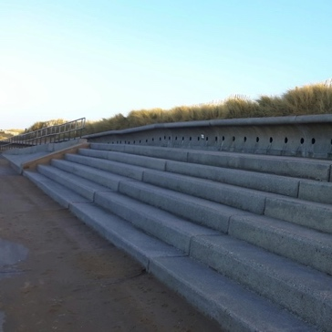
Pre-Fieldwork Activities
Site Selection
The UK has four options for shoreline management
No active intervention
Hold the (existing defence) line (i.e., replace or maintain existing artificial defences to maintain the current shoreline position)
Managed realignment (e.g., allow natural evolution of the shoreline, but with active management of certain processes to direct evolution in certain ways)
Advance the line (i.e., construction of new defences on the seaward side of existing defences)
Select 2–3 sites under contrasting management plans to allow for comparative analysis; for example:
An unprotected stretch of coast with no active intervention
A highly engineered coastline consisting of hard engineering structures (e.g., groynes, seawalls, breakwaters, dikes).
A section of coast managed using soft engineering approaches (e.g., dune regeneration, artificial reefs, mangrove or marsh creation, vegetation planting).
Notes:
Images:
(left) ‘Hold the line’ using hard coastal defences (Prestatyn). Image courtesy of RGS-IBG. Image licence: CC-BY-SA 4.0
(right) ‘Managed realignment’ using soft coastal defences (Gronant and Talacre Dunes, Point of Ayr). Image courtesy of RGS-IBG. Image licence: CC-BY-SA 4.0

Slide 6
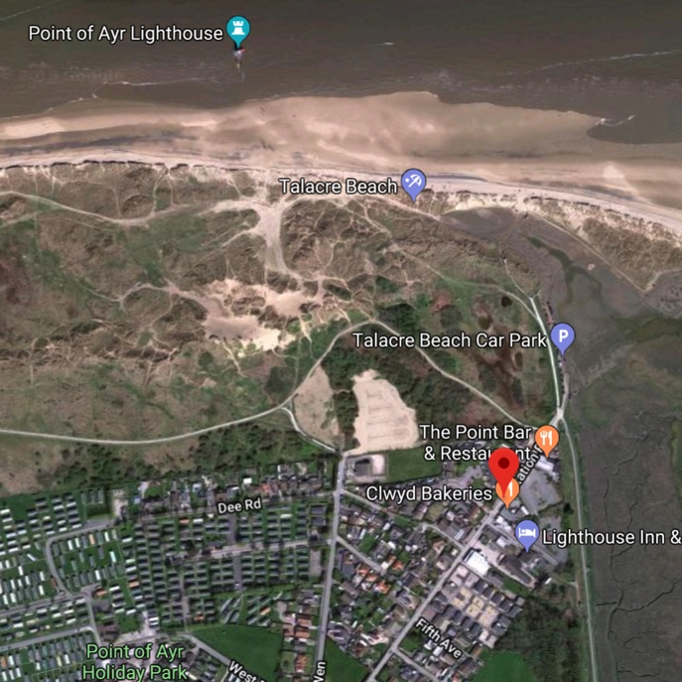
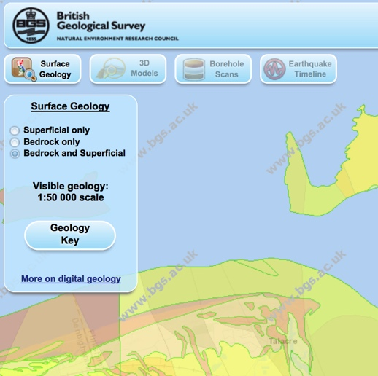
Pre-Fieldwork Activities
Metadata: Cartography
Use maps to identify:
Local and regional scale coastal morphology
Geological setting and impacts on coastal evolution
Proximal natural features/processes
Types of land use and human infrastructure
Land use change over time
For example:
Location on global and UK scale maps (political and topographical)
Current and past Ordnance Survey maps
Geological map of the study area
Current and past aerial /satellite images
Maps of designated (i.e., protected) areas in and around the field area
Environment agency coastal erosion maps of target areas
Notes:
Images:
(top) Google Maps screen grab (Talacre & Point of Ayr)
(bottom) Screen grab from British Geological Survey (BGS) Geology of Britain geological map (http://mapapps.bgs.ac.uk/geologyofbritain3d/index.html)

Slide 7
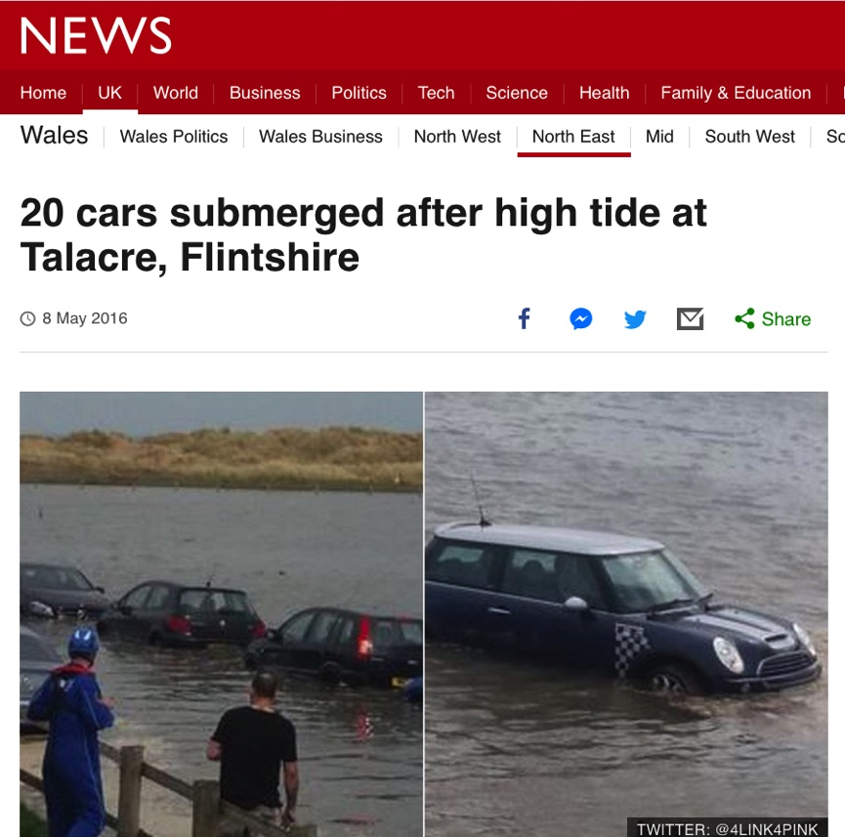
Pre-Fieldwork Activities
Metadata: Other Secondary Data Sources
Environment Agency records and information
Tidal records
Flood risk maps
Media reports
Planning applications
Local guides and publications
e.g., Press coverage of local coastal flooding
Notes:
Images:
- Screen grab of 2016 BBC report on a tidal flooding event at Talacre (http://www.bbc.co.uk/news/uk-wales-north-east-wales-36243086)

Slide 8
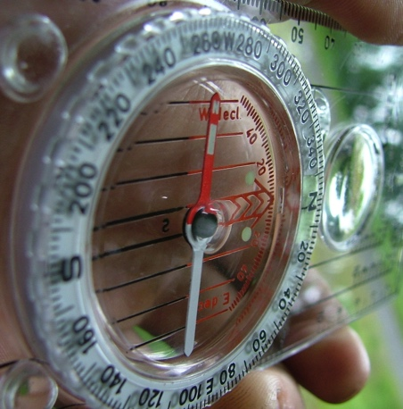
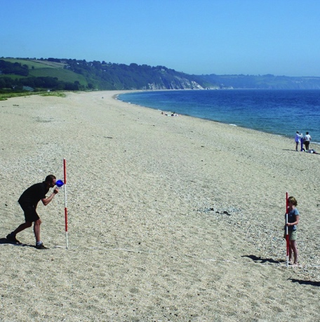
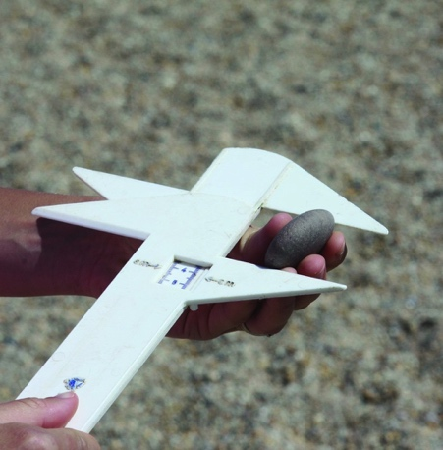
Pre-Fieldwork Activities
Research Techniques
No ‘one size fits all’
Dependent on field area/ field sites
Dependent on features & processes to measure
Dependent on research questions and hypotheses
Dependent on spatial and temporal scales of study
Dependent on available resources (i.e., time, money, expertise)
https://www.rgs.org/schools/teaching-resources/sampling-techniques/
Notes:
Images:
(left) (left) Silva Expedition 4 compass-clinometer (https://en.wikipedia.org/wiki/Silva_compass#/media/File:Silva_compass,_Expedition_4.jpg). Image licence: CC-BY-SA 3.0
(centre) Measuring gradient by the Field Studies Council (https://www.geography-fieldwork.org/a-level/coasts/coastal-management/method/). Image licence: CC_BY
(right) Using callipers to measure the a, b and c axes of a pebble by the Field Studies Council (https://www.geography-fieldwork.org/a-level/coasts/coastal-management/method/). Image licence: CC_BY

Slide 9
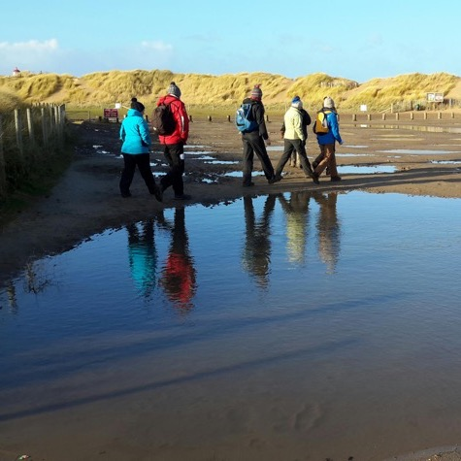

Pre-Fieldwork Activities
Logistical Planning
Field Plan
Dependent on time available
Dependent on number of sites & transit times
Dependent on number of team members
Dependent on data collection techniques
Mitigate impacts of activities on the local environment and habitats, particularly in protected areas (e.g., SSSIs); for example, keep to established paths
Notes:
Images:
(left) Pexels.com (stock photography with a CC0 licence)
(centre) Talacre Beach Lighthouse. Images courtesy of Tornillo Scientific. Image licence: CC-BY-SA 4.0
(right) Group cross flooded car park at Gronant and Talacre Dunes. Images courtesy of RGS-IBG. Image licence: CC-BY-SA 4.0

Slide 10






Pre-Fieldwork Activities
Logistical Planning
Field Kit (Universal)
Clothing (long trousers, long sleeves, wet weather gear, boots)
Field note book
Charged mobile phone
GPS device
Camera
Sharpened pencils
First aid kit
Field Kit (Fieldwork Specific)
Research equipment (e.g., metre ruler, callipers, etc.)
Notes:
Images:
- Pexels.com (stock photography with a CC0 licence)

Slide 11

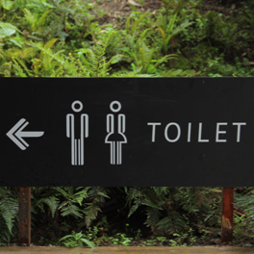
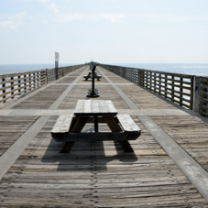
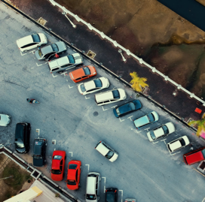

Pre-Fieldwork Activities
Logistical Planning
Site Practicalities
Parking (incl. bus parking)
Toilets
Picnic sites
Shops & cafes
Field centres & visitor centres
Accessibility (roads, foot paths, etc.)
Nearest A&E Department
Notes:
Images:
- Pexels.com (stock photography with a CC0 licence)

Slide 12
Comparative Study of River Regimes Pre-Fieldwork Activities
Products of an evolving planet
Pre-Fieldwork Activities
Logistical Planning
Risk Assessment
Hazard Control Measures Residual Risk
Working near tidal water
Uneven / unstable ground
Biological hazards (dogs, etc.).
Coastal waters will not be entered. Tide schedules consulted before visit. Maintain vigilance. Carry charged mobile phone.
Keep to flat areas; walk with care; ……. etc.
Coastal areas popular with dog walkers. Take precautions around unknown animals (i.e., don't pet dogs without owners’ permission).
MEDIUM
LOW
LOW
https://www.rgs.org/in-the-field/fieldwork-in-schools/fieldwork-safety-and-planning/risk-assessments/
Notes:
Example of factors to consider (NOT exhaustive)

Slide 13
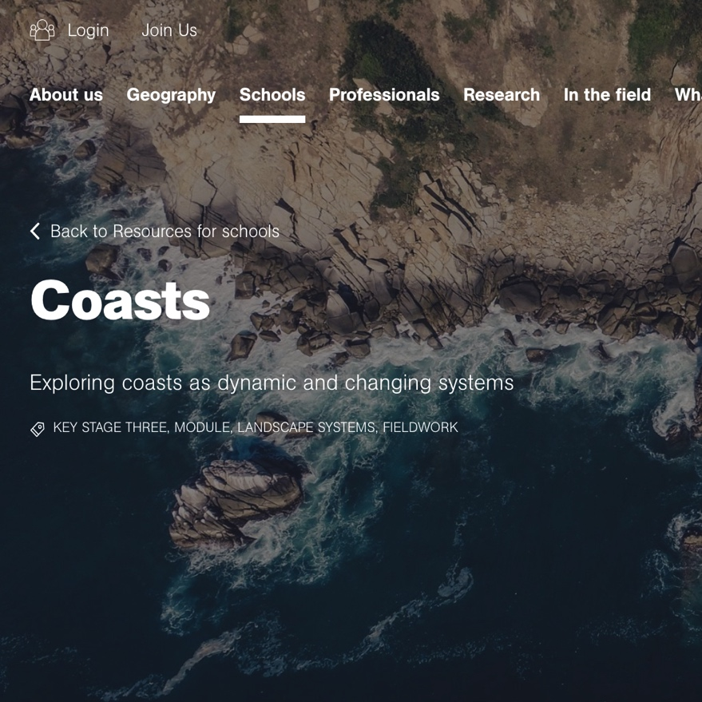
Pre-Fieldwork Activities
Logistical Planning
Other Resources
https://www.rgs.org/schools/teaching-resources/a-student-guide-to-the-a-level-independent-investi/
https://www.rgs.org/schools/teaching-resources/coasts/
https://www.rgs.org/schools/teaching-resources/coastal-processes-and-management/
https://www.rgs.org/schools/teaching-resources/coasts/planning-coastal-fieldwork/
https://www.geography-fieldwork.org/a-level/coasts/coastal-management/method/
Notes:
Image:
- Screen grab from RGS-IBG website (https://www.rgs.org/schools/teaching-resources/coasts/)

Slide 14
Comparative Study of River Regimes Data Collection Technique
Products of an evolving planet
Data Collection Technique
Field Notebook
Critical fieldwork aspect
Record of sites, activities, & data
For professionals, field notebook can be a legal document
Date, time, weather conditions, investigator mood
Name of field site, GPS waypoint name, co-ordinates
Brief site description (e.g., land use, human infrastructure, natural features & processes, vegetation, other relevant observations)
Identification of coastal defence management strategies with reference to the four UK options for shoreline management: (1) No active intervention; (2) Hold the existing defence line; (3) Managed realignment; and (4) Advance the line
Where possible: recent storm history (days, weeks, months previous)
Site sketch
Record of methods & collected data

Slide 15
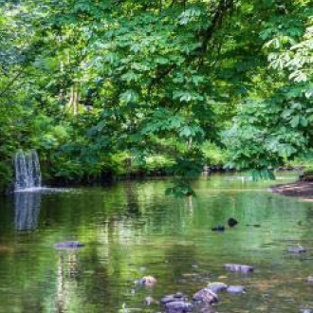
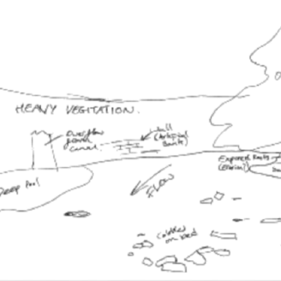
Comparative Study of River Regimes Data Collection Technique
Products of an evolving planet
Data Collection Technique
Field Notebook
Site Sketch Good Practice
Include major features
Sense of scale and spatial distribution of features
Notes:
Images:
- (both) Images courtesy of Environmental Resource Management (ERM)

Slide 16
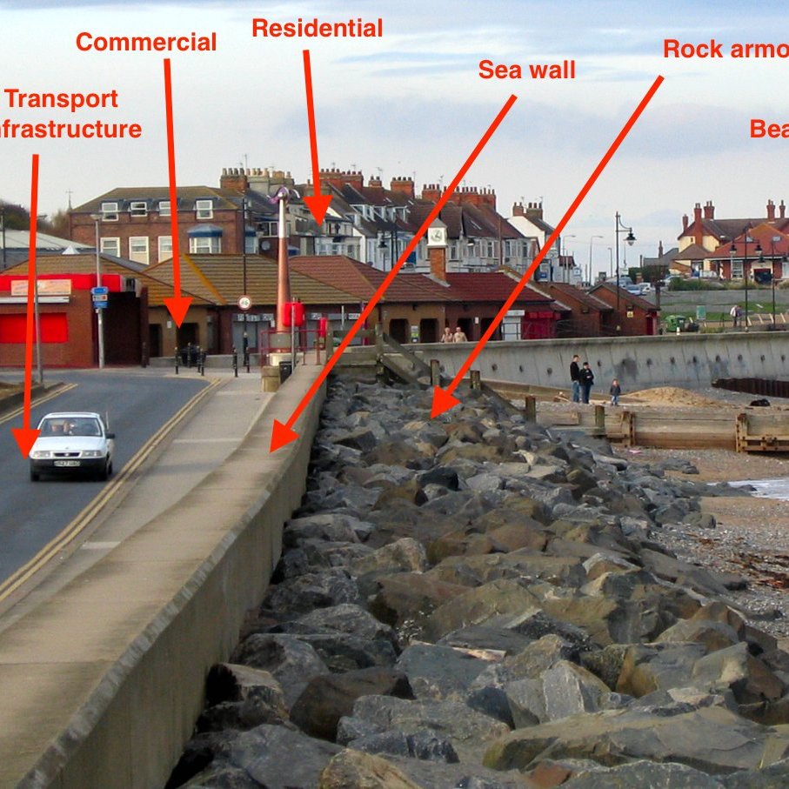
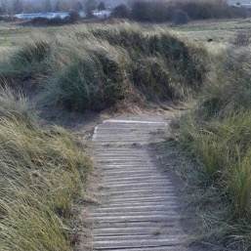
Products of an evolving planet
Data Collection Technique
Inventory of Coastal Features
What is Measured?
Inventory of the main coastal features at the site (e.g., beach, dunes, cliffs, evidence for erosion/deposition, evidence of tides, waves, coastal defences)
Make simple visual observations and sketches
For coastal defences, consider using a point system to assess each feature in terms of different factors (e.g., susceptibility to erosion, aesthetic factors, lifespan, impact on other processes, etc.)
Consider any points of weakness in coastal defences (E.g., gaps) and consider why these exist
Note: some soft engineering coastal defences may not be immediately obvious (e.g., earthen embankments, material inserted into dunes for stabilisation, wooden sand ladders).
Notes:
Images:
(left & right) Coastal defences (Point of Ayr & Prestatyn). Images courtesy of RGS-IBG. Image licence: CC-BY-SA 4.0
(top) Coastal features. Image modified from that of Pete Riches (https://www.flickr.com/photos/peteriches/4181386116/in/photolist-7nuGq5-aCDCLS-sPQgA8-nv6XTn-bxAVCF-mv5Eof-sAGbXD-6gX5wp-7FvUyk-f4iDDY-cFKXrw-6gX4zX-CdWfL-7E1Q8k-c2yW8Q-7FvUVr-cFKVfh-7FzPS5-cFKZuQ-6M3wAr-cFKUqQ-tm7DTA-ddJg7C-8UqTsq-cFKVGu-cFKVpw-cFKUMG-dftkRY-cFL38o-cFL1Yo-7FzPYb-7FvUEn-cFKWXf-9dPnnj-cFKYCm-cFKXeN-9dLqxM-7E5EEq-7FC13t-9q8DYD-oYEwA-6VHaVc-cFL1b3-cFKZFS-cFKZ9u-cFKYTj-cFKXHq-ddJaoQ-6hgGzR-9nqdxw). Image licence: CC-BY 2.0

Slide 17
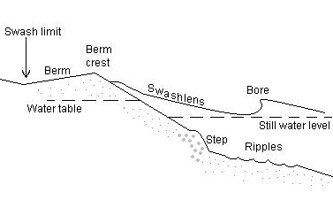
Data Collection Technique
Inventory of Coastal Features
Site Requirements
Any coastal location
Equipment & Costs
Field notebook and pencil (low cost)
Data Resolution Needs
Number of observations will depend on the site and the coastal defence systems in place
Professional Measurement Techniques
Basic field site observations are critical for all fieldwork
Professional coastal studies may also use secondary data to identify key features (e.g., maps, management reports, etc.).
Notes:
Images:
- Beach sketch. Image by Maki Akiyama. Image licence: CC BY 3.0, from Wikimedia Commons

Slide 18

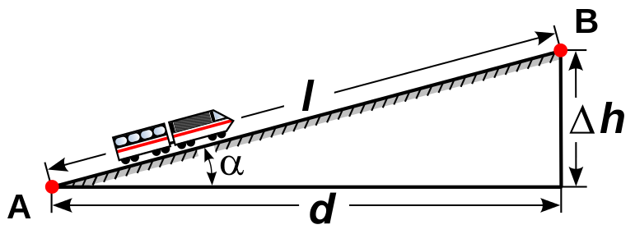
Products of an evolving planet
Data Collection Technique
Beach Profile (Gradient)
What is Measured?
Slope (gradient) of beach perpendicular to shoreline
Profile changes with tidal, season, and after large storm events
Profile can be altered by coastal defences that interrupt the natural transport of material
Difference in height between two sites divided by the distance between those sites
Take multiple measurements across the full width of the beach. Start a new measurement when there is a significant break in the slope
Place measuring poles a known distance apart (one up-profile, one down-profile, with direct line-of-sight perpendicular to the shoreline)
Take angle between matching height horizons using a clinometer
Calculate gradient from equation:
Gradient = Δh /d
Notes:
Images:
(top right) Measuring gradient by the Field Studies Council (https://www.geography-fieldwork.org/a-level/coasts/coastal-management/method/). Image licence: CC_BY
(bottom left) Madcap, from Wikimedia Commons (https://commons.wikimedia.org/wiki/File:Grade_dimension.svg). Image licence: Image in the public domain.

Slide 19
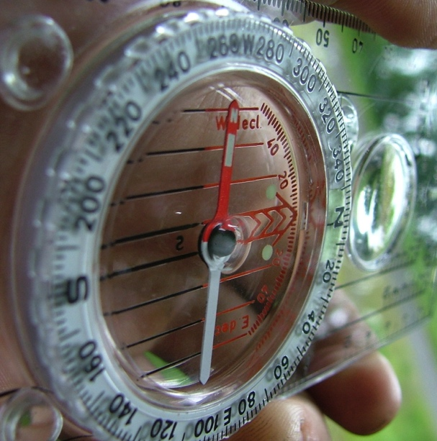
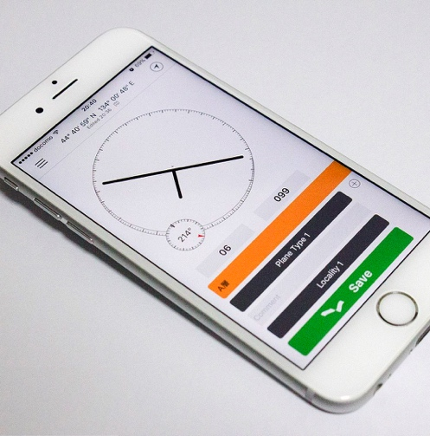
Data Collection Technique
Beach Profile (Gradient)
Site Requirements
Access to full width of the beach at multiple locations along a coastline
Equipment & Costs
Surveying poles (moderate cost) or metre rulers (low cost)
Clinometer: home-made, smartphone app, plastic (all low cost)
Data Resolution Needs
Multiple locations along a stretch of coastline (ideally one hosting different coastal defence structures)
Each profile will contain a number of segments. For each segment, repeat the measurement 3–5 times
Calculate an average (mean or median) value
Calculate data spread (e.g., standard deviation)
Notes:
Images:
(top) Silva Expedition 4 compass-clinometer (https://en.wikipedia.org/wiki/Silva_compass#/media/File:Silva_compass,_Expedition_4.jpg). Image licence: CC-BY-SA 3.0
(bottom) Clinometer on a smartphone. Image by Rufiyaa (https://commons.wikimedia.org/wiki/File:Clinometer_on_smartphone.jpg). Image licence: CC-BY-SA 4.0

Slide 20
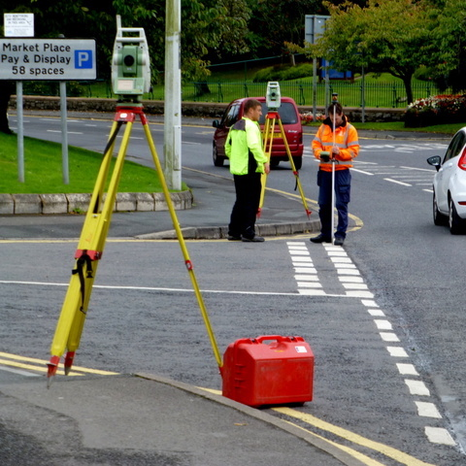
Data Collection Technique
Beach Profile (Gradient)
Professional Measurement Techniques
Surveying poles & clinometers
Theodolites and laser-based equipment
LiDAR data
Digital Elevation Models (DEMs) derived from aerial & satellite images
Notes:
Image:
- Theodolite surveying in Dublin, Ireland. Image by Kenneth Allen (http://www.geograph.ie/photo/4190504). Image licence: CC-BY-SA 2.0

Slide 21
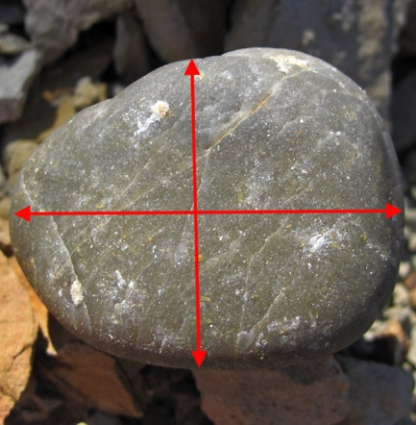
Data Collection Technique
Beach Material Analysis
What is Measured?
Sand and pebbles that make up the beach material
Data on sediments and sediment sorting can be used in conjunction with longshore drift to consider material transport along a coastline
Insights into local and regional coastal dynamics, energy, and source material
Impacted by coastal defence structures that alter the natural transport of material
Collect samples at regular intervals along a beach-wide transect perpendicular to the shoreline
Use callipers or a ruler to measure pebble axes
Qualitatively assess sand grain size by comparison to a geological grain size chart
Quantitatively assess sand grain size using grain sieves
Notes:
Images:
- Image modified from original by James St. John (https://www.flickr.com/photos/jsjgeology/39200485210). Image licence: CC-BY 2.0

Slide 22
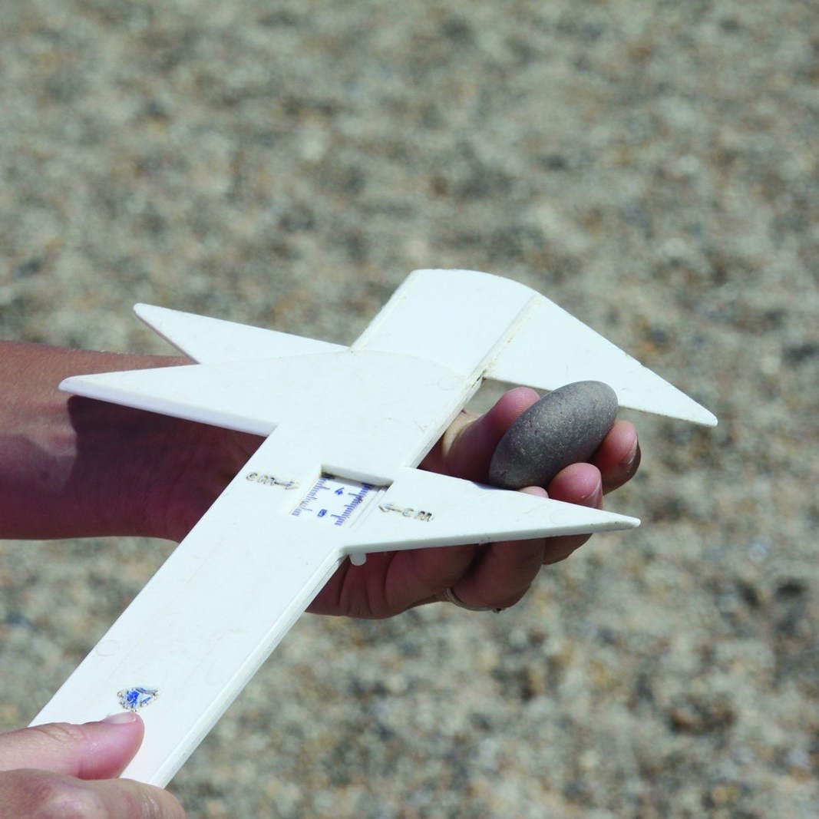
Data Collection Technique
Beach Material Analysis
Site Requirements
Direct access to a beach (ideally, access to full width of the beach at multiple locations along a coastline)
Equipment & Costs
Plastic callipers or a ruler (low-cost)
Digital callipers (moderate to high cost)
Sediment sieves (moderate to high cost)
Geological grain size chart (low cost)
Data Resolution Needs
Take samples from multiple points across transect. Intervals depend on beach width and time available
At each spot along transect, collect a single sediment sample or at least 10 pebbles
For pebbles, calculate average (mean or median) size
For pebbles, calculate data spread (e.g., standard deviation)
Notes:
Images:
- Using callipers to measure the a, b and c axes of a pebble by the Field Studies Council (https://www.geography-fieldwork.org/a-level/coasts/coastal-management/method/). Image licence: CC_BY

Slide 23
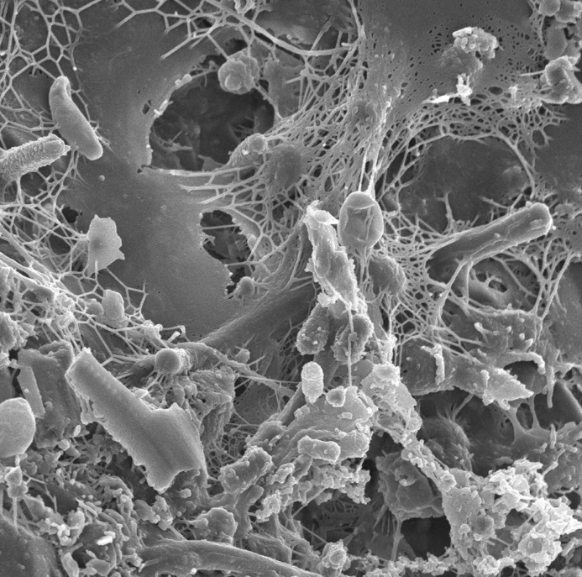
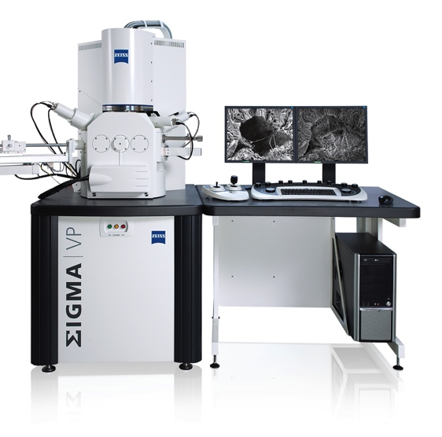
Data Collection Technique
Beach Material Analysis
Professional Measurement Techniques
Manual grain-size analysis (e.g., high-precision calliper measurements)
Laboratory-based testing of collected sand and pebble samples
Laboratory testing methods include:
Scanning electron microscopy (SEM; see images) for compositional and morphological analysis of beach material
Laser granulometry for grain size analysis
Notes:
Image:
(top) Sand grains under SEM. Image courtesy of the Lewis Lab at Northeastern University (https://www.flickr.com/photos/adonofrio/albums/72157623620596451). Image created by Anthony D'Onofrio, William H. Fowle, Eric J. Stewart and Kim Lewis. Image licence: CC-BY 2.0
(bottom) Image by ZEISS Microscopy (https://www.flickr.com/photos/zeissmicro/10710025785). Image licence: CC-BY-SA 2.0

Slide 24
Data Collection Technique
Longshore Drift
What is Measured?
The movement of material along a coastline
Impacted by coastline morphology, coastal defences, seasons, and weather conditions
Select a distance along which to measure (e.g., 10 m)
Place a floating object in the water at the start point
Use a stopwatch to time how long it takes the object to travel the designated distance
Alternatively, set a time (e.g., 2 minutes) and measure distance travelled within that time
Site Requirements
Direct access to a beach (ideally, at multiple locations along a coastline hosting different coastal defence structures)

Slide 25
Data Collection Technique
Longshore Drift
Equipment & Costs
Tape measure (low cost)
Stopwatch (low cost)
Floating object that is easy to see (e.g., a bright colour) and biodegradable (e.g., an orange) in case of loss (low cost)
Data Resolution Needs
Ideally, data should be collected for multiple contrasting beach sites along a stretch of coastline,
At each location, measure longshore drift at least 3–5 times
Calculate an average (mean or median) value
Calculate data spread (e.g., standard deviation)
Professional Measurement Techniques
The simple technique outlined above
More accurate, high-tech approaches include current meters, streamer traps, and Fourier transform analysis of pixels in video imagery

Slide 26
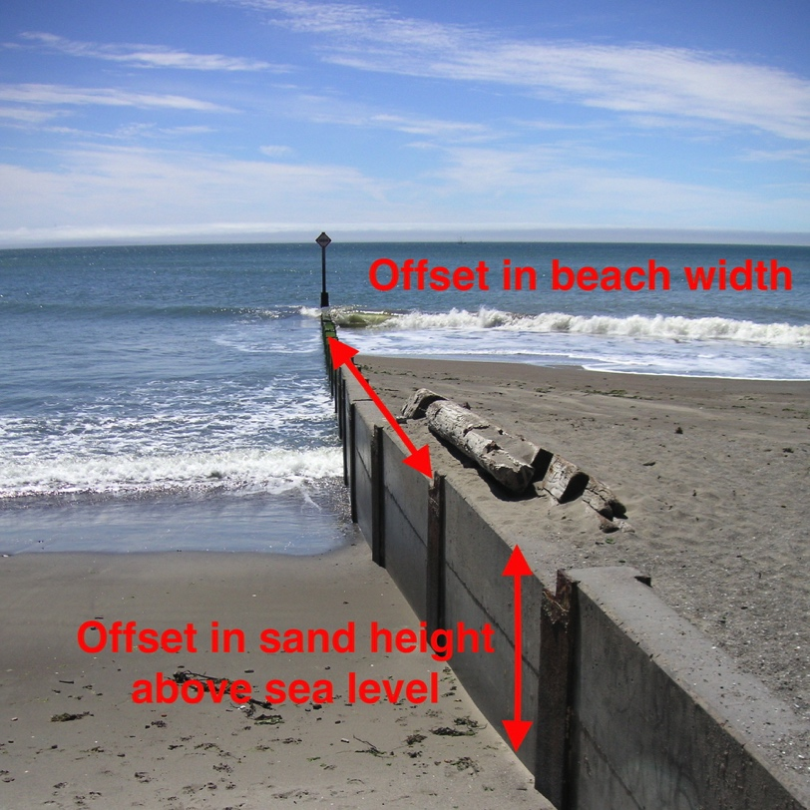
Comparative Study of River Regimes Data Collection Technique
Products of an evolving planet
Data Collection Technique
Sediment Traps
What is Measured?
Natural sediment movement that is interrupted by human structures; for example, sand accumulation against one side of groynes or other coastal defence features
Human engineering can significantly alter sediment budgets along a coastline
Measure the difference in sediment levels on either side of a man-made feature
For example, for groynes, measure (1) the distance between the top of the groyne and the top of sand on either side, and (2) the offset in beach width on either side.
Notes:
Images:
- Sediment pile-up and beach extension on one side of a wooden groyne. Image modified from that of Beatrice Murch (https://www.flickr.com/photos/blmurch/952523971). Image licence: CC-BY-SA 2.0

Slide 27
Data Collection Technique
Sediment Traps
Site Requirements
Direct access to a beach with groynes or other human features running perpendicular to the coastline
Equipment & Costs
Metre ruler or tape measure (low cost)
Data Resolution Needs
Take multiple measurements at regular intervals (e.g., every 1 m) on both sides of the groyne (or other feature) and along its full length (e.g., from the low tide mark to the top of the beach)
Data can be presented as an average (mean or median) with an indicator of data spread (e.g., standard deviation), or as individual data points distributed along a linear feature.
Professional Measurement Techniques
Aerial and satellite imagery

Slide 28

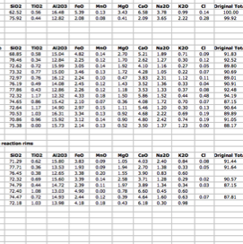
Post-Fieldwork Activities
Data Organisation & Input
For professionals, fieldwork is only the start
Post-fieldwork activities are the longest part of any project
The first step is data organisation and management
Transfer field data to computer or tablet
Consider storage options (e.g., Microsoft Excel, ArcGIS, Google Earth)
For groups, develop data management plan & sharing facilities (e.g., Google Drive, Dropbox)
Notes:
Images:
(left) Microsoft excel screen grab
(right) Screen grab of Dropbox homepage (https://www.dropbox.com/?landing=dbv2)

Slide 29
Post-Fieldwork Activities
Data Analysis & Interpretation
Appropriate use of:
Statistical techniques (e.g., data averaging, data spread, etc.)
Chart types and tables
Spatial analysis (e.g., ArcGIS, which is freely available to UK schools)
Interpretation and analysis should:
Reflect and be supported by the data
Compare and contrast different sites
Consider the results of similar studies & compare data with available secondary data sources
Return to original scientific questions and hypotheses
Consider how results would change under different conditions (e.g., changing seasons, after a storm event)
Consider how results may change in the future (e.g., impacts of climate change)
Data limitations should be considered and clearly presented

Slide 30
Post-Fieldwork Activities
Data Analysis: Calculations
Pebble Roundness
Use long and short axes measurements to perform particle shape analysis via pebble roundness indices (e.g., Cailleux Index)
Cailleux roundness (R) = 2r x 1000 / L
L = average length of pebbles
r = average radius of curvature (obtained from a chart)

Slide 31
Post-Fieldwork Activities
Data Analysis & Interpretation
Using data collected in the field and additional metadata:
Consider the positive and negative aspects of coastal defence strategies observed (e.g., effectiveness, cost, environmental impact, aesthetics, longevity, etc.)
For each defence system, consider why it was chosen and identify its primary function
For each defence system, consider the consequences if it were not there, and identify any other features (natural or man-made) that are needed to ensure the structure behaves as planned
Consider the implications of a breach event (e.g., flood water coming over the defence system).
Consider the future of coastal defence strategies, with particular reference to the pressures of changing climate

Slide 32



Comparative Study of River Regimes Post-Fieldwork Activities
Products of an evolving planet
Post-Fieldwork Activities
Data Reporting & Sharing
Data sharing and open access is required for some professionals
For others, data sharing is restricted to paid clients
Data sharing & reporting must consider the needs of the audience
Can include written reports, oral presentations, graphical representations
Present at ‘conferences’, where different teams present concurrently using posters or talks
To reach a broader audience:
Webpage creation
Social media & blogging
Citizen science platforms
Notes:
Images:
- Pexels.com (stock photography with a CC0 licence)

Slide 33
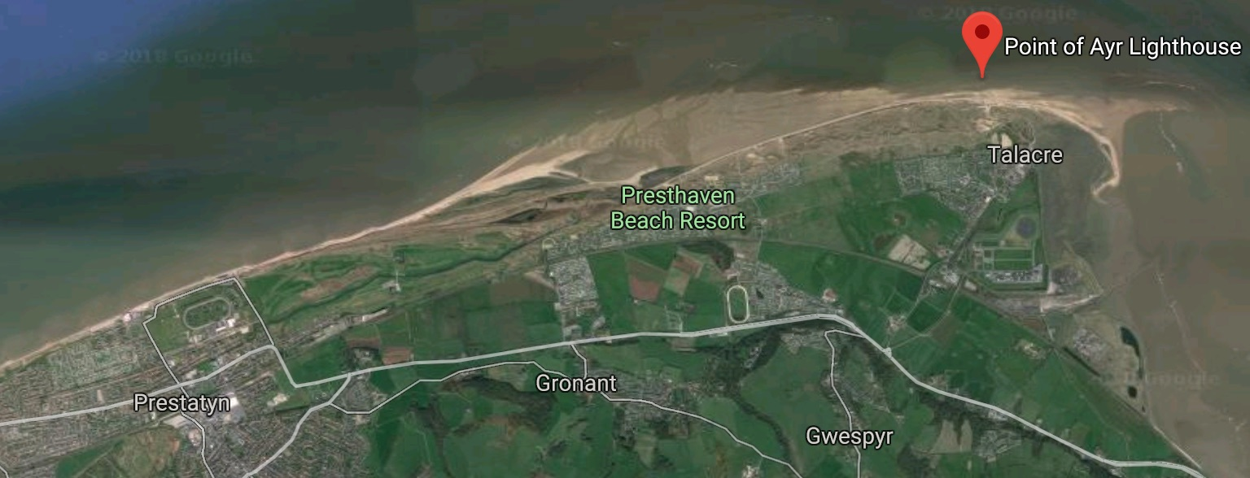
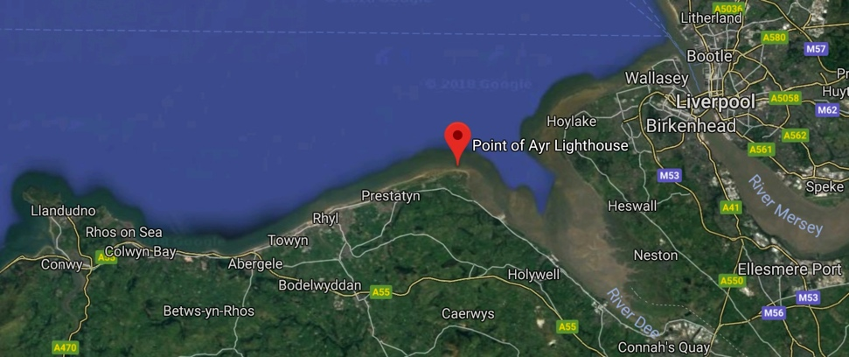
Case Study
Point of Ayr, North Wales
North-easterly most point of Wales
High-energy sandy coastline meets the low energy Dee Estuary
Notes:
Image:
(all) Google Maps screen grabs (Northeast Wales & Point of Ayr)

Slide 34
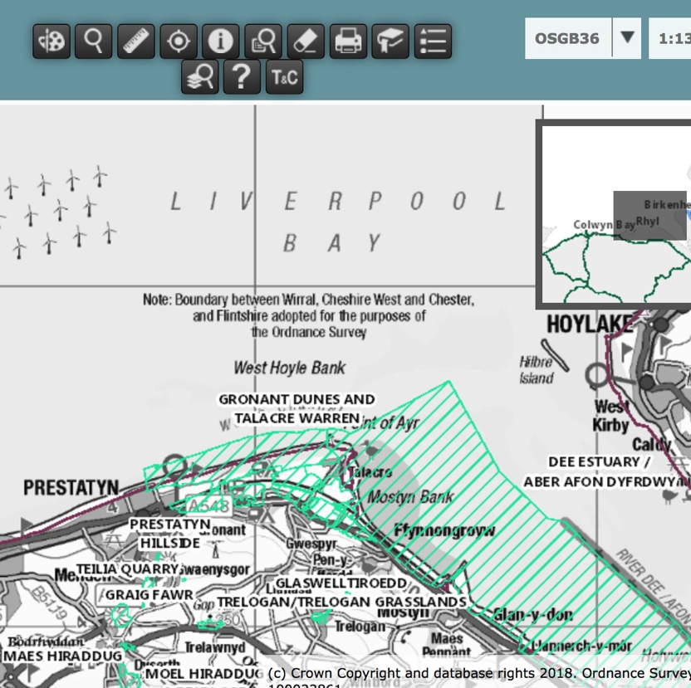
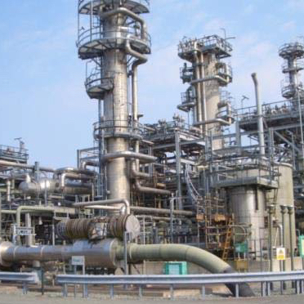
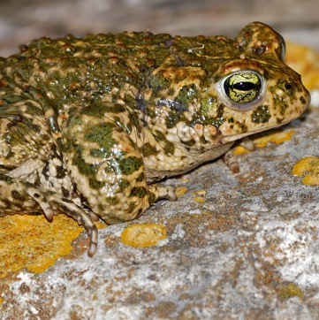
Case Study
Point of Ayr, North Wales
Multiple competing interests
Environment
(Wildlife, dunes & SSSIs)
Industry
(ENI Point of Ayr Gas Terminal)
Notes:
Images:
(top left) Dune management. Image courtesy of RGS-IBG. Image licence: CC-BY-SA 4.0
(bottom left) Natterjack toad. Image by Bernard Dupont (https://www.flickr.com/photos/berniedup/40768303714). Image licence: CC-BY-SA 2.0
(Centre) Screen grab of UK Magic Map showing SSSIs around Point of Ayr (www.natureonthemap.naturalengland.org.uk/magicmap.aspx)
(right) Point of Ayr Gas Terminal. Image courtesy of Environmental Resource Management (ERM)

Slide 35
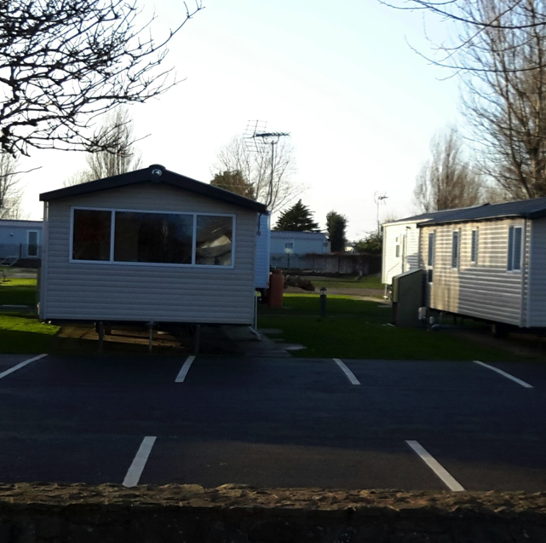
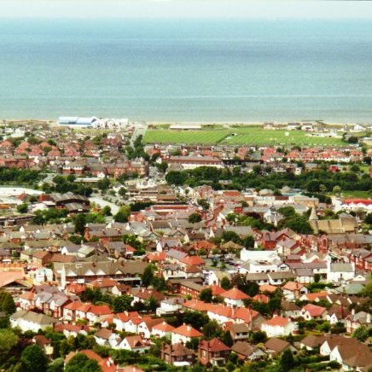
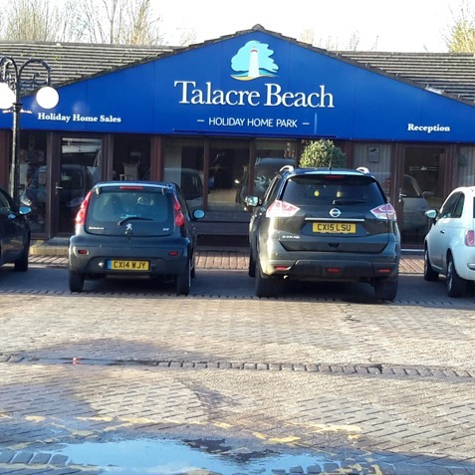
Case Study
Point of Ayr, North Wales
Multiple competing interests
Local residents
(Talacre village/ Prestatyn town)
Tourists
(Talacre holiday park)
Notes:
Images:
(left) Prestatyn, Image by Graham Horn (http://www.geograph.org.uk/photo/724208). Image licence: CC-BY 2.0
(centre & right) Talacre holiday park. Images courtesy of RGS-IBG. Image licence: CC-BY-SA 4.0

Slide 36
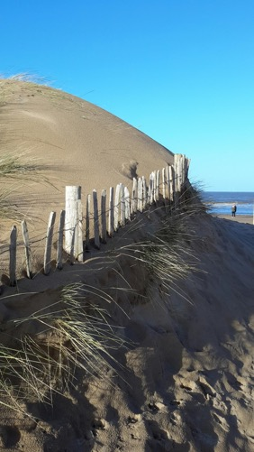
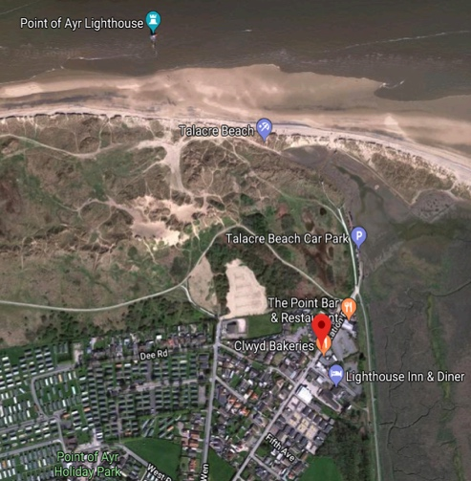
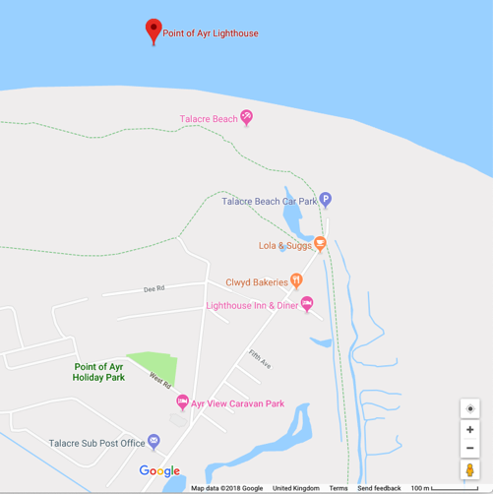
Case Study
Point of Ayr, North Wales
Gronant and Talacre Dunes & Beach (53°21'18.5"N 3°19'02.7"W)
Coastal dune and salt marsh with important coastal protection function
Almost only natural coastline between Dee Estuary and Great Orme
Above gas pipeline from offshore fields to Point of Ayr Gas Terminal
Historical (foundations of chalets to house WW2 evacuees still visible)
SSSI designated for dune system habitats
Popular holiday and leisure location
Notes:
Images:
(left) Gronant & Talacre Dunes. Image courtesy of RGS-IBG. Image licence: CC-BY-SA 4.0
(centre and right) Google Maps screen grabs (Gronant and Talacre Dunes at 53°21'18.5"N 3°19'02.7"W)

Slide 37
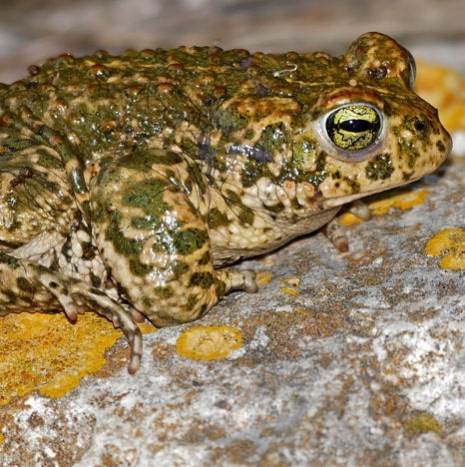
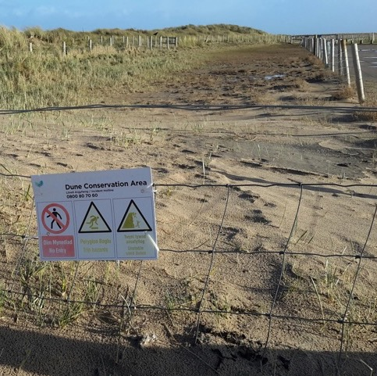
Case Study
Point of Ayr, North Wales
Gronant and Talacre Dunes & Beach (53°21'18.5"N 3°19'02.7"W)
Under active management to:
Species re-introduction
(e.g., natterjack toad)
Encourage sand accretion
Control visitor pressure
Pathways to focus human traffic
Gradual reduction of dune-based car park
Novel dune stabilisation methods (e.g., old Christmas trees)
Notes:
Images:
(right-side cluster) Active management (pathways, flooded car park, car park blocked off for regeneration). Images courtesy of RGS-IBG. Image licence: CC-BY-SA 4.0
(centre) Natterjack toad. Image by Bernard Dupont (https://www.flickr.com/photos/berniedup/40768303714). Image licence: CC-BY-SA 2.0
(left) Dune stabilisation for sand accretion. Images courtesy of RGS-IBG. Image licence: CC-BY-SA 4.0

Slide 38
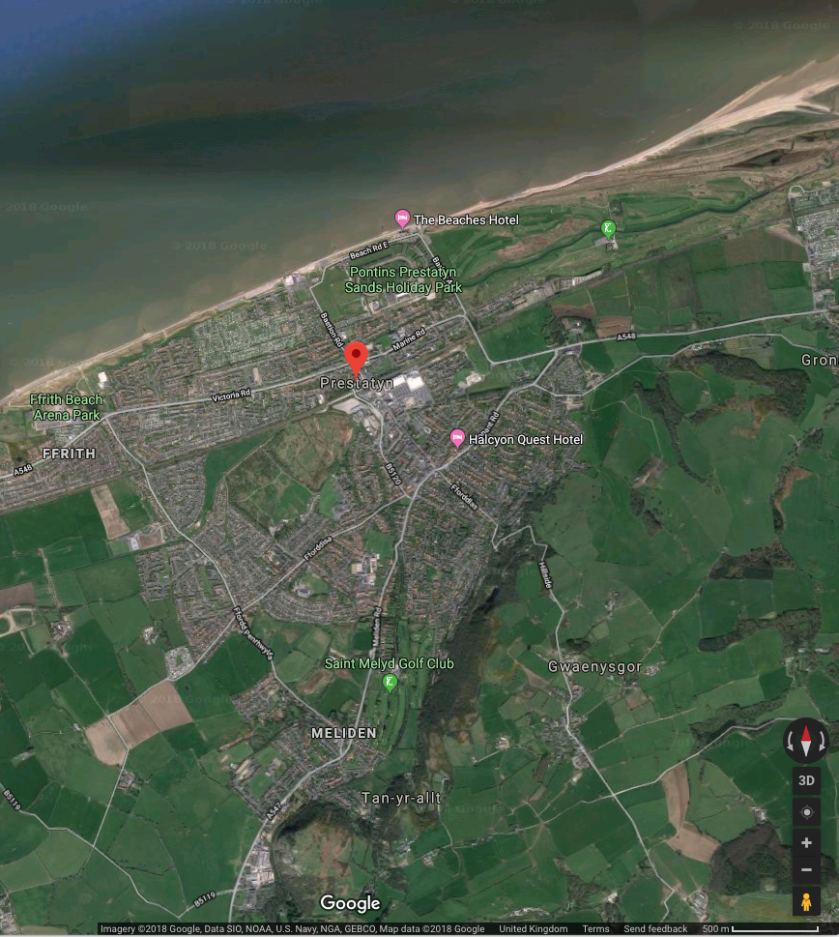
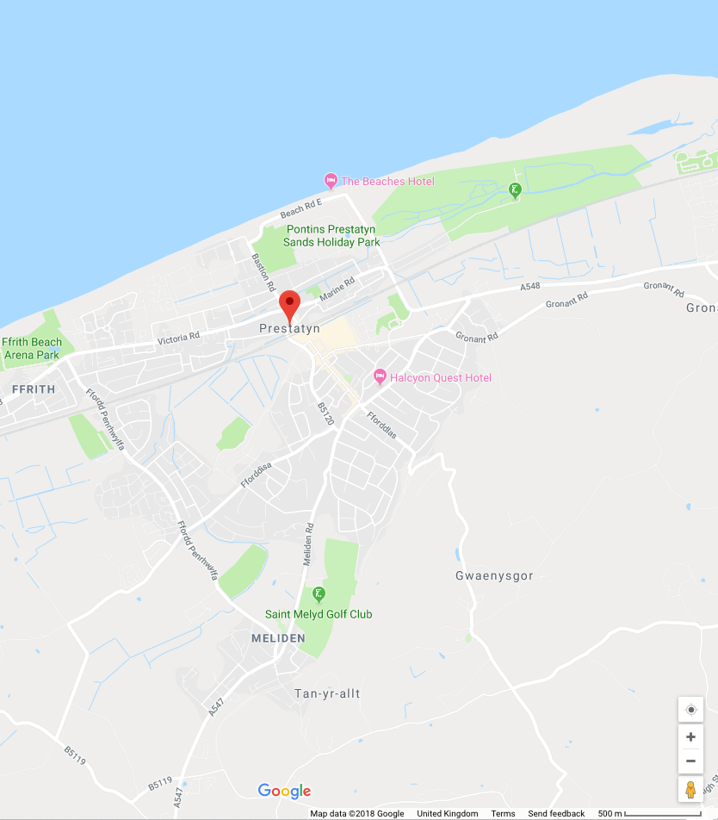
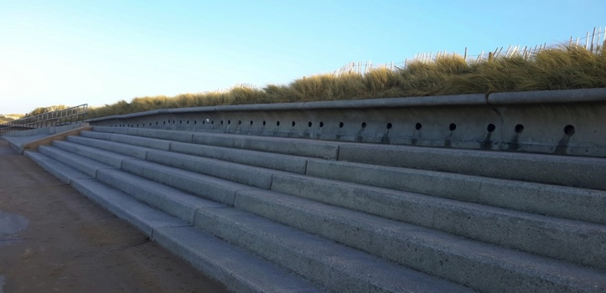

Case Study
Point of Ayr, North Wales
Prestatyn Sea Defences (53°20'30.3"N 3°24'54.5"W)
Denbighshire coastal town between Talacre and Rhyl
Significant commercial, residential, and tourism infrastructure
Heavily engineered coastline (e.g., groynes, sea walls, rock armour, flood gates, introduction of new beach material)
History of pluvial flooding from heavy rain / surface runoff
With changing climate, risk of flooding is increasing
Notes:
Images:
(left & second to left) Google Maps screen grabs (Prestatyn Sea Defences at 53°20'30.3"N 3°24'54.5"W)
(top right) Sea wall at Prestatyn. Image courtesy of RGS-IBG. Image licence: CC-BY-SA 4.0
(bottom right) Rock armour at Prestatyn. Image courtesy of RGS-IBG. Image licence: CC-BY-SA 4.0

Slide 39





Case Study
Point of Ayr, North Wales
Gas Colliery Quay Wall and Revetment (53°20'40.0"N 3°18'37.6"W)
South (quay wall) and east (revetment) of former colliery site
Quay wall: ~220 m long / Revetment: 10-m wide rock armour
Hard coastal engineering protects industrial & residential areas
Surrounded by protected habitats (SSSIs) and used for leisure
Actively managed by Point of Ayr Gas Terminal
Notes:
Images:
(left & second to left) Google Maps screen grabs (Gas Colliery Quay Wall and Revetment at 53°20'40.0"N 3°18'37.6"W)
(second to right) Pathway used for leisure by tourists and local residents. Image courtesy of RGS-IBG. Image licence: CC-BY-SA 4.0
(top right) Property protected by raised coastal defence. Image courtesy of RGS-IBG. Image licence: CC-BY-SA 4.0
(bottom right) Pumping station to manage flood water. Image courtesy of RGS-IBG. Image licence: CC-BY-SA 4.0

Slide 40



Case Study
Point of Ayr, North Wales
Talacre Coastal Embankment (53°21'13.2"N 3°18'59.3”W)
Runs ~800 m along northeast frontage of Talacre (north end of station road to raised ground east of Point of Ayr Gas Terminal)
Earthen embankment rising ~6.5 m AOD
Runs behind dunes providing secondary coastal defence
Notes:
Images:
(all) Google Maps screen grabs (Talacre Coastal Embankment at 53°21'13.2"N 3°18'59.3”W)

