Slide 1
Glaciation and past climate of the Drakensberg Mountains, southern Africa
Lesson 1 Main
Slides on the present-day climate and environment of the Drakensberg

Slide 2
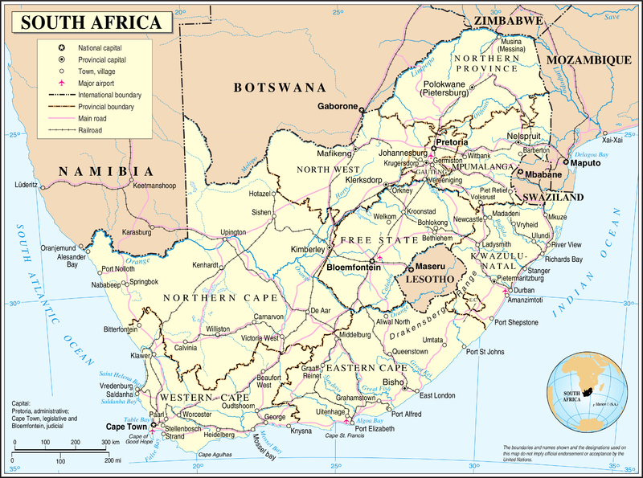
Wikimedia Commons
The Drakensberg are located on the east side of southern Africa
They form the headwaters of the Vaal River and Orange River
Highest area along the border region between eastern Lesotho and South Africa

Slide 3
The Drakensberg (the ‘Dragon Mountains’ from Afrikaans)
Highest mountains in southern Africa
Several peaks over 3,000 metres above sea-level
Consists of basalt rock overlying sandstones
From 2,500m upwards, treeless landscape of ‘alti-montane grasslands’, mainly tussock grass and shrubs
From 1,800 up to 2,500m, landscape of ‘montane grassland and woodland’ with coniferous trees
Giant’s Castle region, Drakensberg, KwaZulu-Natal, South Africa
Wikimedia Commons (KlausF)

Slide 4
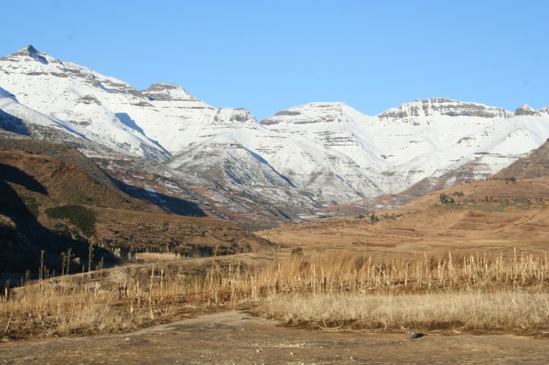
High Drakensberg
Cool climate at high altitudes: Some precipitation falls as snow in winter, but summers are too warm for glaciers to form today.
Photo from Ukhahlamba/Drakensberg Park
Wikimedia Commons

Slide 5
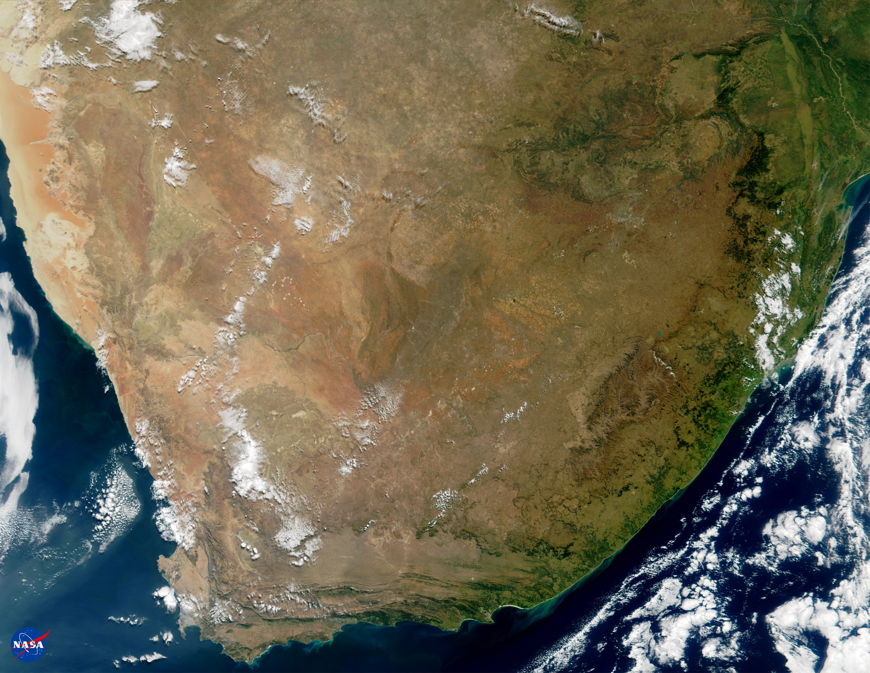
The High Drakensberg form the eastern boundary between Lesotho and KwaZulu-Natal province of South Africa
Thabana Ntlenyana
highest point of
Drakensberg
KwaZulu-
Natal
Lesotho
Eastern Cape
Earthobservatory.nasa.gov

Slide 6
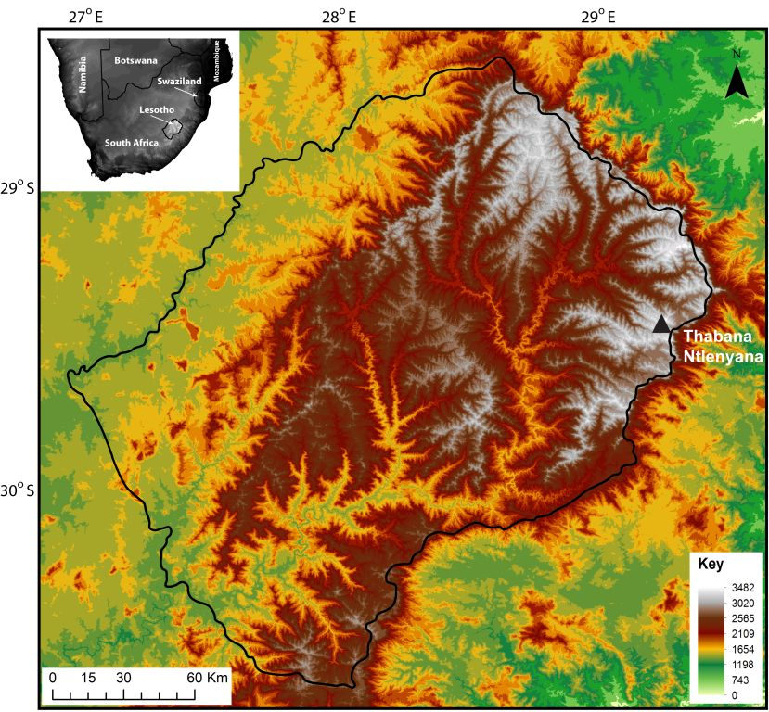
Border
between
Lesotho and
S.A.
Elevation map of High Drakensberg (S.Mills)
High areas between 28⁰ and 30⁰S, 28⁰ and 30⁰E

Slide 7
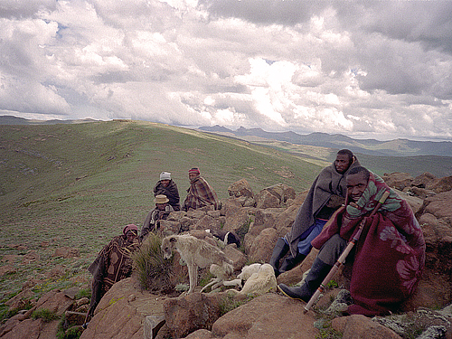
Source: http://www.peakware.com/peaks.html?pk=2391
Uploader: Russell Shaw, Photographer: Lars Lindblom
Thabana Ntlenyana, Lesotho
Highest point in southern Africa
at 3,482 metres
http://www.youtube.com/watch?v=4aIG9Z1_XJ4&feature=related

Slide 8
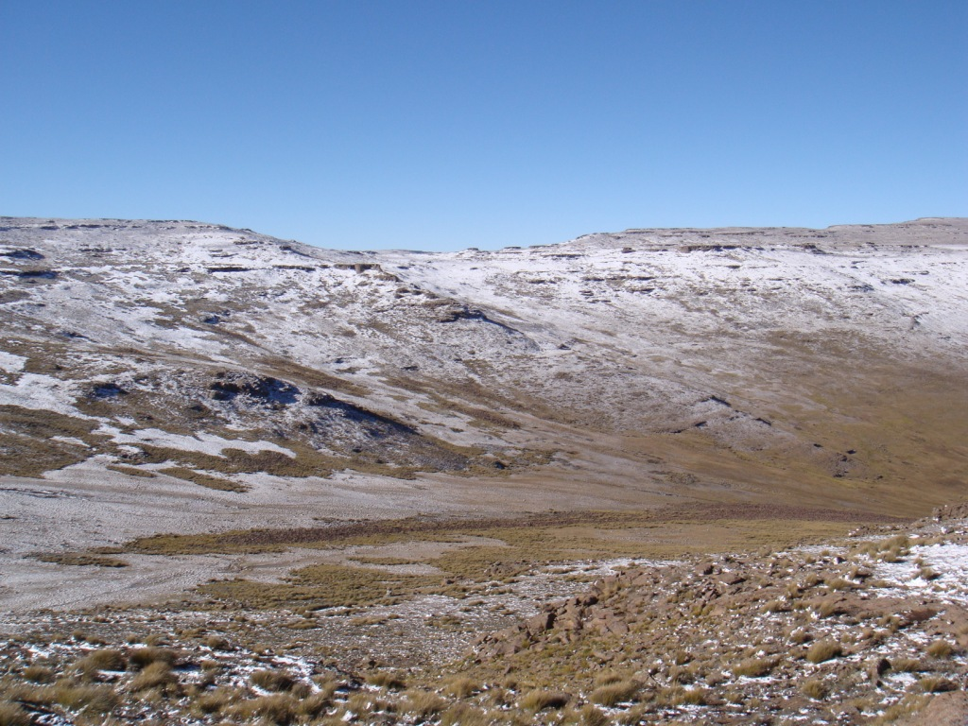
Drakensberg – high elevation
S.Mills

Slide 9
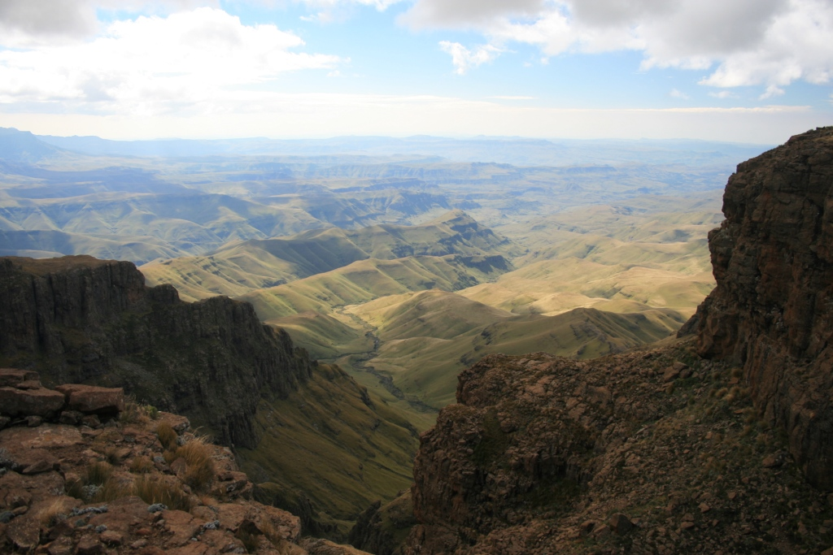
S.Mills

Slide 10
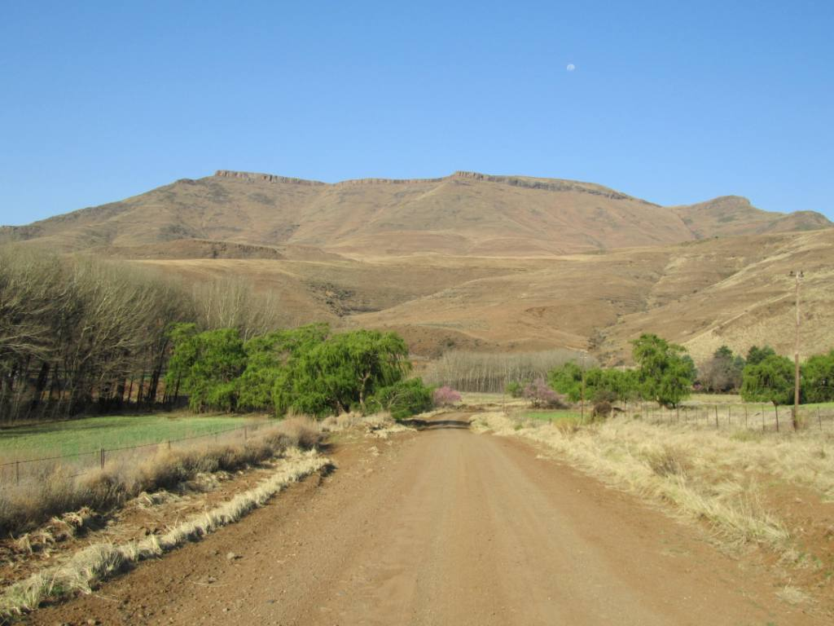
Drakensberg – lower elevation
S.Mills

Slide 11
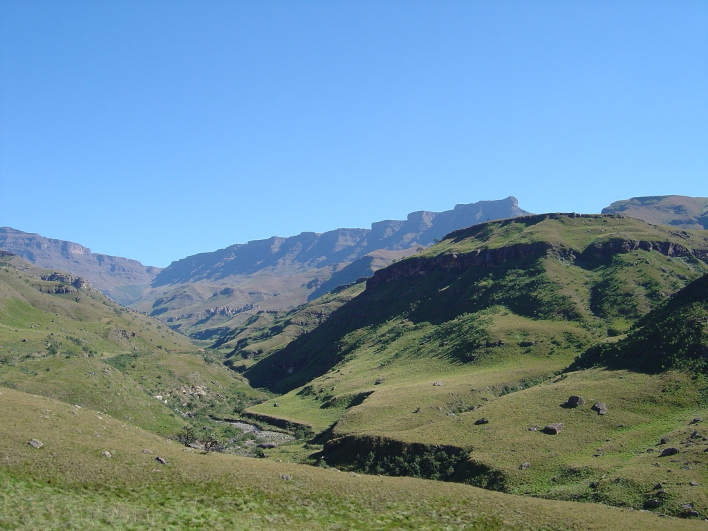
‘12 Apostles’, S. Mills
Basalt forms a ‘cap rock’ over other rock formations creating the distinctive high plateaux and cliffs of the Drakensberg.

Slide 12
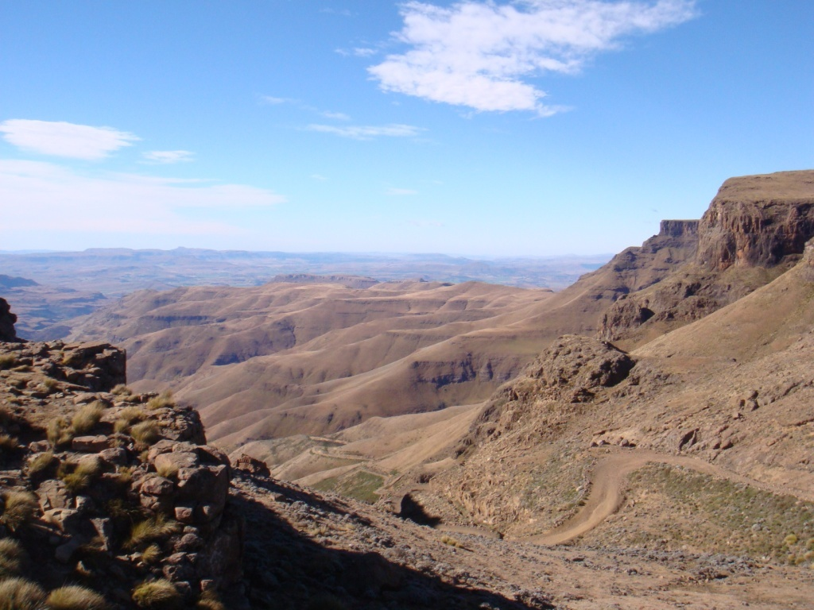
Layers of basalt
from ancient
lava flows
S.Mills

Slide 13
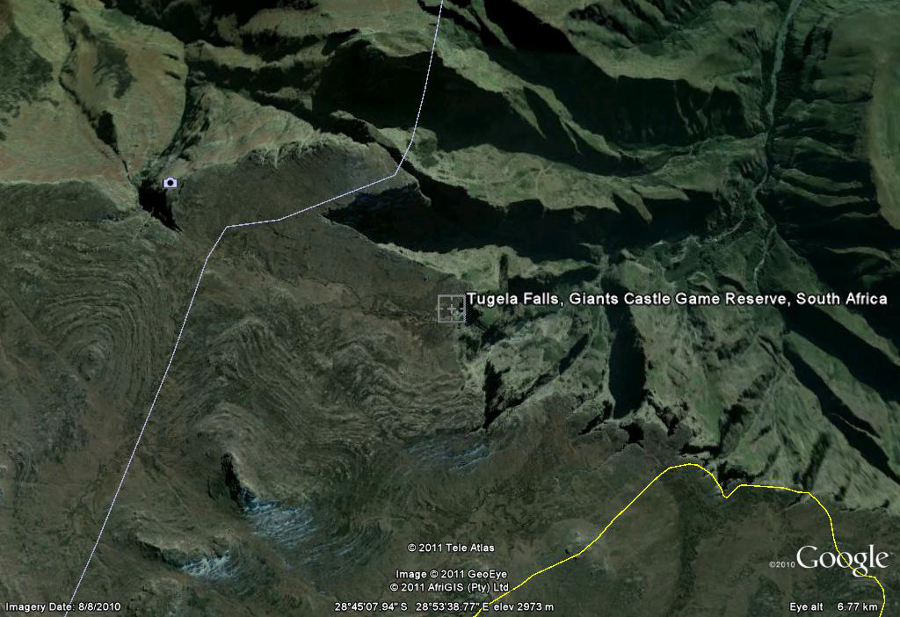
KwaZulu-Natal
Lesotho
Google Earth screenshot
Notice the high plateau broken with steep cliffs and deep valleys in top right of image.

Slide 14
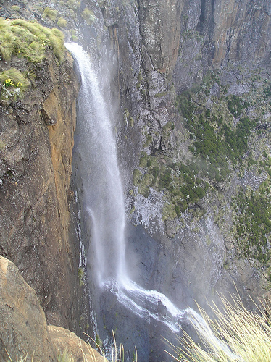
http://www.flickr.com/photos/champagneformonkeys/401709803/
Tugela Falls, 2nd highest waterfall in the world with a 948m drop.

Slide 15
Geological history
During the Paleozoic Era (542 to 251 million years ago), sedimentary rocks were formed across southern Africa (shale, mudstone, sandstone)
Southern Africa was part of a much larger southern ‘super-continent’ called ‘Gondwana’
About 200 million years ago as tectonic forces split Gondwana apart, huge amounts of lava were extruded through volcanic fissures, forming layers of basalt rock up to 1,400m thick
This hard rock forms the high plateaux and cliffs of the Drakensberg
Click here for animations of the break up of Gondwana
http://homepages.see.leeds.ac.uk/~eargah/Gond.html
http://www.pbs.org/wgbh/nova/eden/media/stt.html

Slide 16
Climate
“The Drakensberg Mountains offer a lovely respite to the summer sun (December to February), and temperatures will rarely reach above 86 Fahrenheit (30 C). Rainfall can be significant during the summer months, but for the most part the thunder storms are interspersed with perfect weather. Winters (June to August) are dry and temperatures usually reach around 68 Fahrenheit (20 C) at midday. Nights are often freezing at higher elevations and snow is common. The best time to visit the Drakensberg Mountains is April and May.”
(extract from: http://goafrica.about.com/library/bl.weather.southafrica.htm#anchor4)
(This link above also has weather data for other parts of South Africa.)

Slide 17
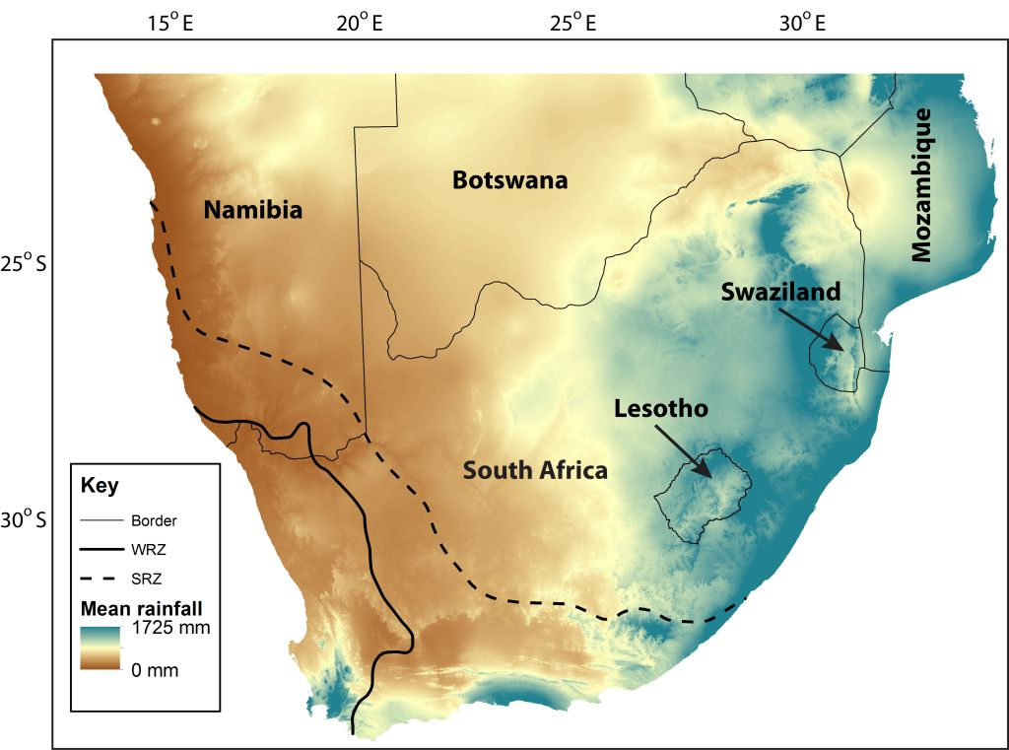
S.Mills
(Adapted from Hijmans et al. 2009
and Chase and Meadows 2007)
Today winter rainfall dominates southwest of the solid line, and summer rainfall dominates northeast of the dashed line. In between the two lines rainfall is distributed fairly evenly throughout the year. Also notice the higher precipitation levels in eastern
South Africa, Lesotho, and Swaziland.

Slide 18
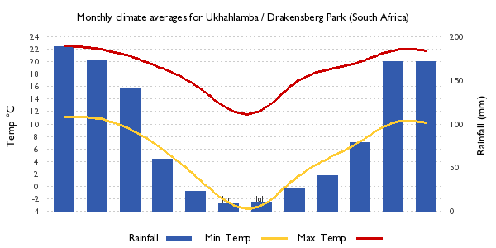
Climate graph for Ukhahlamba/Drakensberg Park (29⁰22’ S, 29⁰32’ E)
Source: European Commission Joint Research Centre, Global Environment Monitoring Unit
http://bioval.jrc.ec.europa.eu/APAAT/pa/900006/
This graph shows the typical climate for this UNESCO World Heritage Site area of the Drakensberg which covers the border region between Lesotho and KwaZulu-Natal.

Slide 19
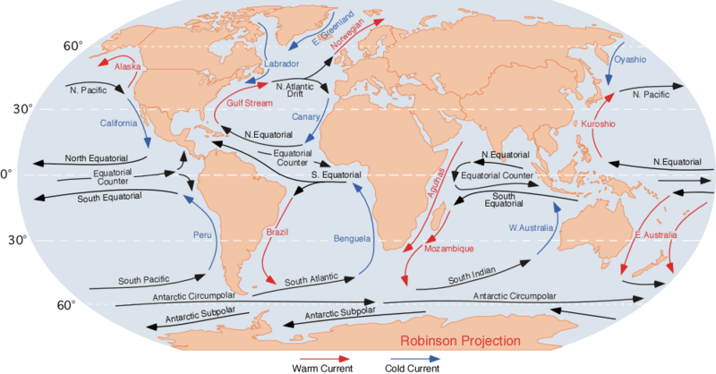
World ocean currents summary
Wikimedia Commons (M.Pidwirny)

Slide 20
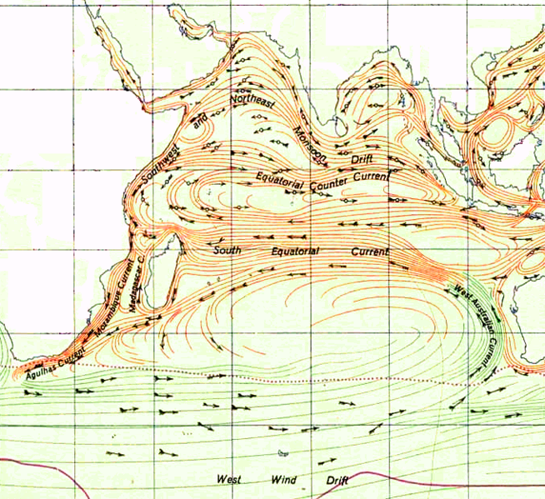
Agulhas
Current
Wikimedia Commons
(Indian Ocean Gyre)
The Agulhas current carries warm water southwards along the southeast African coast.
It also causes some warm, saline water to move from the Indian Ocean into the South Atlantic Ocean.

Slide 21
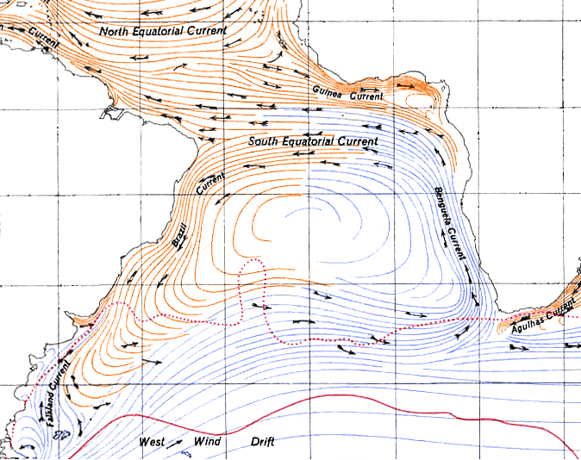
The Agulhas Current is important for transferring surface water from the Indian Ocean to the South Atlantic.
This has an effect on the North Atlantic currents too, through influencing exchange of water across the Equator.
Wikimedia Commons (South Atlantic Gyre)
Some exchange of water
happens here.

Slide 22
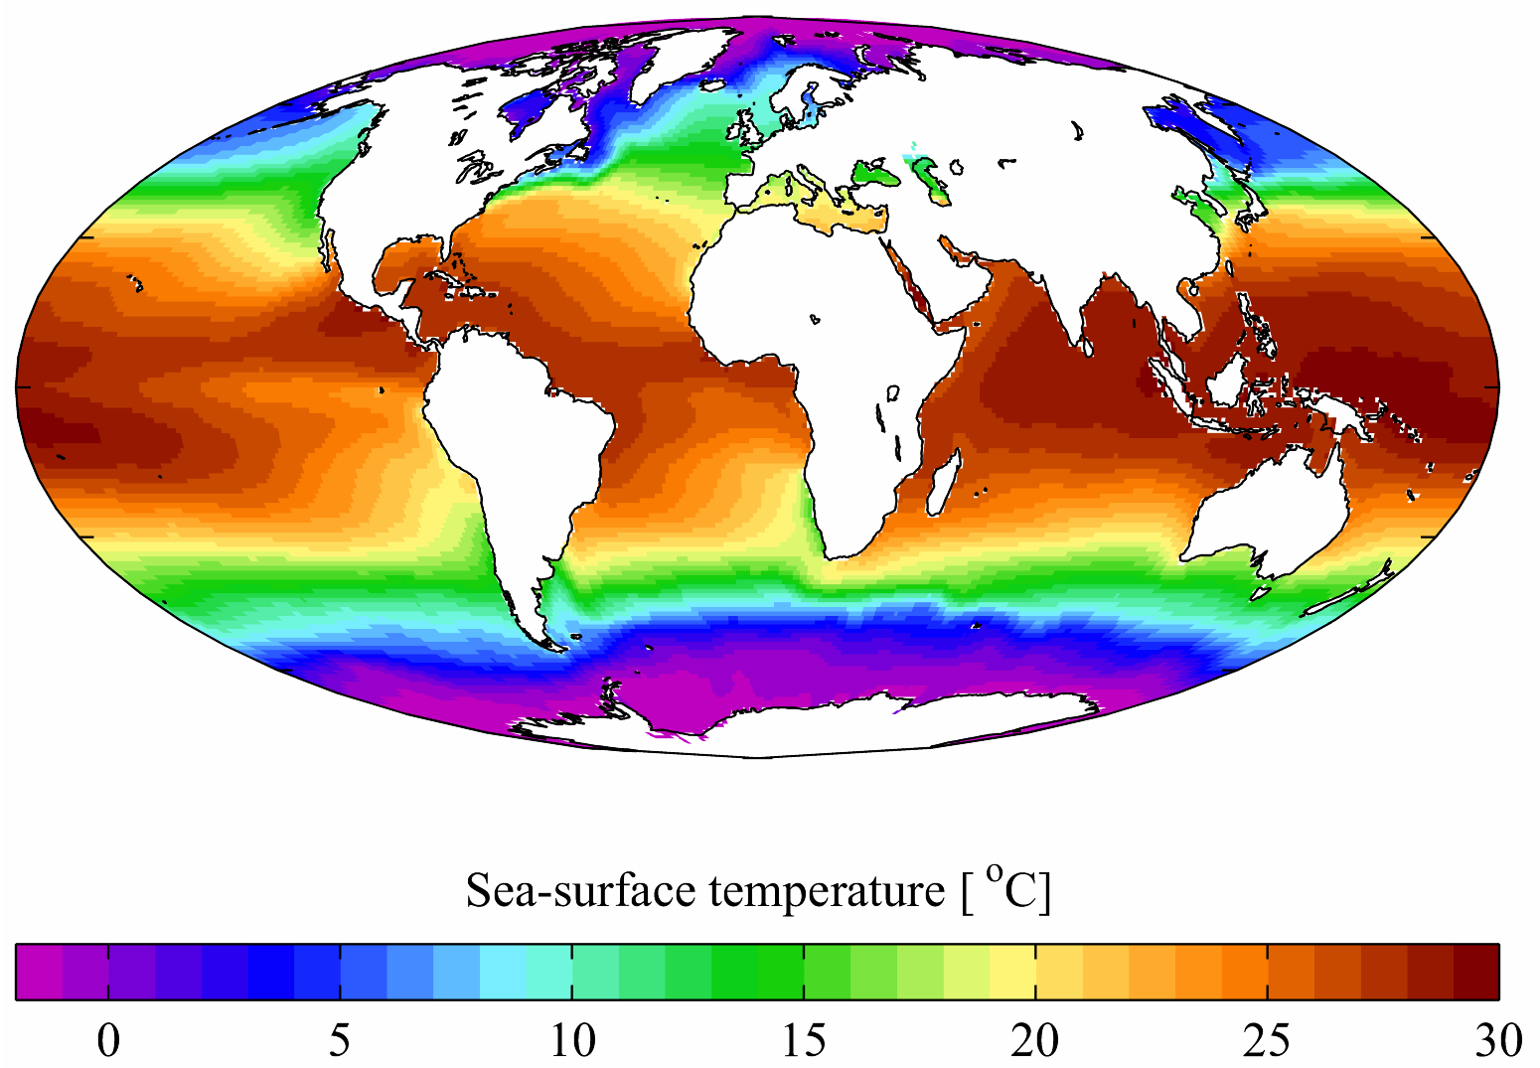
Seas off the southeast African coast average 20 to 24 ⁰C
Wikimedia Commons (data from the World Ocean Atlas, 2001)

Slide 23
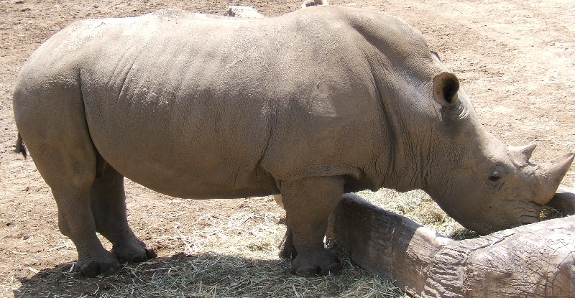
Wikimedia Commons
The Southern White Rhinoceros is found along the lower slopes of the Drakensberg.
Other mammals include the black wildebeest, eland, zebra, leopard, jackal, baboon.

Slide 24
Flora and fauna
Over 2,000 species of plants can be found in the High Drakensberg, along with almost 50 species of mammal and 299 species of bird.
Many of the species (nearly 100 plants) are ‘endemic’ to the Drakensberg.
‘Endemic’ means unique to the area and not found elsewhere.
http://www.drakensberg.net/fauna-flora.html

Slide 25
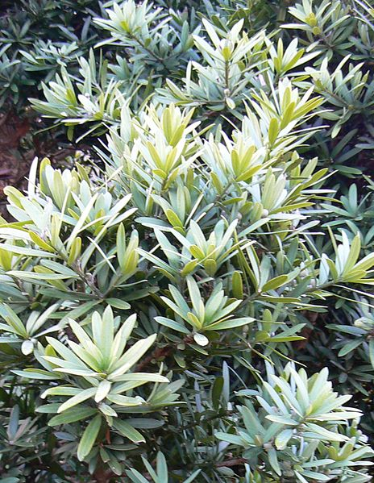
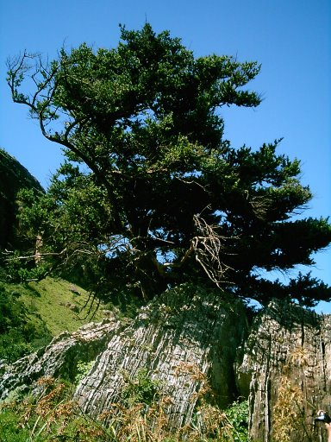
Podocarpus – the coniferous tree found in the lower slopes of the Drakensberg
Podocarpus latifolius (Real Yellowwood tree)
Wikimedia Commons (Shawka)
Podocarpus is a genus of tree found
mostly in the Southern Hemisphere.
It includes over 100 different species.
Podocarpus latifolius in KwaZulu-Natal Drakensberg
(Wikipedia)

Slide 26
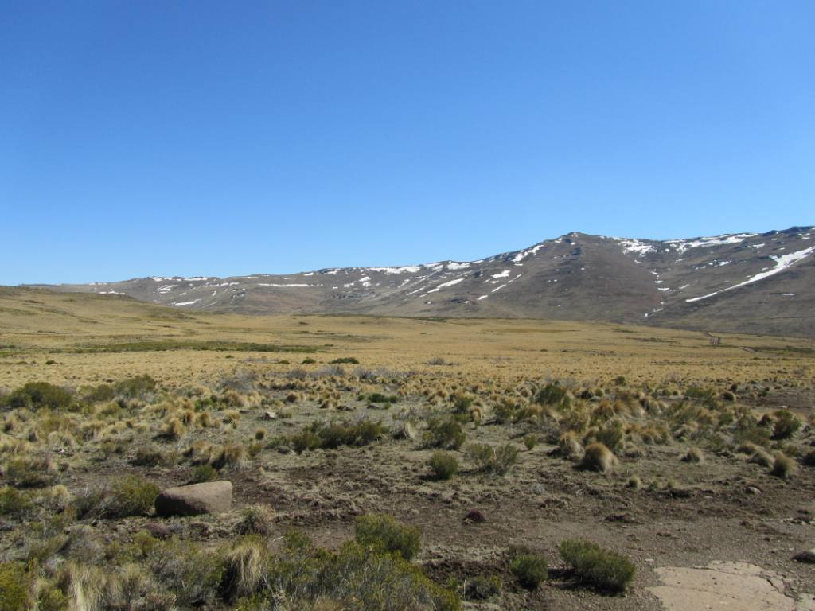
High elevation: alti-montane shrub and grassland
S.Mills

