Slide 1
Oman’s employment structure

Slide 2
Oman’s Employment Structure
 | 1990 | 2017
Primary Industry | 9.5 | 5
Secondary Industry | 7.3 | 39.6
Tertiary Industry | 83.5 | 55.4
Notes:
Low rainfall, high temperatures

Slide 3
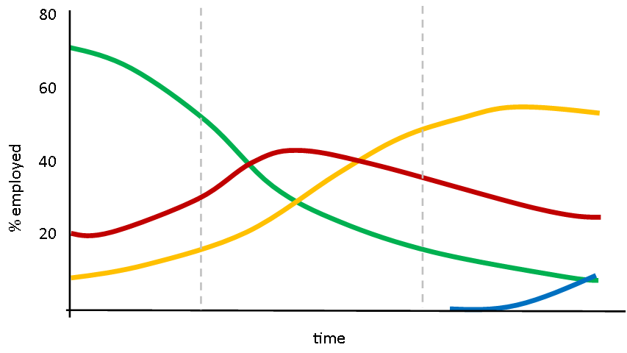
Oman’s Employment Structure
Clark - Fisher Model
Primary
Secondary
Tertiary
Quaternary
Notes:
Low rainfall, high temperatures

