Slide 1
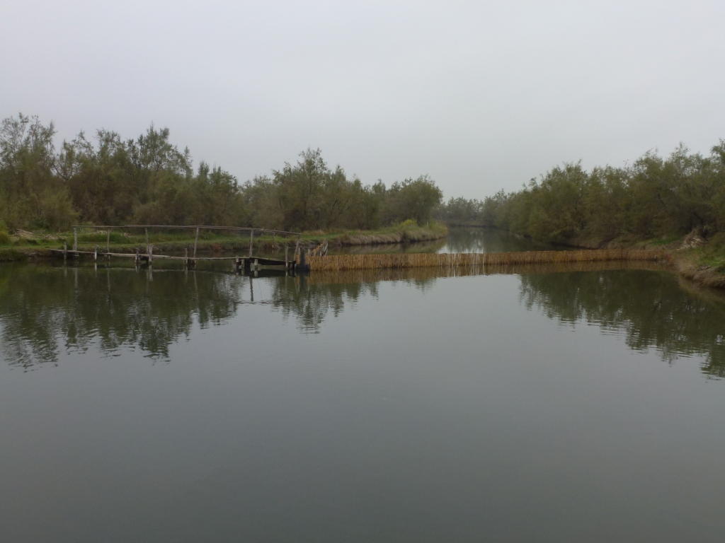
Venice images 4, illustrating aspects of management and sustainable use of the Lagoon of Venice
lesson 3: the lagoon ecosystem and sustainable use
Lagoon in Venice © David Anderson

Slide 2
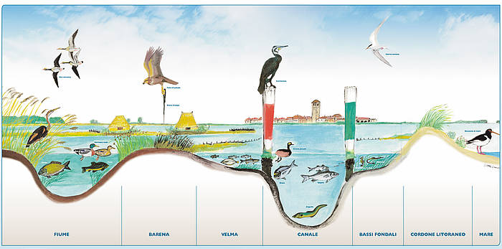
Biodiversity of the lagoon is related to habitat diversity as illustrated here. Erosion, deepening, and flattening of the lagoon bed (related to shipping) reduces habitat diversity.
https://www.veneziainvela.com/it/articoli/laguna-il-sistema-acqua/

Slide 3
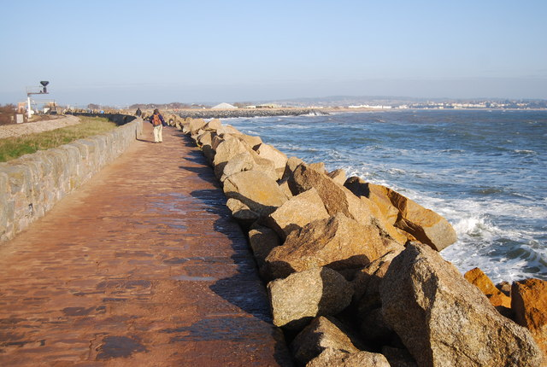
Rip rap to combat erosion
Rip rap © N. Chadwick, Geograph

Slide 4
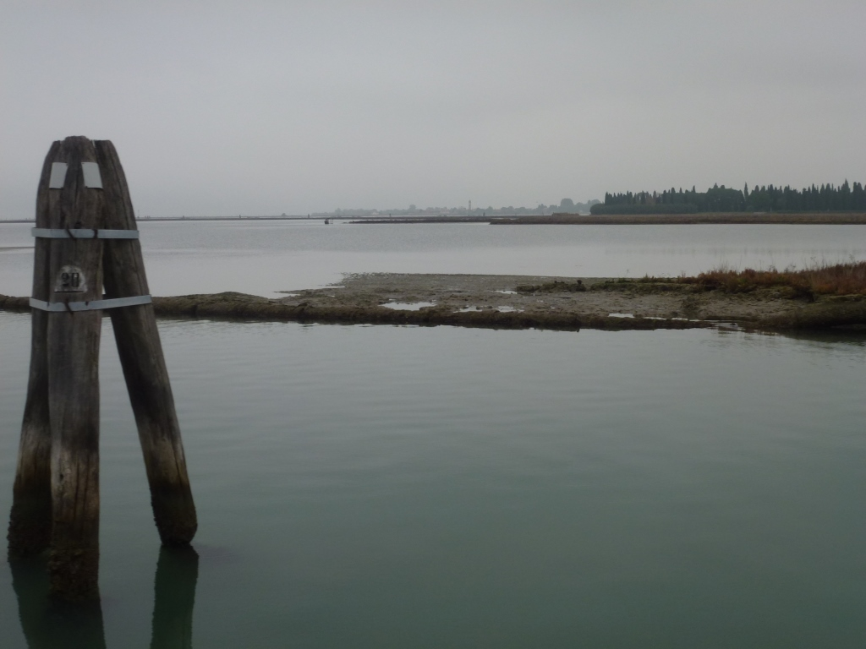
Mudflat and salt marsh in the
northern part of the lagoon
Mudflat and salt marsh © David Anderson

Slide 5
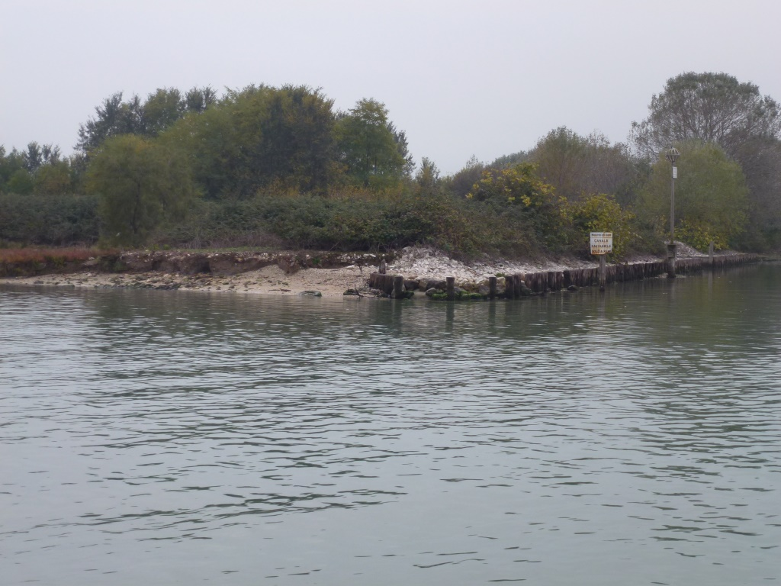
Bank erosion
Protected bank
Bank erosion © David Anderson

Slide 6
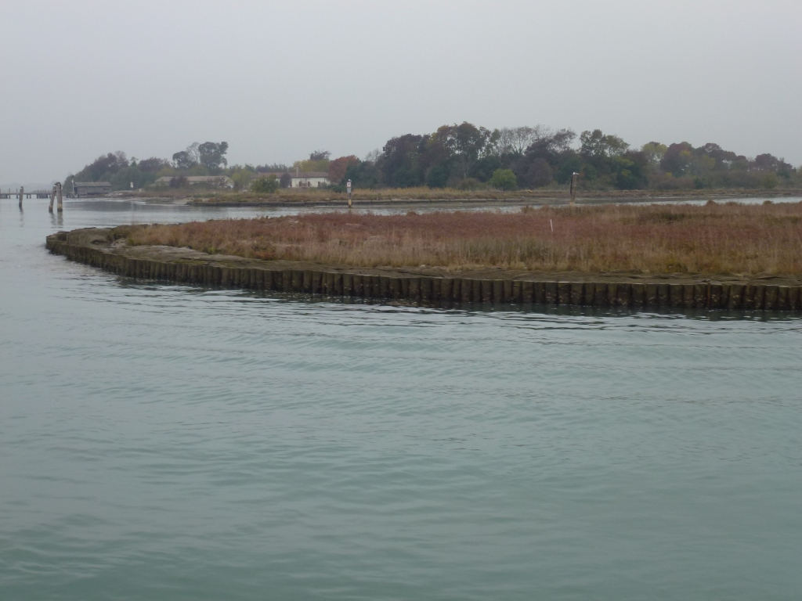
Wood posts preventing erosion
from the wash of boats
Wood posts to prevent erosion © David Anderson

Slide 7
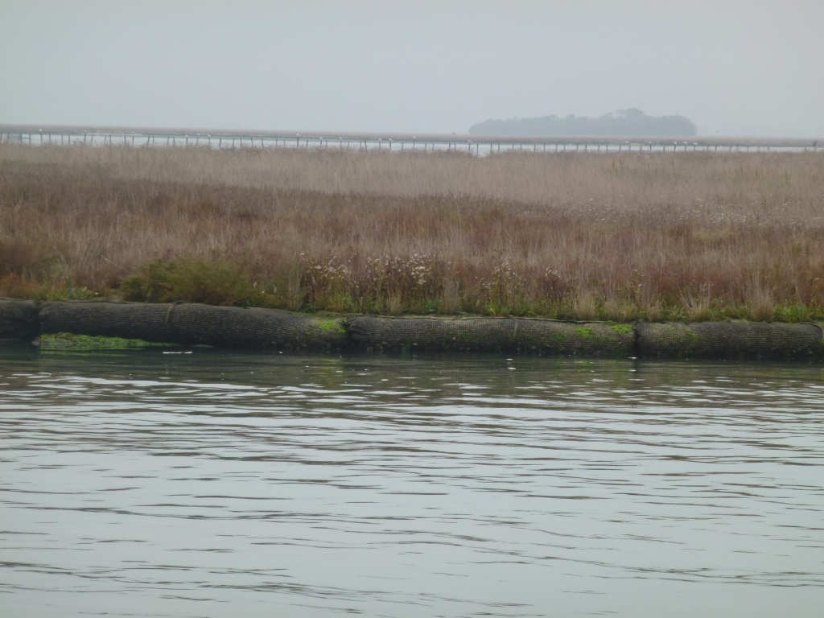
Cement protecting against salt marsh erosion
Cement protecting against salt marsh erosion © David Anderson

Slide 8
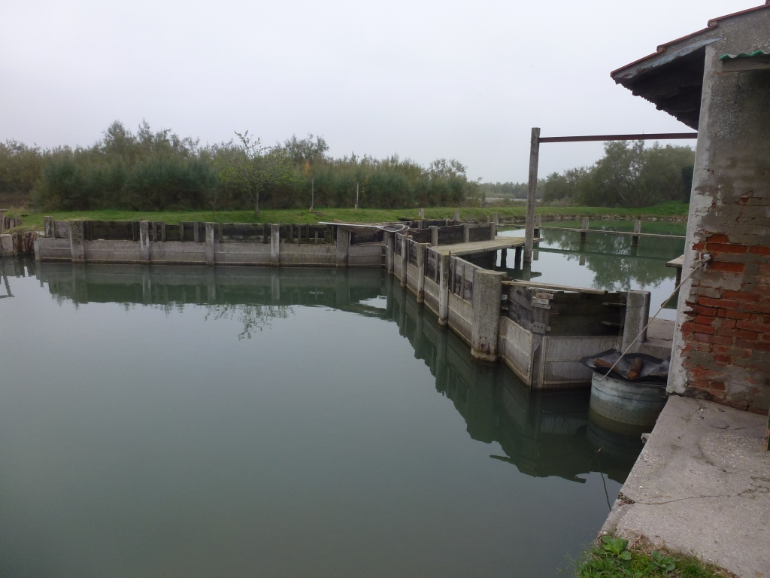
A valle da pesca with gates
for controlling movement of fish
Gates to control the movement of fish in the lagoon © David Anderson

Slide 9
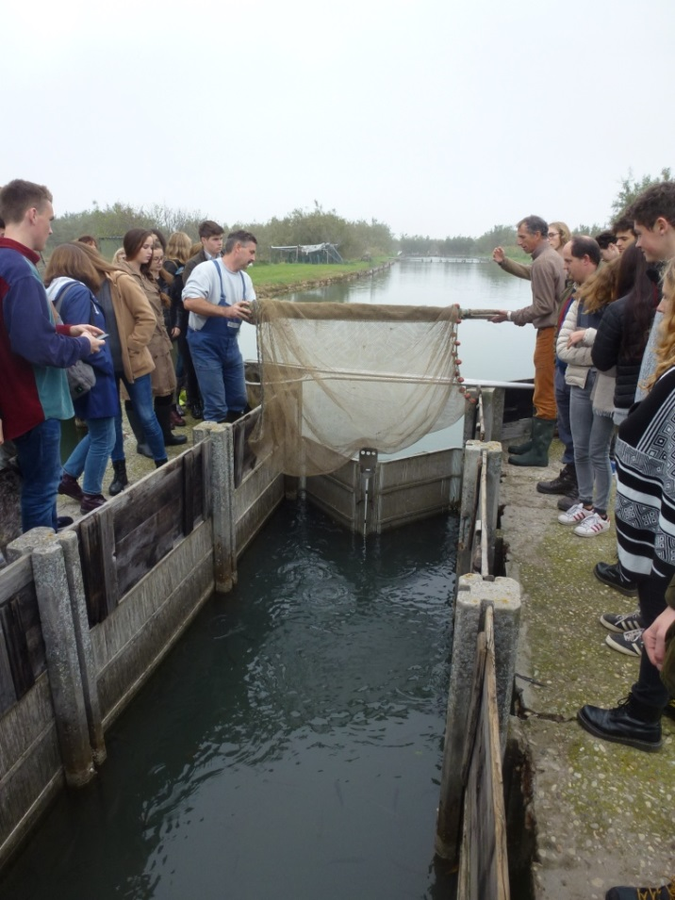
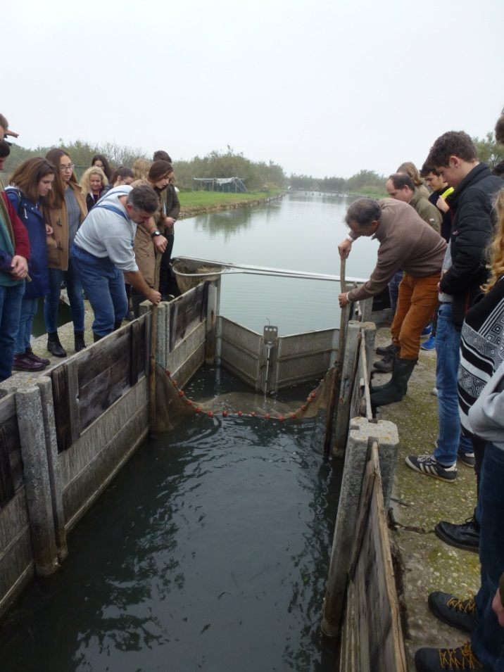
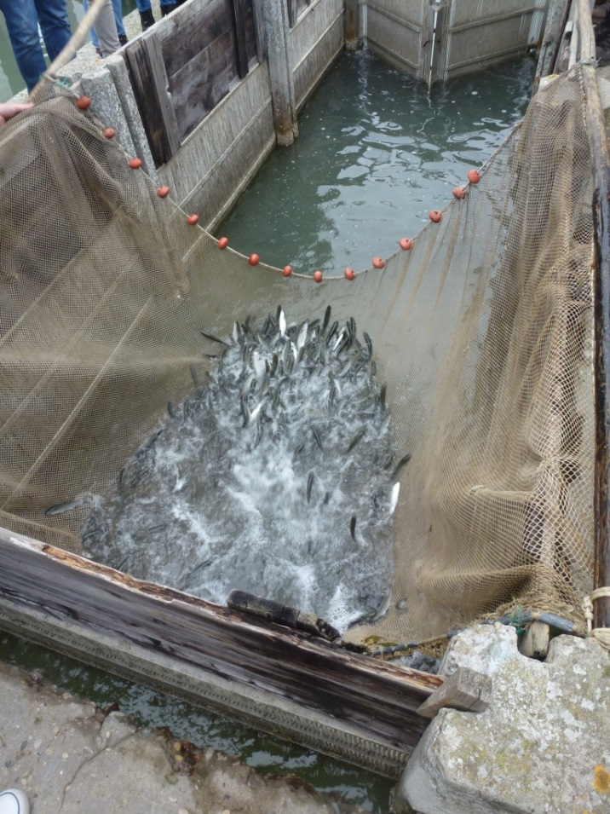
Netting fish at a valle da pesca in the northern Lagoon of Venice
Net fishing © David Anderson

Slide 10
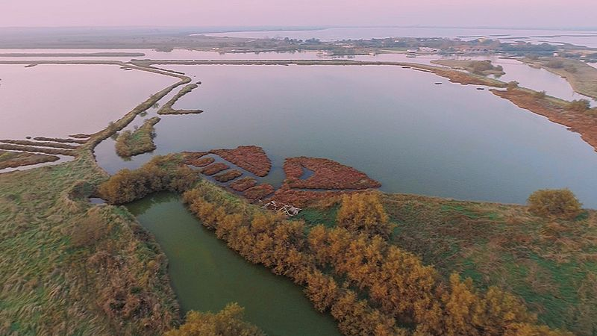
A larger scale example of valle da pesca
Fishing valley © Dion Marsan, Wikimedia Commons

Slide 11
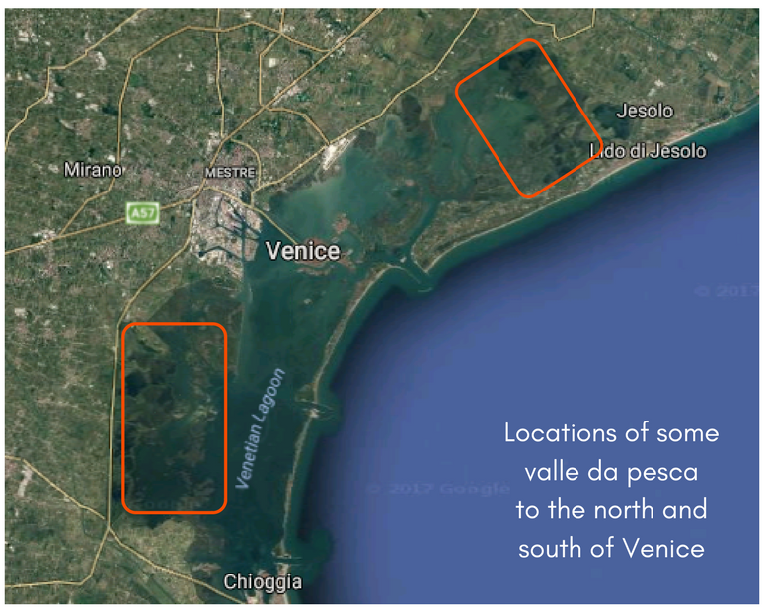
Locations of some valle da pesca north and south of Venice

