Slide 1
www.thewaterdiaries.com

Slide 2
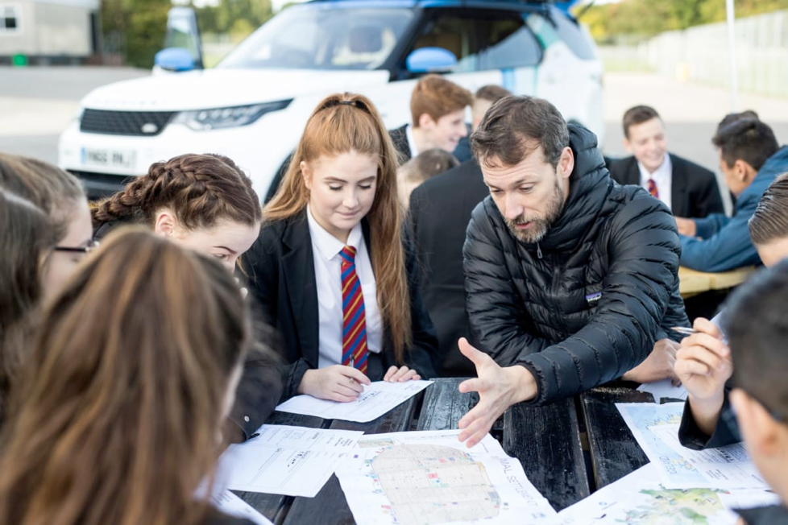
The water diaries team
Winners of the RGS Land Rover Bursary 2017. The team drove a new model Discovery across Jordan to investigate Water Issues.
Temujin Doran
Fearghal O'Nuallain
Shane McGuinness
Filmmaker
Teacher | Lead
Field Scientist
www.thewaterdiaries.com

Slide 3
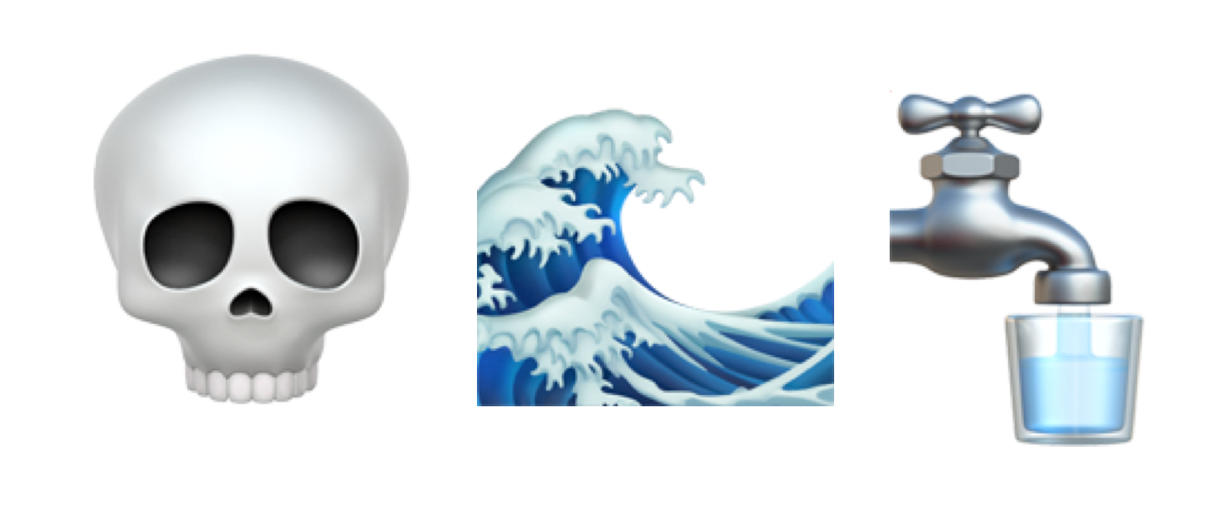
Teacher
Brief
SAVING THE DEAD SEA
www.thewaterdiaries.com

Slide 4
Teacher
Brief
SAVING THE DEAD SEA
O V E R V I E W
Duration - 120mins
Level - 14-16years
Description - This resource focuses on the Dead Sea. It is composed of a collection of activities that can be used separately or as a scheme of work building towards a Decision Making Exercise.
Objectives - Develop and apply graphicacy, numeracy and mapping skills to make a practical decision about the future of the Dead Sea.
Outcome - by the end of this scheme of work students will have been introduced to the Dead Sea crisis through a crossword, graphed the receding sea and will have identified and analysed the Environmental, Ecological, Economic and Social elements of the issue. They will then produce an evaluation of the Red Sea Dead Sea Pipeline, displaying their comprehension of the impacts and trade offs involved in a complex Geo-political issue.
www.thewaterdiaries.com

Slide 5
Teacher
Brief
SAVING THE DEAD SEA
A C T I V I T I E S
T H I S D E C K C O N T A I N S:
INTRO
examining
Evidence
GraphING
1
REPORTING
ANALYSING
MaPPING
www.thewaterdiaries.com

Slide 6
Teacher
Brief
SAVING THE DEAD SEA
S K I L L S
Literacy
Graphicacy
Investigation
Map Reading
Analysis
www.thewaterdiaries.com

Slide 7
Teacher
Brief
SAVING THE DEAD SEA
A C T I V I T Y T I M I N G S
Total Duration
2hrs
This unit consists of 2hrs total teaching content for 14-16ys. Each activity can be taught alone or several can be taught together. See the chart below for individual timings.
Intro
5mins
Graphing
20mins
Mapping
20mins
Crossword
20mins
Teacher Exposition
5mins
www.thewaterdiaries.com

Slide 8
Teacher
Brief
SAVING THE DEAD SEA
FOR THIS UNIT YOU WILL NEED:
PRINT RESOURCES
PENCILS & RULERS
GRAPH PAPER
Internet Access
ATLAS
Print X1 sheet per student for each activity click the red words to download sheets.
Each student will need a pencil and a ruler for the graphing activity. by
X1 sheet of graph paper per student for the graph exercise.
Internet access will be required to view the online map and video.
An Atlas or ESRI’s GIS for schools will be useful for the mapping activity.
www.thewaterdiaries.com

Slide 9
SAVING THE DEAD SEA
www.thewaterdiaries.com

Slide 10
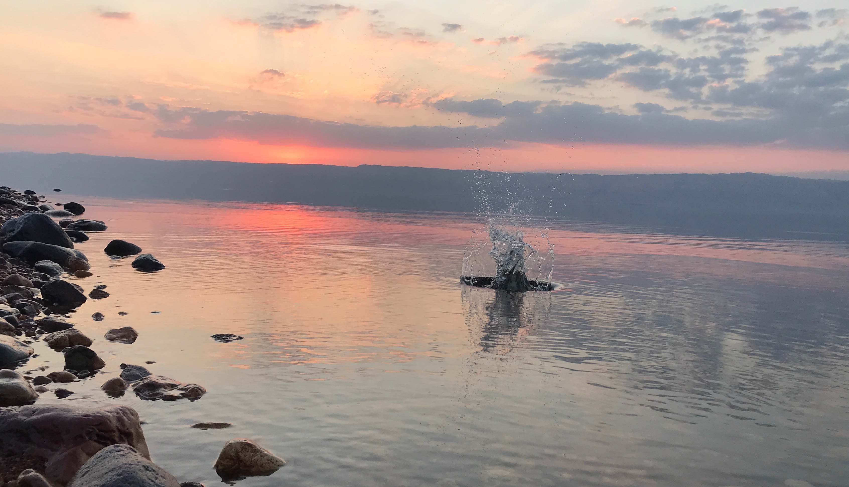
INTRO
Watch the short film showing the Dead Sea and write a short description of the landscapes you observe.
www.thewaterdiaries.com

Slide 11
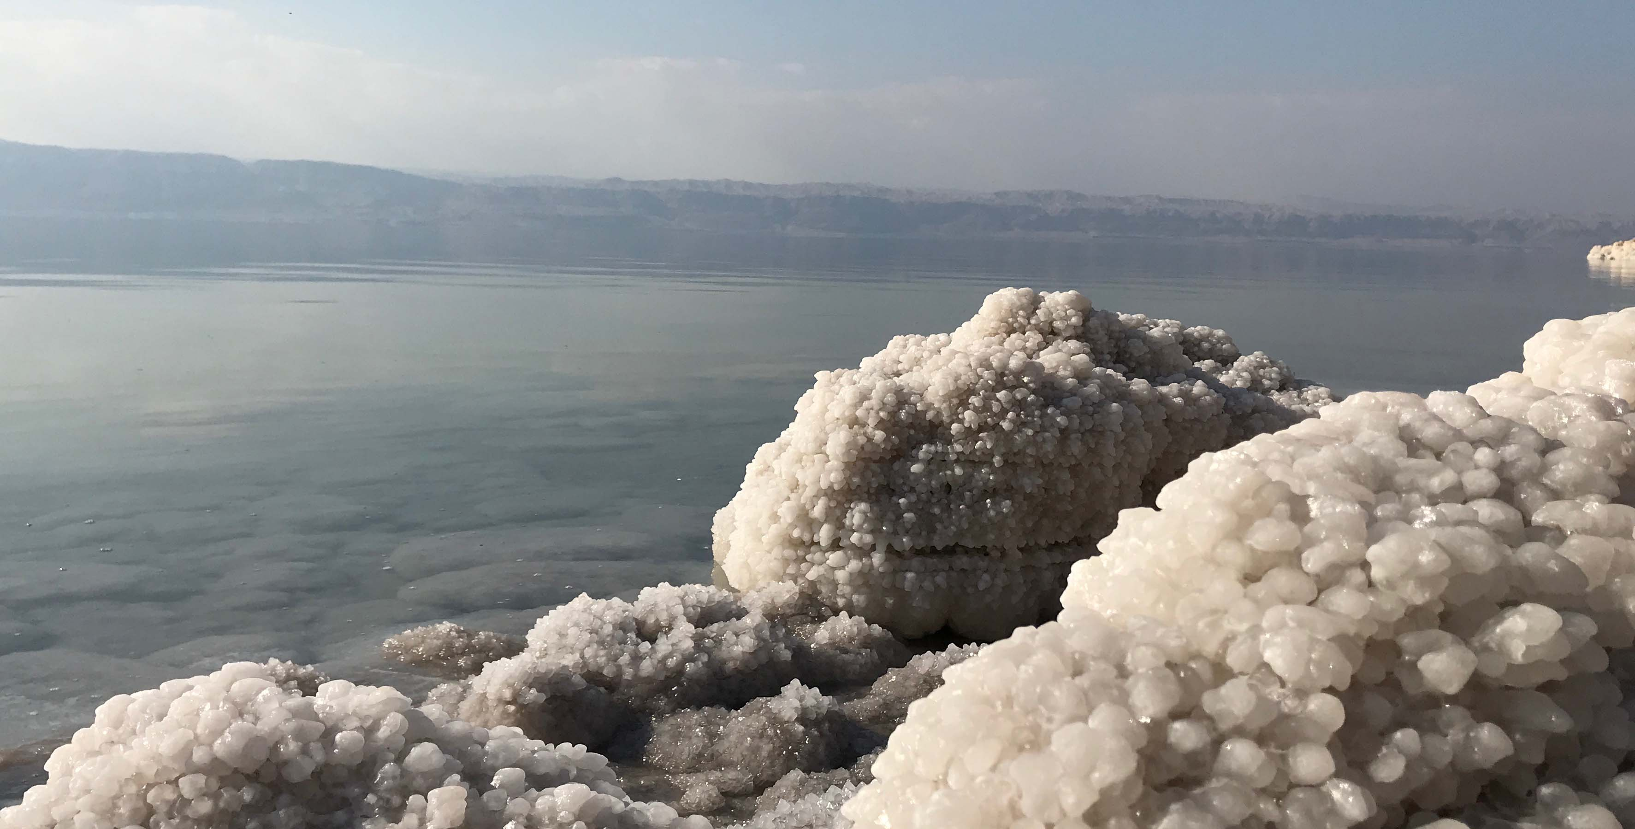
INTRO
Why is the Dead Sea Dying?
Read the text and complete the crossword to find out.
www.thewaterdiaries.com

Slide 12
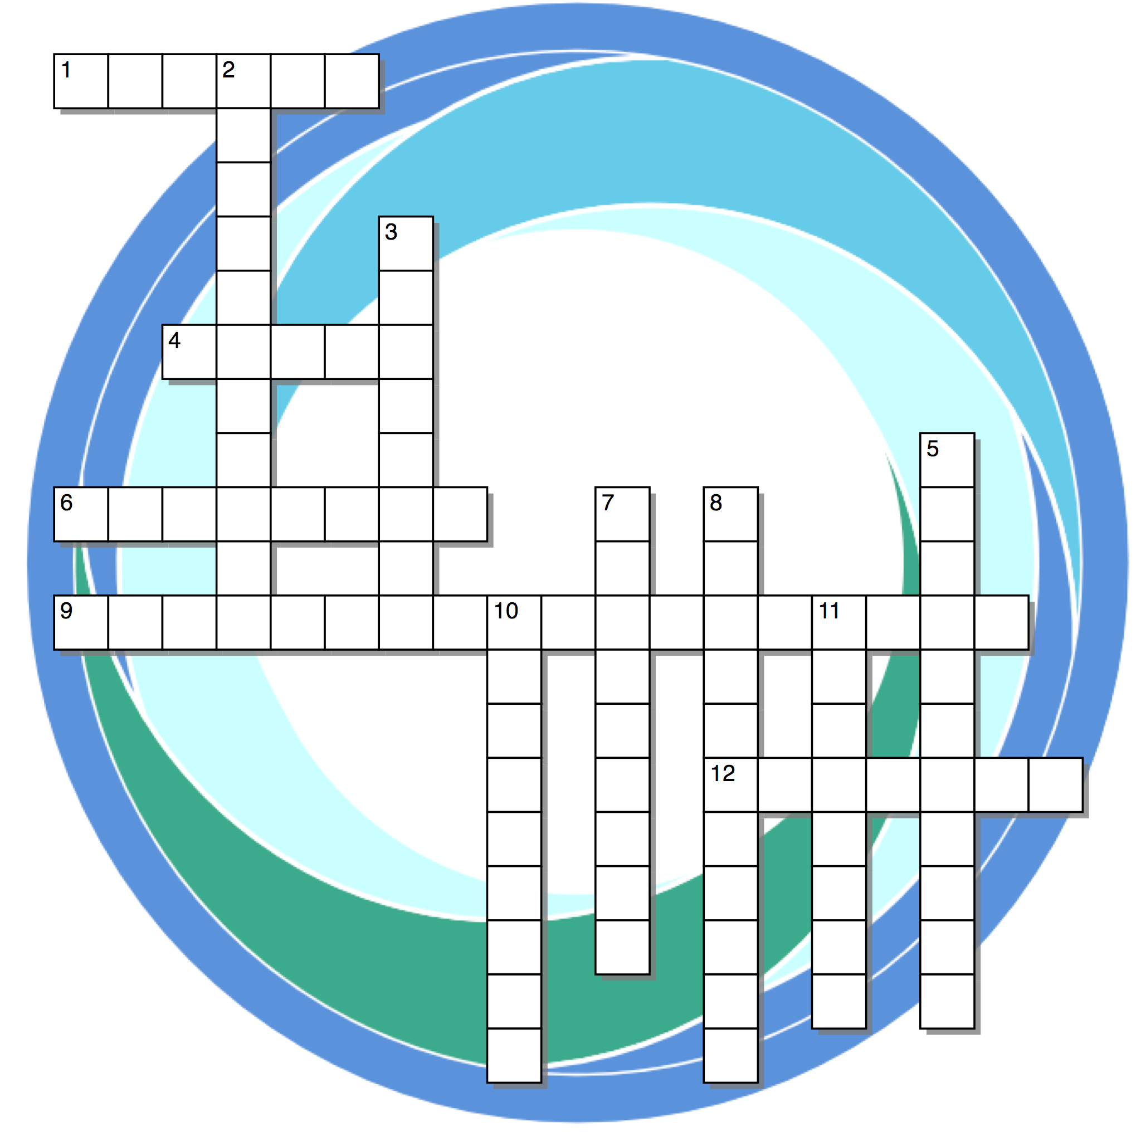
INTRO
Across
1) This country diverted water from the upper Jordan.
4) Salty Water.
6) Another word for saltiness.
9) Until this decade, the flow of fresh water equaled the rate of evaporation.
12) This river is a tributary of the River Jordan.
Down
2) Part of the water cycle, this causes the drop in the level of the Dead Sea.
3) Each year the level of the Dead Sea drops by this amount.
5) The source of most of the Dead Sea’s water.
7) These are swallowing up land on the shore of the Dead Sea.
8) The Dead Sea is this long.
10) Hotels have installed these to provide guests with access to the Dead Sea.
11) They come to swim in the Dead Sea.
Read the text and complete
the crossword.
www.thewaterdiaries.com

Slide 13
INTRO
www.thewaterdiaries.com

Slide 14
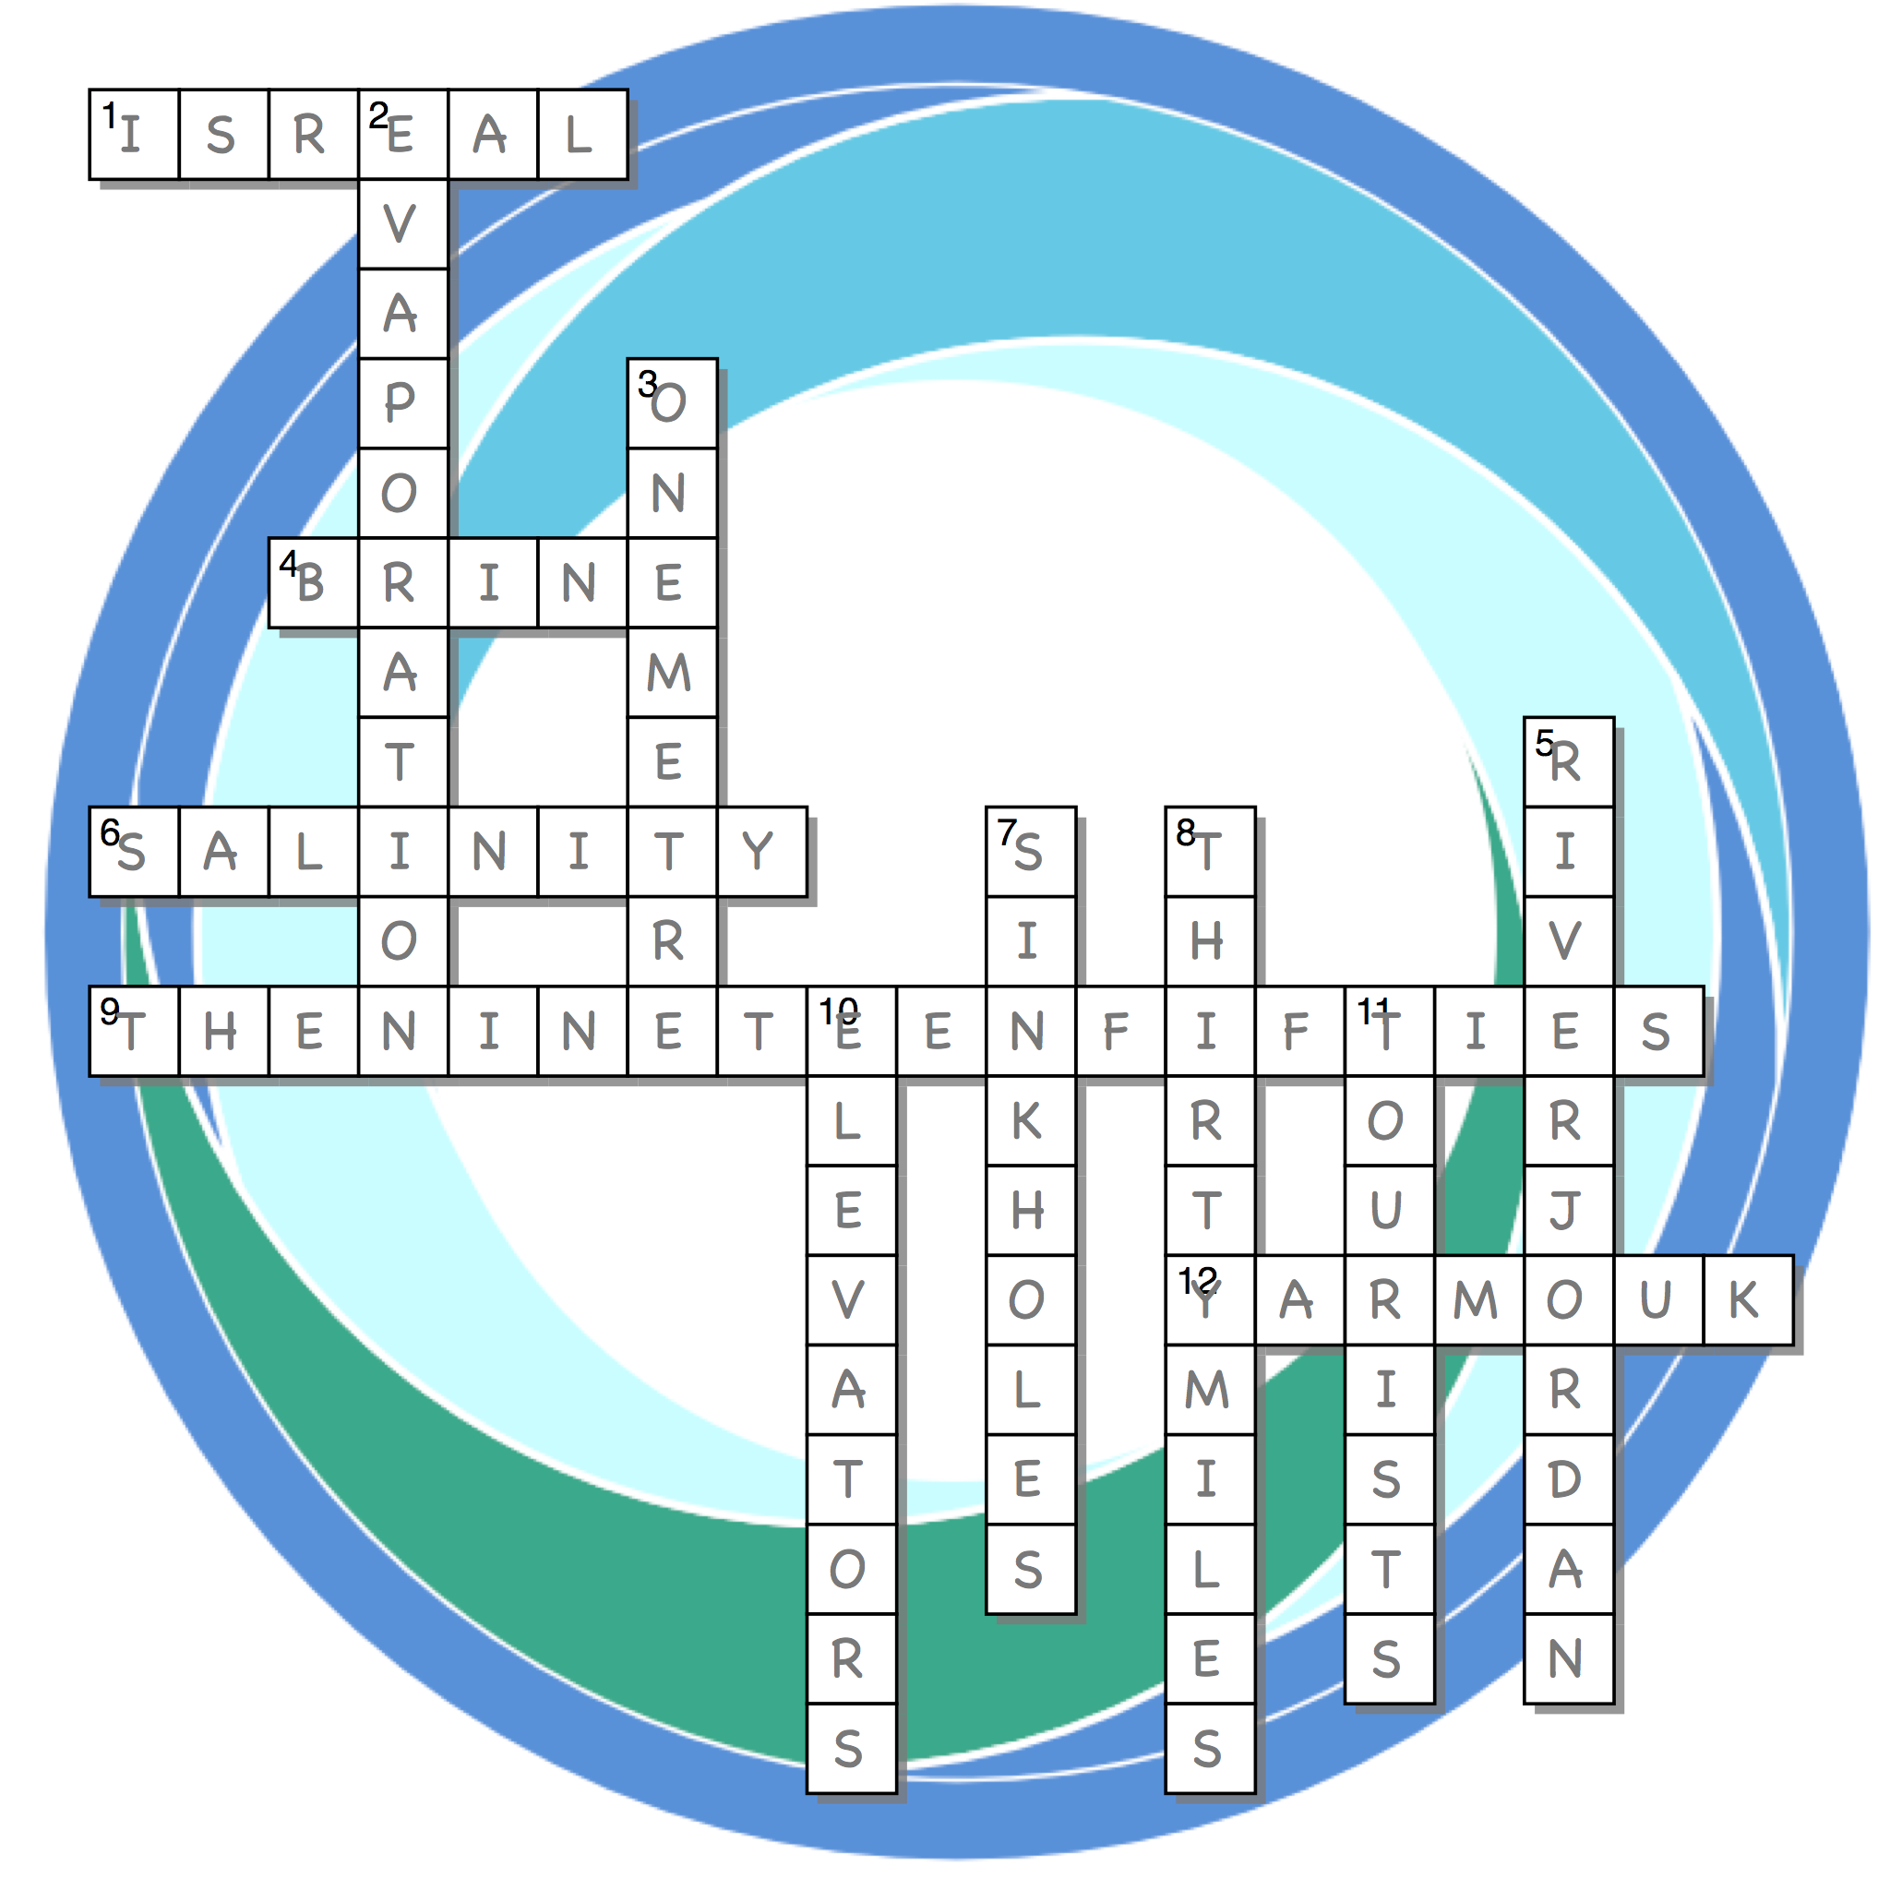
INTRO
SOLUTIONS
www.thewaterdiaries.com

Slide 15
INTRO
Why is the Dead Sea Dying?
Describe of two of the issues causing The Dead Sea to recede.
www.thewaterdiaries.com

Slide 16
examining
Evidence
1
Use the satellite images & photographs and examine the evidence that the level of the Dead Sea is receding.
www.thewaterdiaries.com

Slide 17
examining
Evidence
1
The following images show the area of the Dead Sea from space in 1972, 1989 & 2011.
Examine the images and describe the changes.
www.thewaterdiaries.com

Slide 18
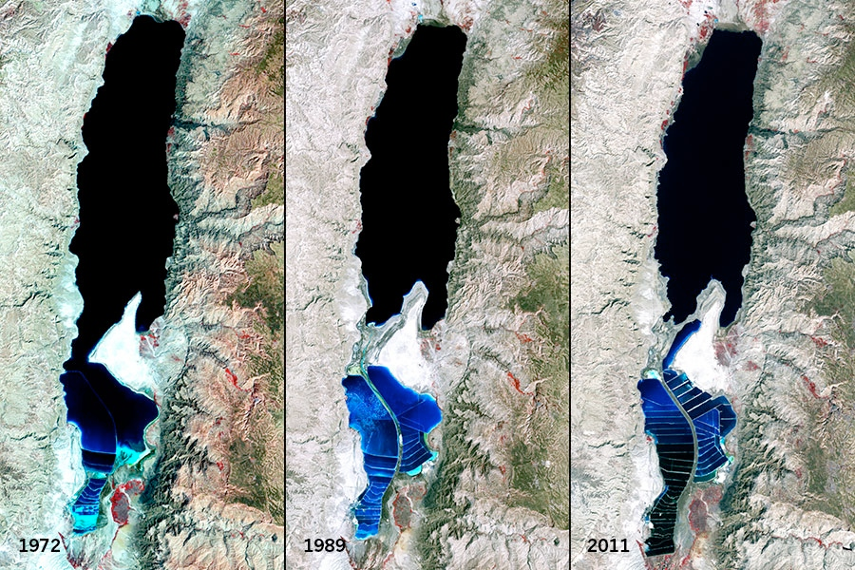
examining
Evidence
1
www.thewaterdiaries.com

Slide 19
examining
Evidence
1
The following image shows the Dead Sea coast in 2017. The red lines show the coastlines in 2015,16 &17.
Examine the image and describe the changes.
www.thewaterdiaries.com

Slide 20
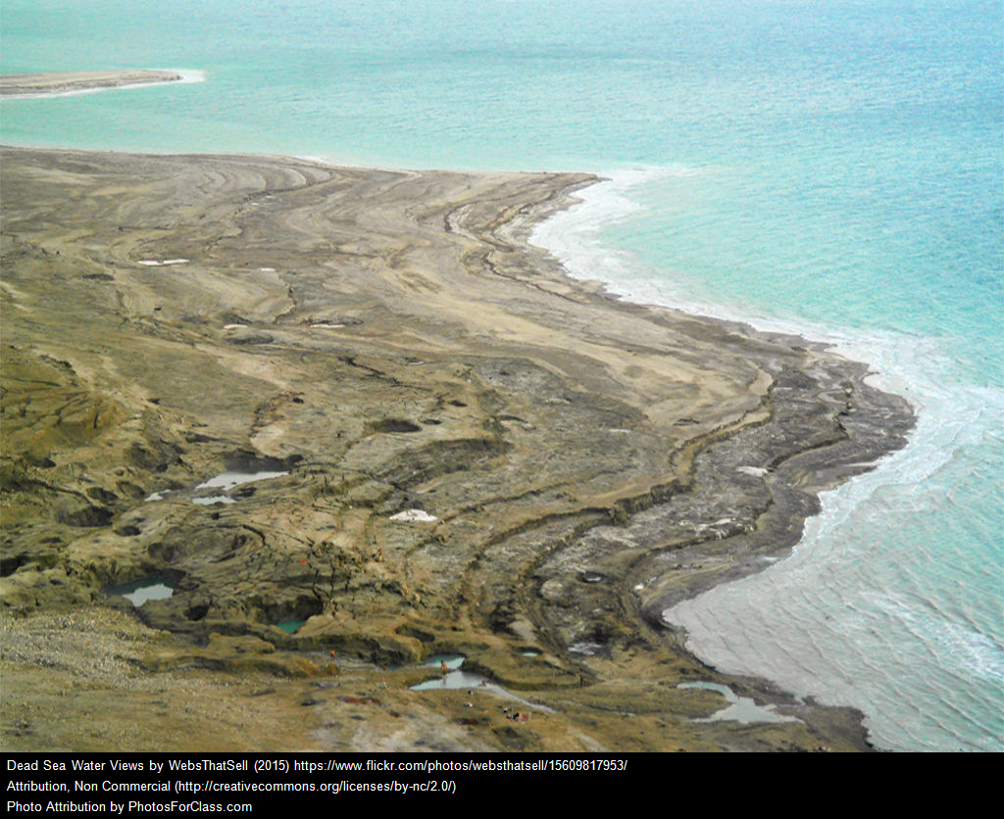
1
examining
Evidence
1
1
2017
2016
2015
www.thewaterdiaries.com

Slide 21
examining
Evidence
1
The following images shows the Wadi Mujib
in 1927 & 2017.
Its clear that the river connected to the sea in 1927. In 2017 the coastline is almost 100 metres away.
Examine the image and describe the changes.
www.thewaterdiaries.com

Slide 22
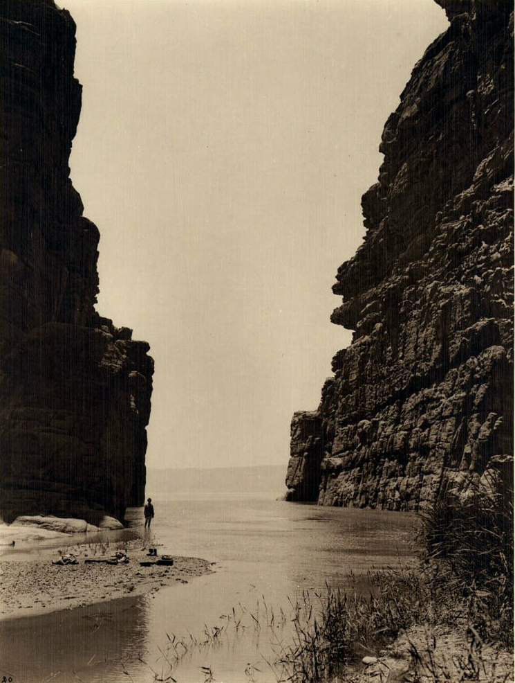
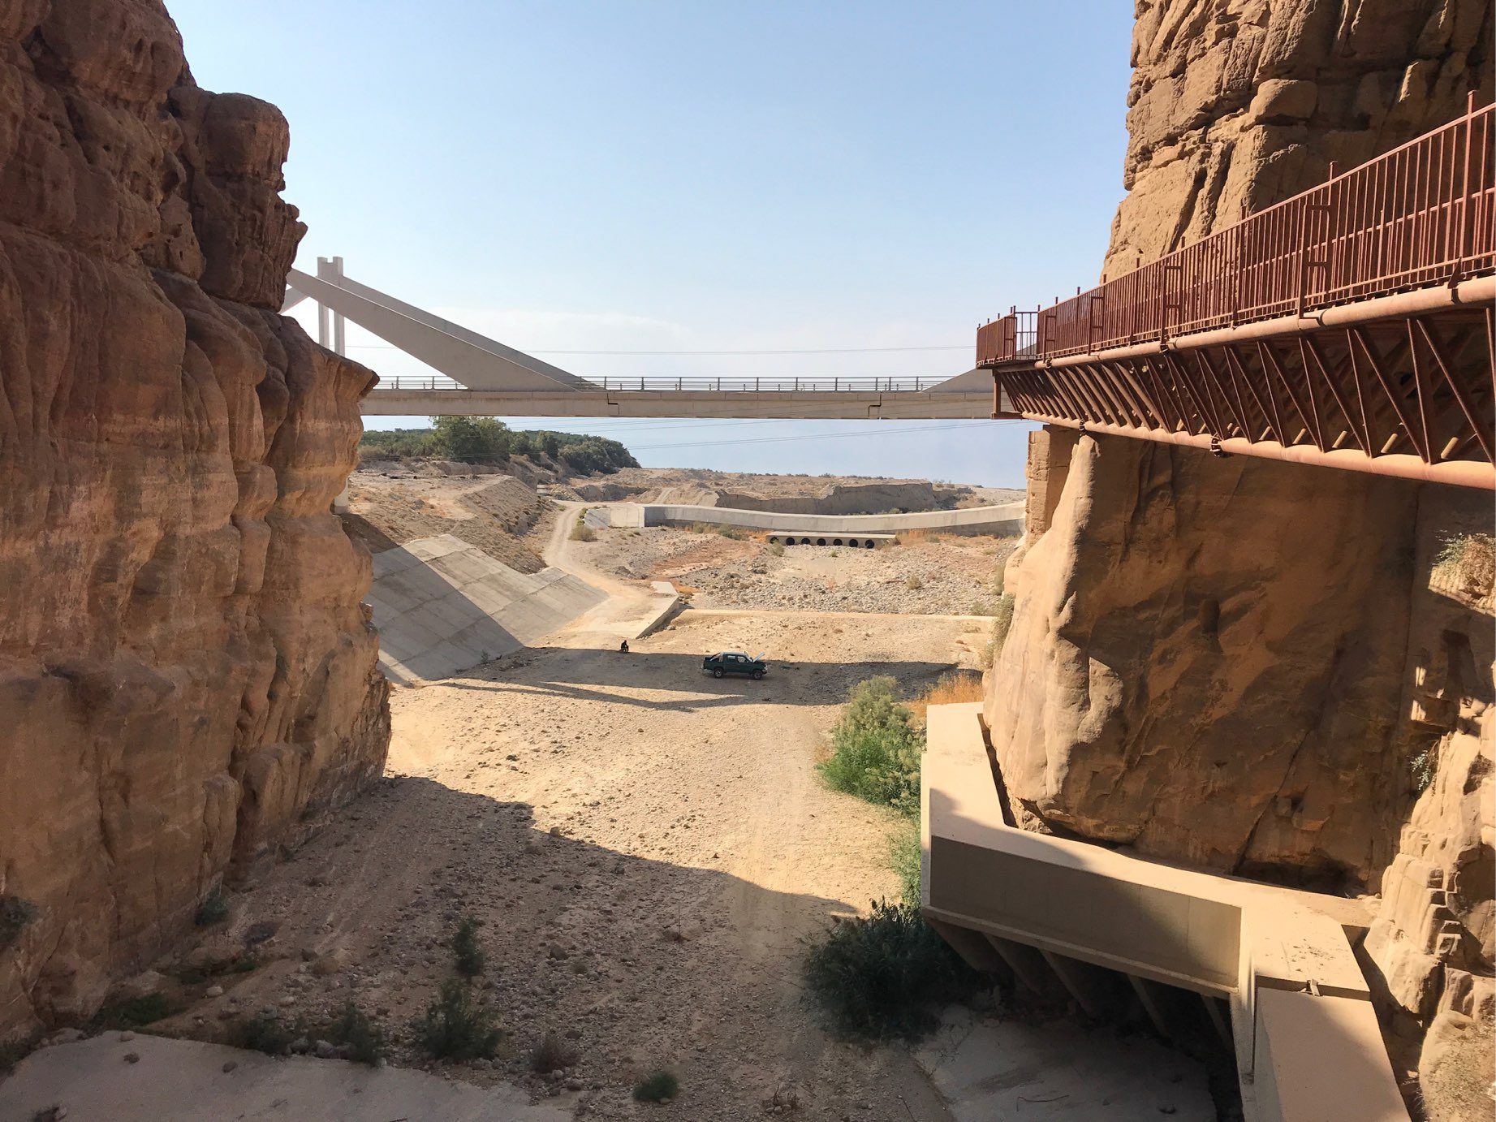
examining
Evidence
WADI MUJIB - Jordan
1
In 1928 the wadi flowed into the sea topping it up with fresh water.
1927
2017
www.thewaterdiaries.com

Slide 23
examining
Evidence
examining
Evidence
WADI MUJIB - Jordan
1
1
In 1928 the wadi flowed into the sea topping it up with fresh water.
The sea is 100m away from the wadi mouth and water no longer makes it to the sea
1927
2017
www.thewaterdiaries.com

Slide 24
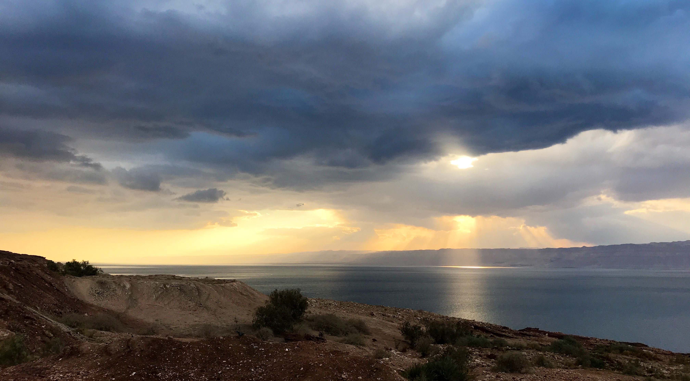
GraphING
USE THE DATA TO PLOT A GRAPH SHOWING THE LEVELS OF THE DEA SEA
SINCE 1930 AND ANSWER THE FOLLOWING QUESTIONS.
www.thewaterdiaries.com

Slide 25
GraphING
PLOT GRAPH SHOWING DEAD SEA DECLINE:
Create a graph showing the levels of the Dead Sea since 1930
 | 1930 | 1940 | 1950 | 1960 | 1970 | 1980 | 1990 | 2000 | 2010 | 2018 | 2028
Dead Sea Level(m) (minus value means below sea level) | -390 | -394 | -393 | -395 | -396 | -400 | -408 | -415 | -425 | -430 | -440
www.thewaterdiaries.com

Slide 26
GraphING
GraphING
www.thewaterdiaries.com

Slide 27
GraphING
Use your graph to answer the following questions:
1- Which year was the Dead Sea at its highest? What was the level of the Dead Sea then?
2- Which decade saw the biggest drop in the Dead Sea Levels?
3- What is the current level of the Dead Sea?
4- If it continues to drop by roughly 1m per year what will the level be in 2050?
5- If it is 304m deep in 2018 and it is dropping by roughly 1m per year what year will it totally disappear?
www.thewaterdiaries.com

Slide 28
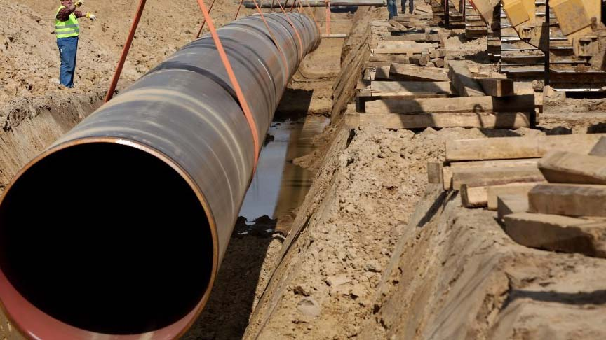
MaPPING
ISREAL AND JORDAN ARE PLANNING TO SAVE THE DEAD SEA BY BUILDING A PIPELINE TO TOP IT UP WITH WATER FROM THE RED SEA.
www.thewaterdiaries.com

Slide 29
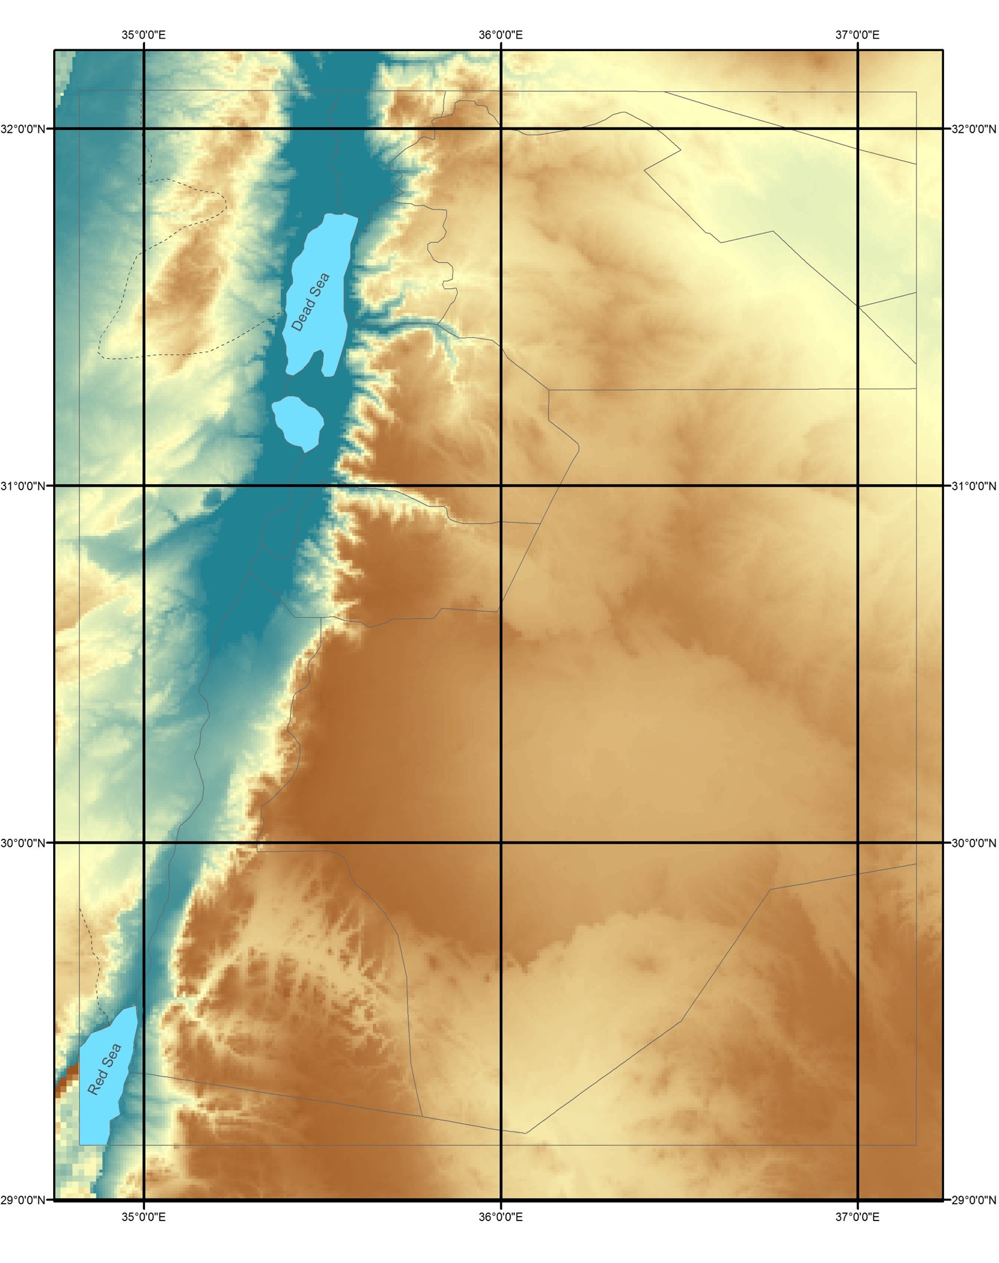
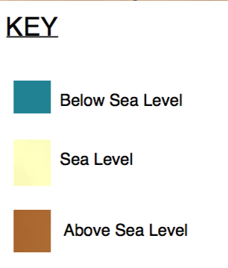
MaPPING
Use the co-ordinates to plot the route of the pipeline on paper or using GIS. Then answer the questions on the following slide.
www.thewaterdiaries.com

Slide 30
Use the co-ordinates to plot the route of the pipeline on paper or using GIS.
MaPPING
1. Describe the route that the pipeline is taking.
2. List and explain one economic, environmental, political and political factor behind the route.
3. Plot the hydroelectric power stations. Use the map to explain why you think they will be built in those locations
www.thewaterdiaries.com

Slide 31
Use the co-ordinates to plot the route of the pipeline on paper or using GIS.
MaPPING
1. Use the co-ordinates to plot the route of the pipeline on paper or using GIS. | See map on following page.
2. Describe the route it is taking. | The Pipeline follows a North East route along the Jordan Rift Valley from the Red Sea to the Dead Sea.
3. List and explain one economic, environmental, physical and political factor behind the route. | Economic: Near road to reduce transport costs. Environmental: Avoids hills to allow flow and reduce the need for pumping (CO2) Physical: Follows the Jordan Rift Valley. Political: Avoids crossing borders into Palestine or Isreal.
4. Plot the hydroelectric power stations. Use the map to explain why you think they will be built in those locations | Located at the bottom of a descent to capture kinetic energy and turn it into electricity.
ANSWERS
www.thewaterdiaries.com

Slide 32
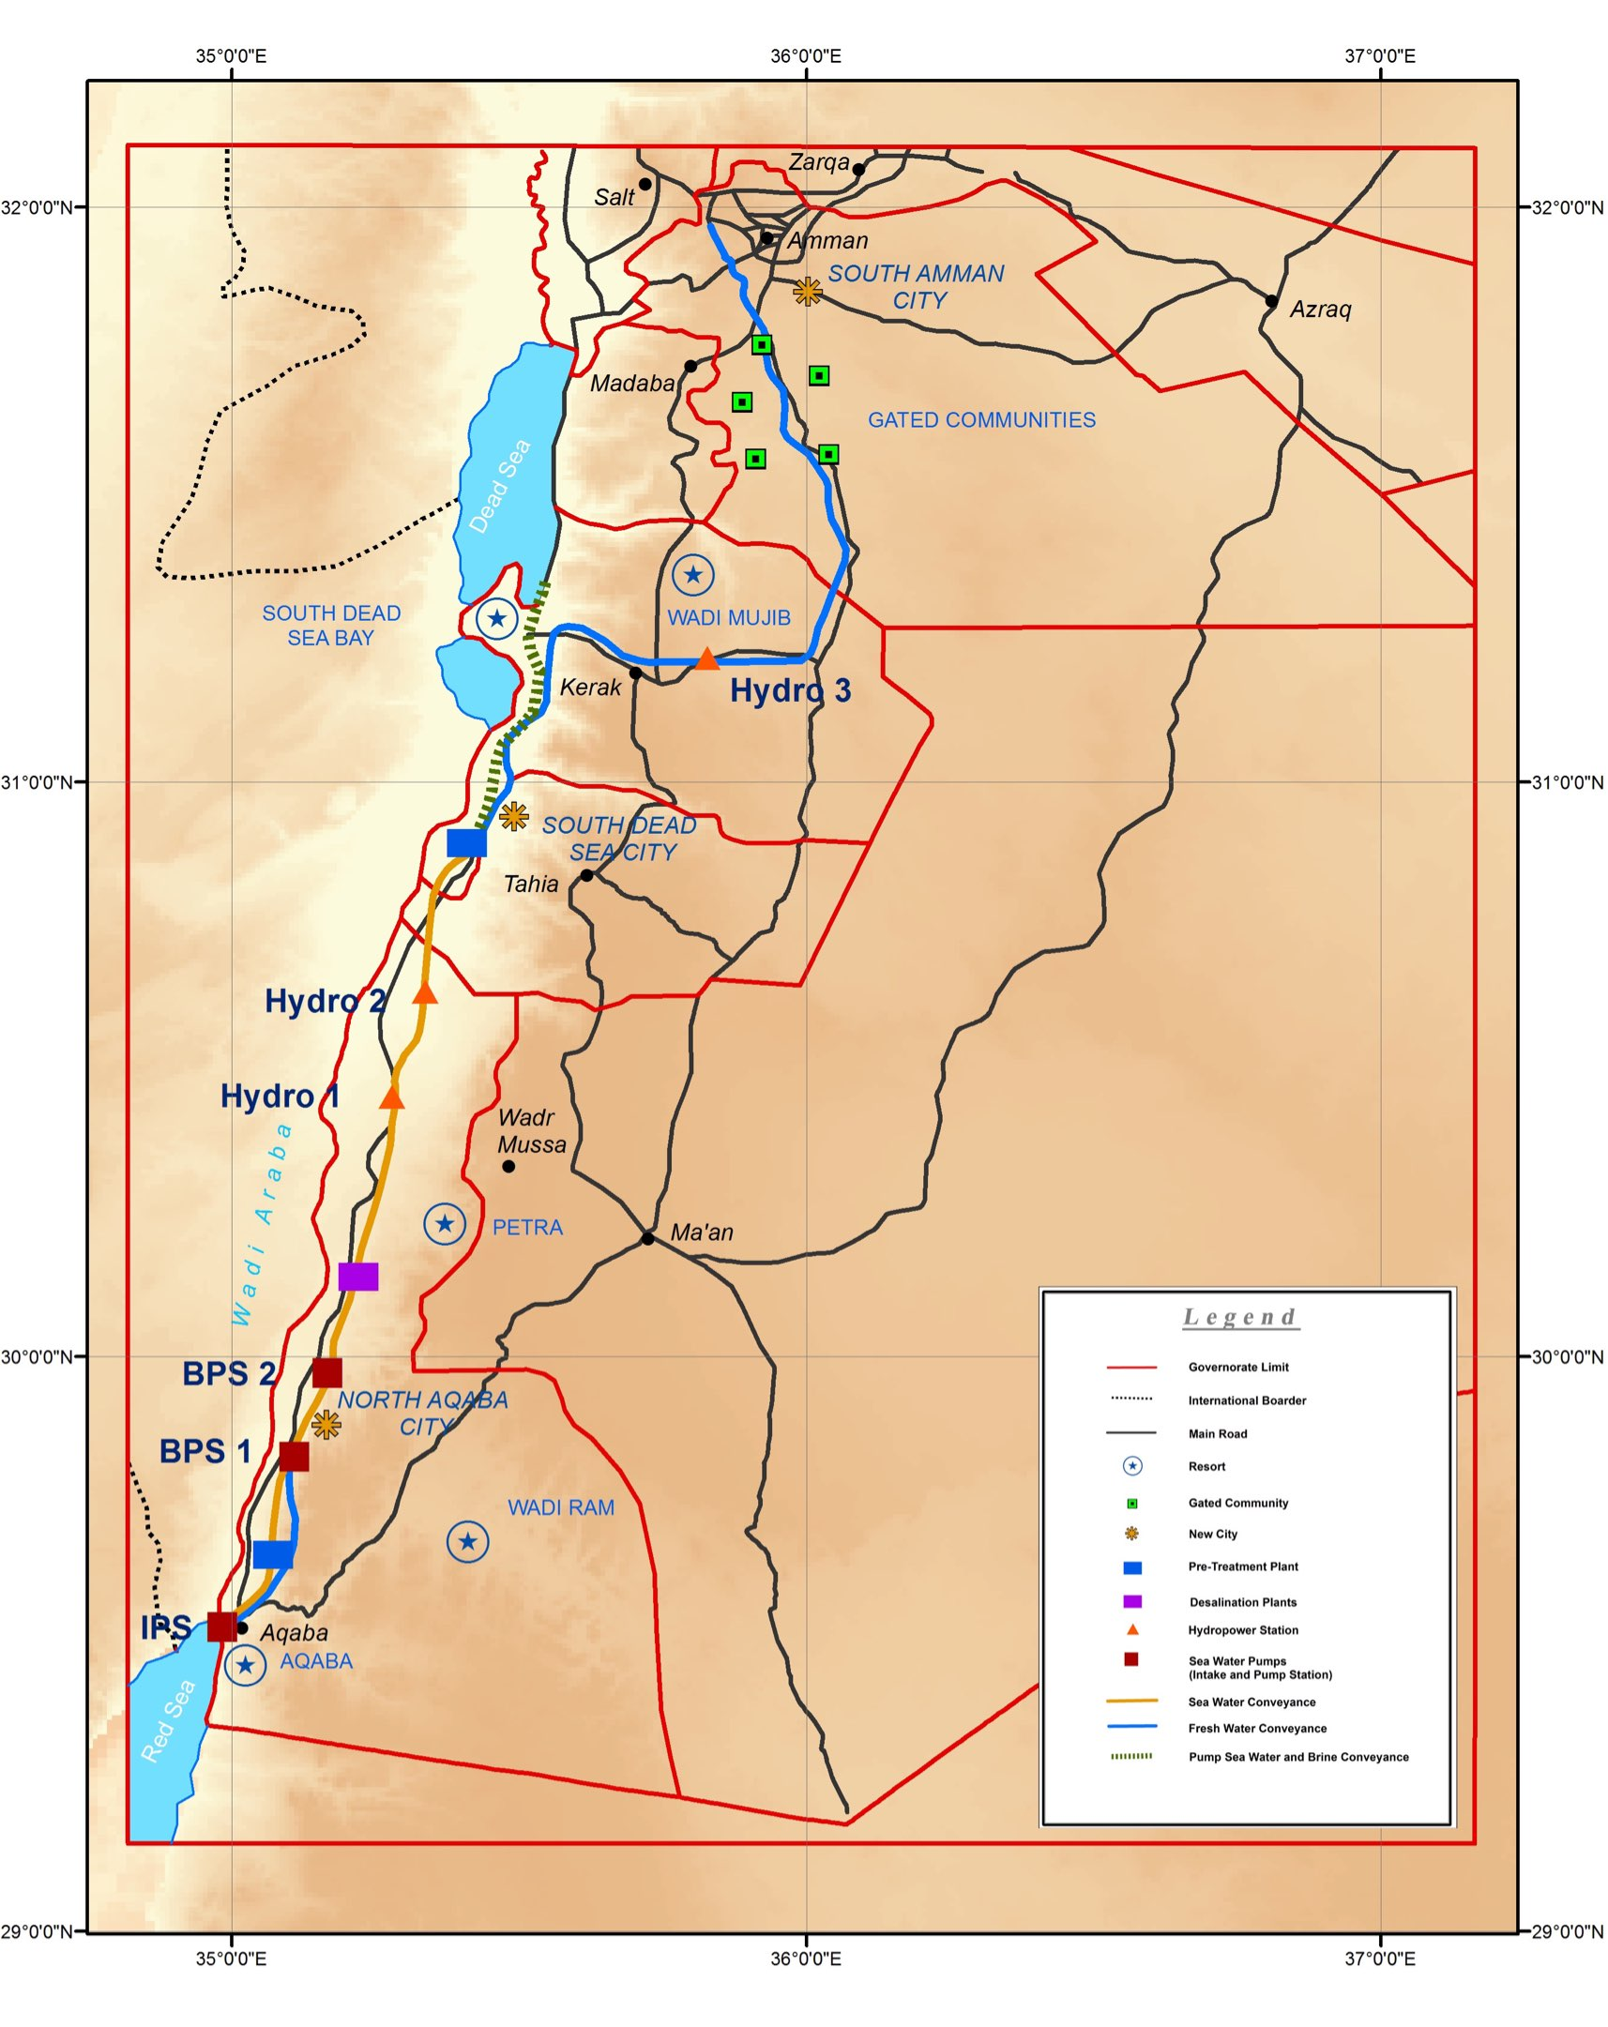
MaPPING
Use the map to answer the questions.
1- List three resorts.
2- Describe the location of Amman.
3- Suggest why the Gated Communities are located where they are.
4- Describe the location of the Dead Sea in relation to Aqaba and Amaan.
5- Provide 6 figure references for: PETRA Hydro 3 South Amman City
www.thewaterdiaries.com

Slide 33
MaPPING
1- List three resorts. | PETRA, AQABA WADI RUM, SOUTH DEAD SEA BAY
2- Describe the location of Amman. | Amman is located in the North Eastern part of Jordan.
3- Suggest why the Gated Communities are located where they are. | Close to the capital city Amman, source of fresh water from new pipeline.
4- Describe the location of the Dead Sea in relation to Aqaba and Amaan. | North of the Aqaba, South East of Amman.
5- Provide 6 figure references for: PETRA Hydro 3 South Amman City | PETRA (354,279) Hydro 3 (358,313) South Amman City (360,319)
ANSWERS
www.thewaterdiaries.com

Slide 34
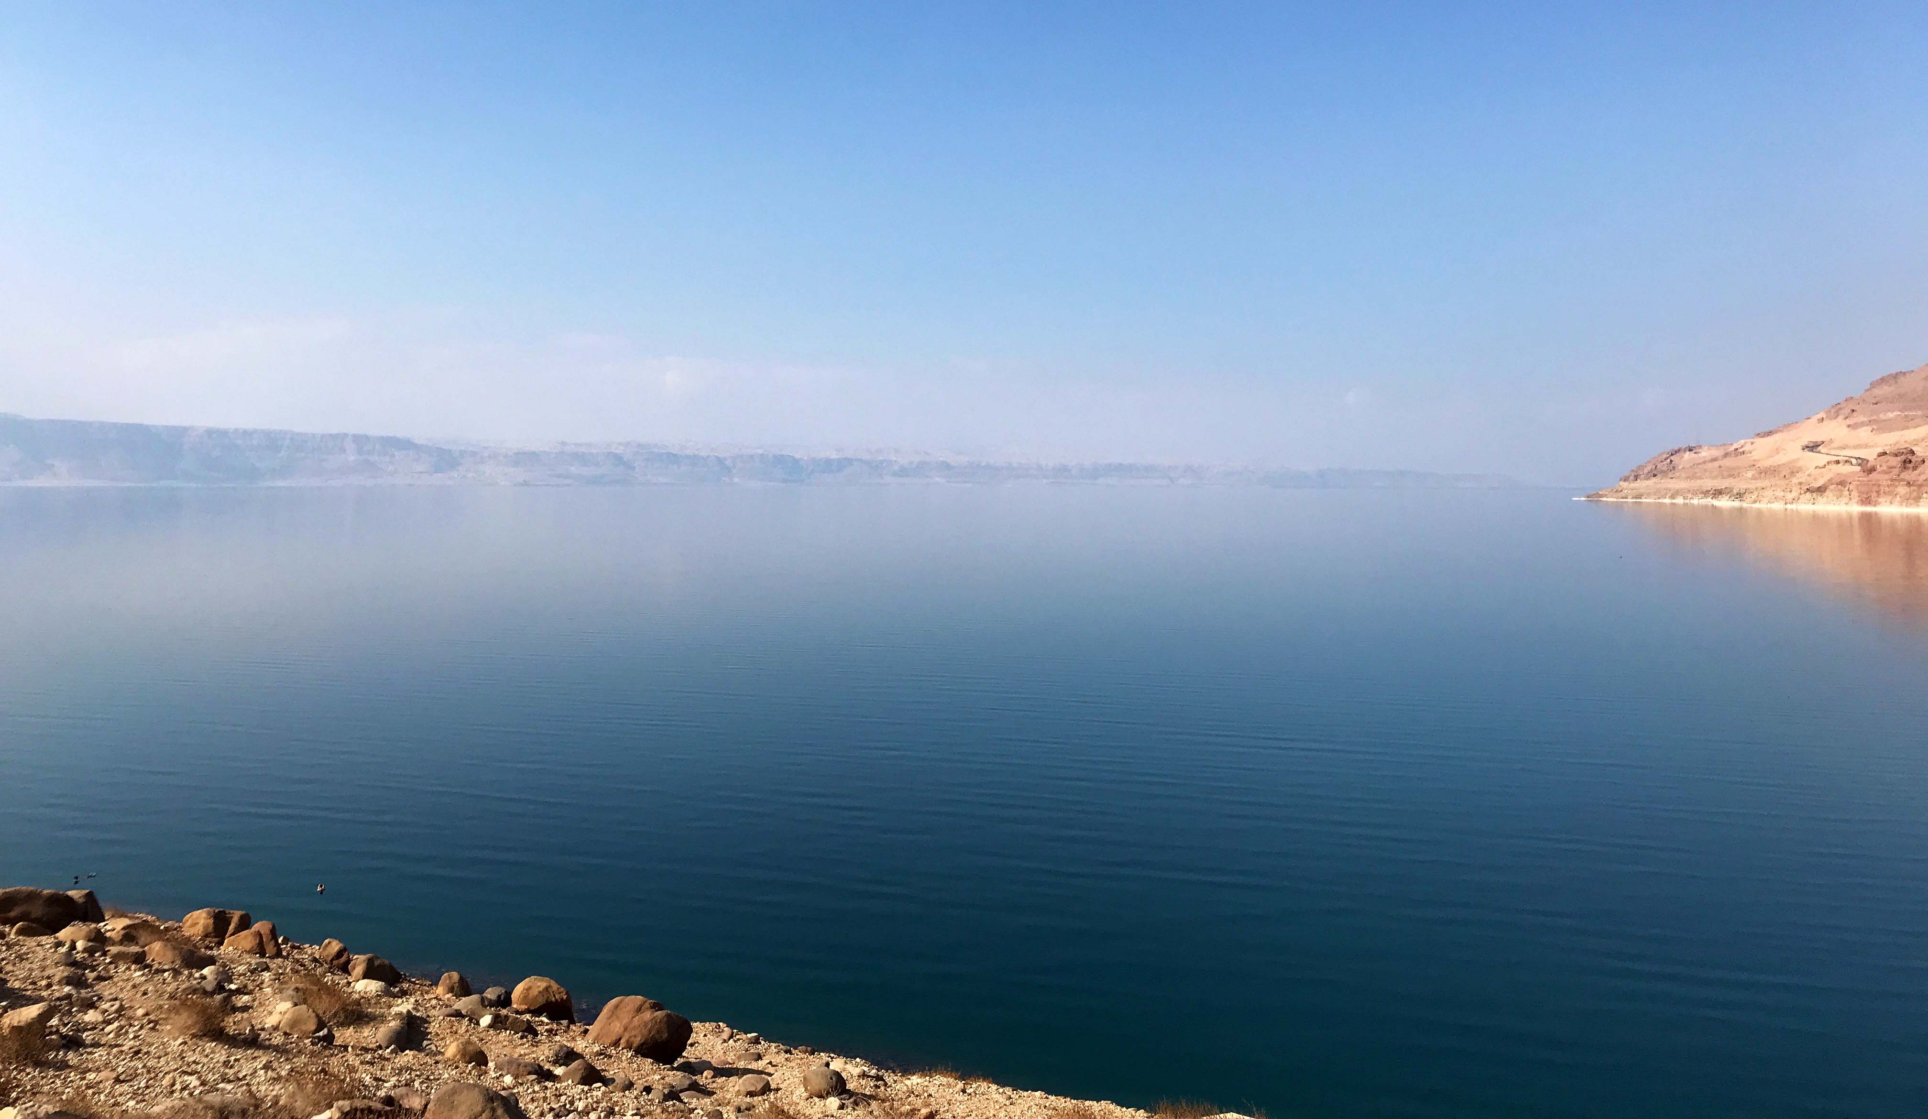
ANALYSING
READ THE ARTICLE AND COMPLETE THE TABLE
Use highlighters to code the following elements:
SOCIAL
ECONOMIC
ENVIRONMENTAL
ECOLOGICAL
www.thewaterdiaries.com

Slide 35
Complete The Table
ANALYSING
PIPELINE IMPACTS
 | Positive | Negative
ECONOMIC
ENVIRONMENTAL
ECOLOGICAL
SOCIAL
www.thewaterdiaries.com

Slide 36
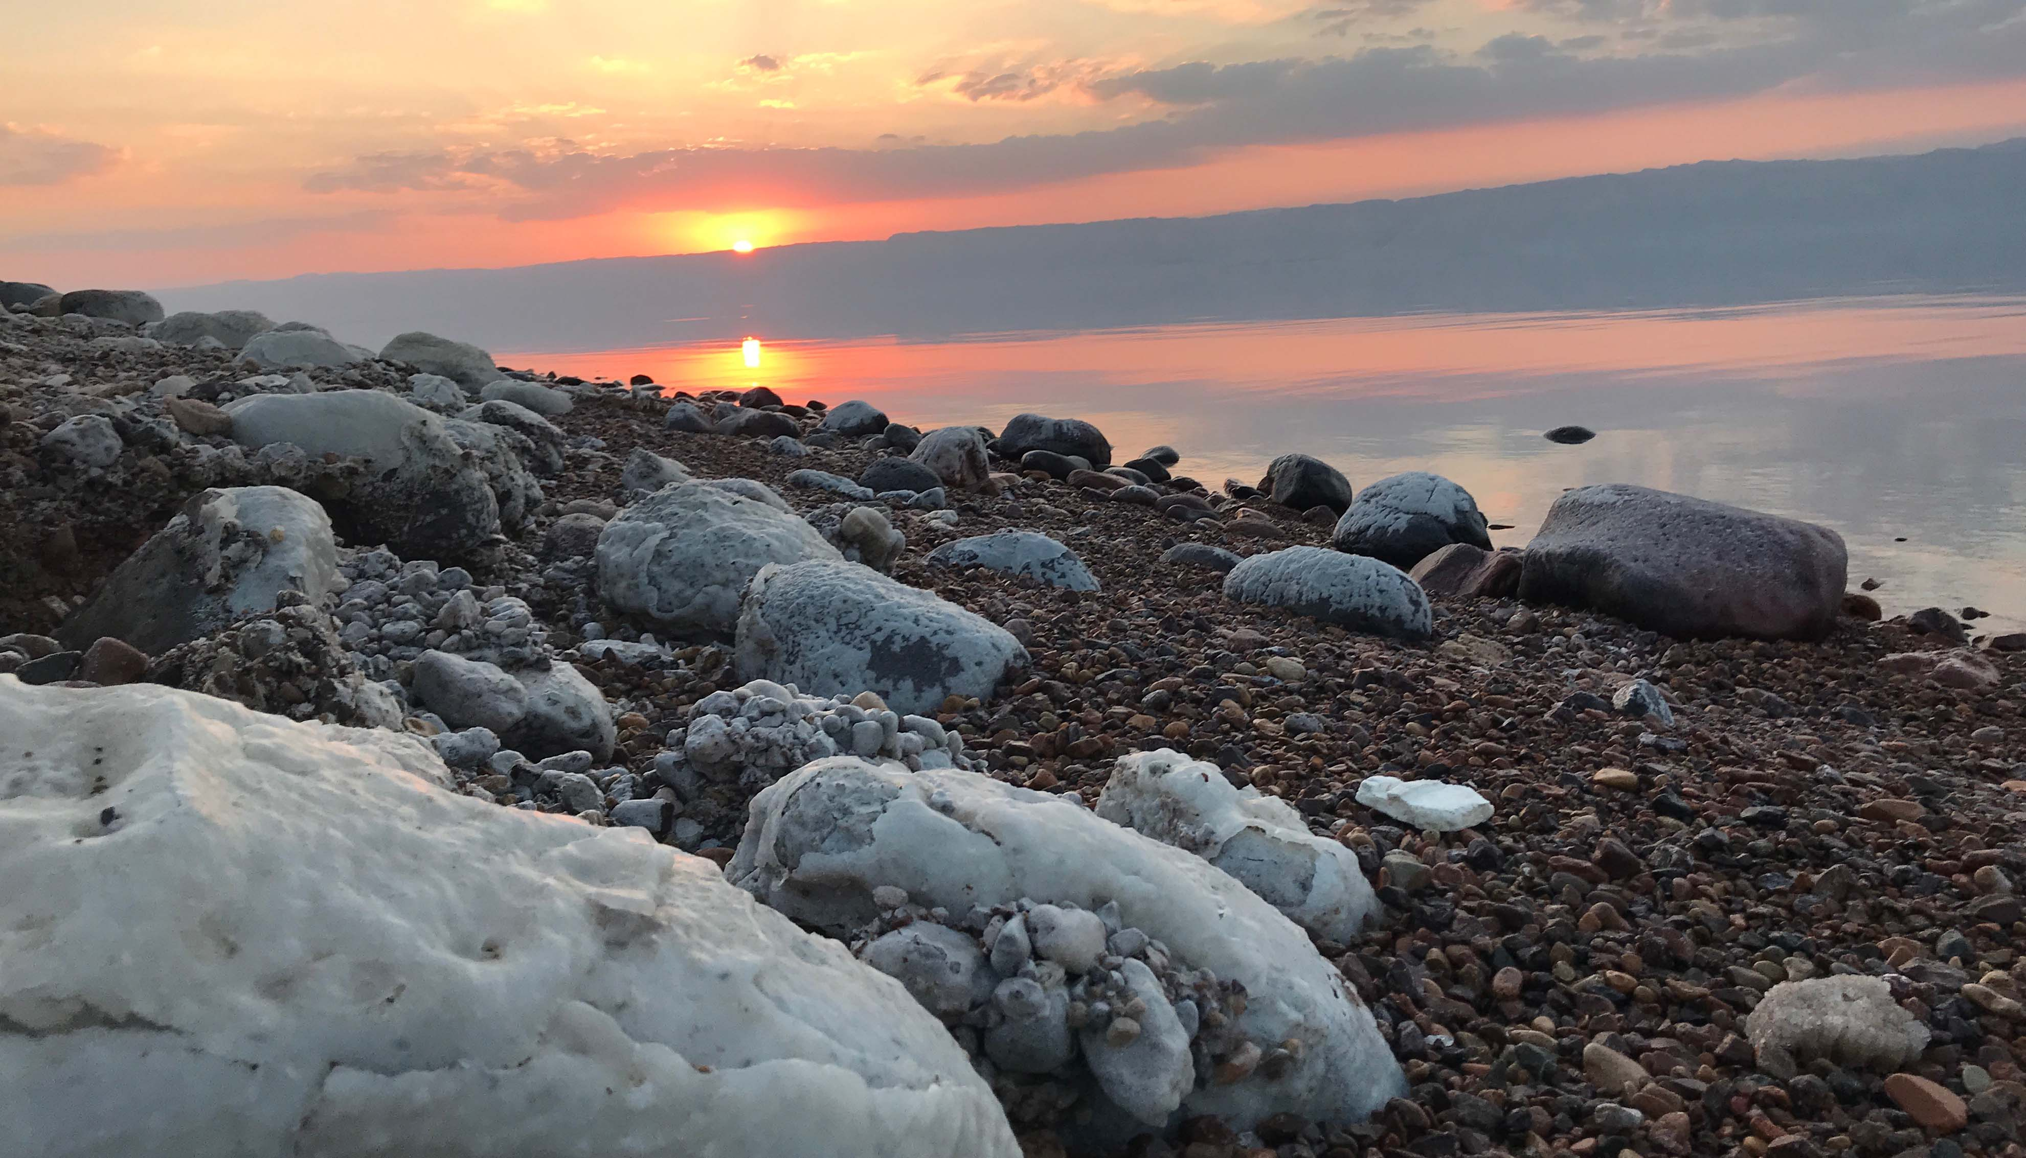
ANALYSING
Write a report advising the Jordanian Government whether or not to proceed with the Pipeline.
Use the writing frame to guide you.
www.thewaterdiaries.com

Slide 37
SAVING THE DEAD SEA
www.thewaterdiaries.com

Slide 38
The water diaries team
Temujin Doran
Fearghal O'Nuallain
Shane McGuinness
Filmmaker
Teacher | Lead
Field Scientist
www.thewaterdiaries.com

Slide 39
SUPPORTED BY
THE RGS LAND ROVER BURSARY 2017
www.thewaterdiaries.com

