Slide 1
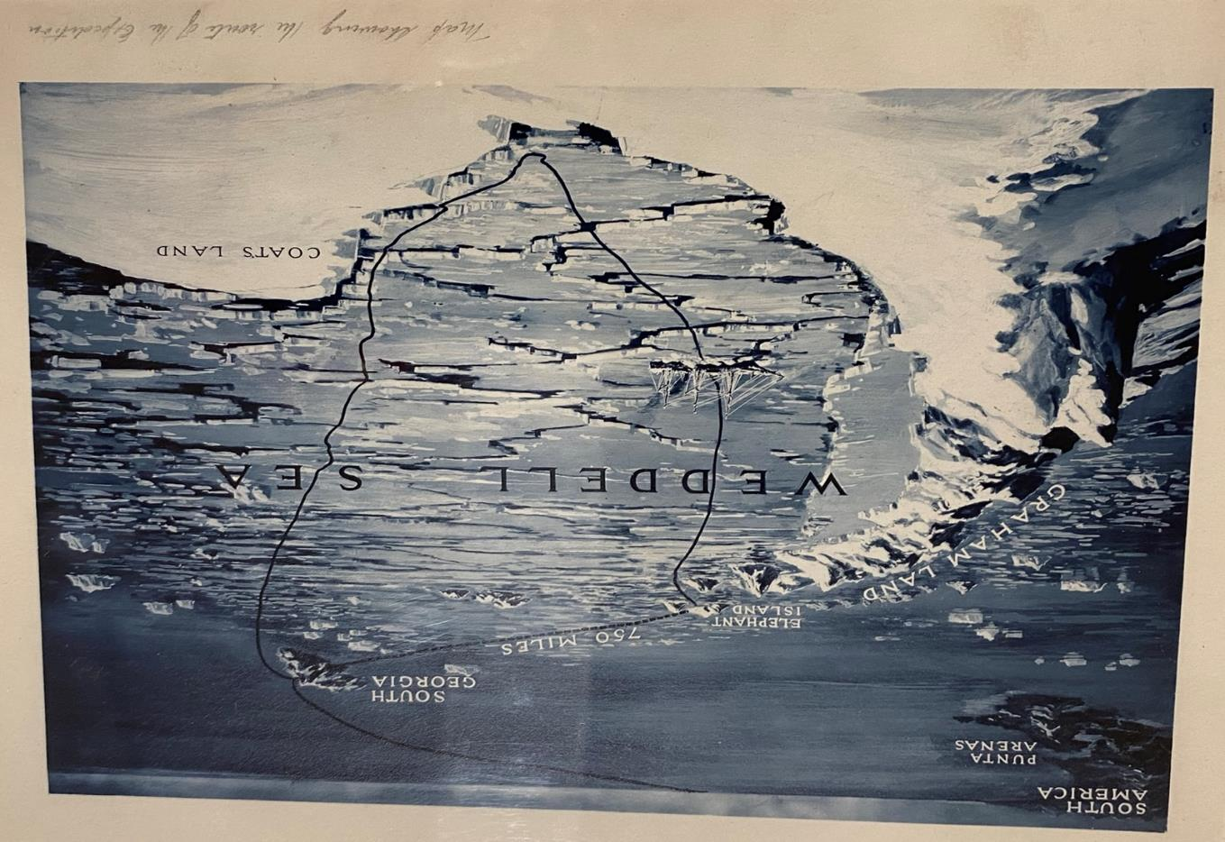
Shackleton’s Endurance
A story of adventure and leadership
All images © Royal Geographical Society

Slide 2
Contents
Page | Shackleton’s Endurance
Part 1: The Expedition | Part 1: The Expedition | Part 4: Abandon Ship!
1 | Title | 16 | Shackleton’s Birthday
2 | Contents | 17 | Keeping Busy
3 | The story so far | 18 | Abandon ship
4 | The Trans-Antarctic Expedition | 19 | Dump Camp to Ocean Camp
5 | Map of Shackleton’s planned route | 20 | Endurance lost
Part 2: The Crew and Boats |  | Part 5: Staying Alive
6 | Endurance: Who’s who | 21 | Patience Camp
7 | The Crew list: Endurance | 22 | To the lifeboats
8 | Crew from Endurance and Aurora | 23 | The James Caird
9 | The ship: Endurance | 24 | Elephant Island
10 | The Ship: Aurora | 25 | The Journey to South Georgia
Part 3: Setting Out from South Georgia |  | Part 6: Uncharted
11 | Proceed! | 26 | Boat at Sea
12 | Leaving South Georgia | 27 | Uncharted glaciers
13 | Seals! | 28 | Rescue!
14 | Pack Ice | 29 | Postscript
15 | Trapped! | 30 | Glossary

Slide 3
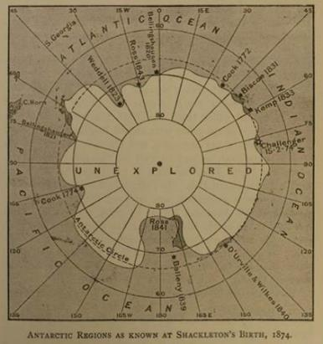
Unexplored! The Story so far.
Not much was known about Antarctica when Ernest Shackleton was born in 1874, but explorers kept going further south to find out. James Weddell, reached 74 degrees South in 1823, and in 1839, Sir James Clark Ross and his crew mapped and named the Ross Sea and Ross Ice Shelf. By this time, the race to explore Antarctica and reach the geographic South Pole first was well and truly on!
In 1901 Captain Robert Scott set sail for Ross Island. In his crew, was Ernest Shackleton, a 27- year-old merchant seaman seeking adventure and fame. After this expedition, Shackleton bought his own ship in 1907, the Nimrod, and attempted to reach the South Pole, but it was not to be. He got to within 100 miles of the prize before a lack of supplies forced him to give up. However, Shackleton returned a hero and was Knighted.
A Norwegian, Roald Amundsen was the first to reach the Pole in 1911, beating Captain Scott and his men, who died in the attempt. Shackleton decided he would have to do something else that hadn’t been done before. He announced a plan to cross the entire continent of Antarctica.
Antarctica. The coldest, windiest continent on the planet, surrounded by a raging ocean. What a challenge for explorers!
Map of Antarctic regions as known at Shackleton’s birth, 1874. From: Mill, Hugh Robert. The life of Sir Ernest Shackleton. William Heinemann, 1924, p.11.

Slide 4
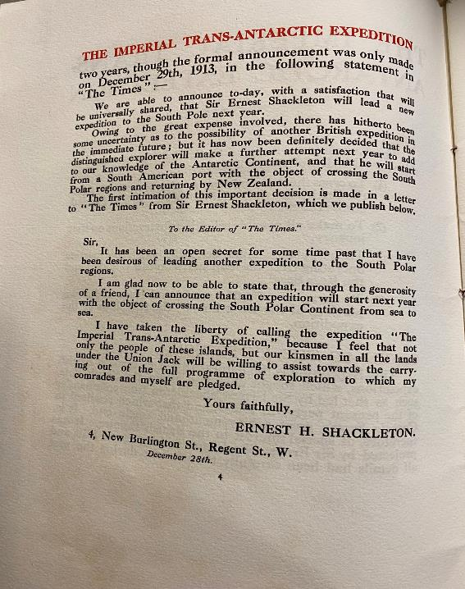
The Trans – Antarctica Expedition
An announcement was made in ‘The Times’ newspaper on December 29th 1913:
“Sir Ernest Shackleton will lead a new expedition to the South Pole next year…”
Shackleton’s Trans-Antarctic Expedition was a daring plan. His ship the Endurance, would set sail from London to arrive in Antarctica late in 1914. Shackleton would then lead a small party of men the 1800 miles across the entire continent to the Ross Sea.
Meanwhile, another ship, the Aurora, would land a separate crew on the opposite side of the continent, and that crew would travel to meet Shackleton’s men, after first setting up a series of food and equipment stashes. Both crews would then return to the Ross Sea together.
Sir Ernest Shackleton would lead, with six men, about 100 dogs and motorised sledges from Endurance.

Slide 5
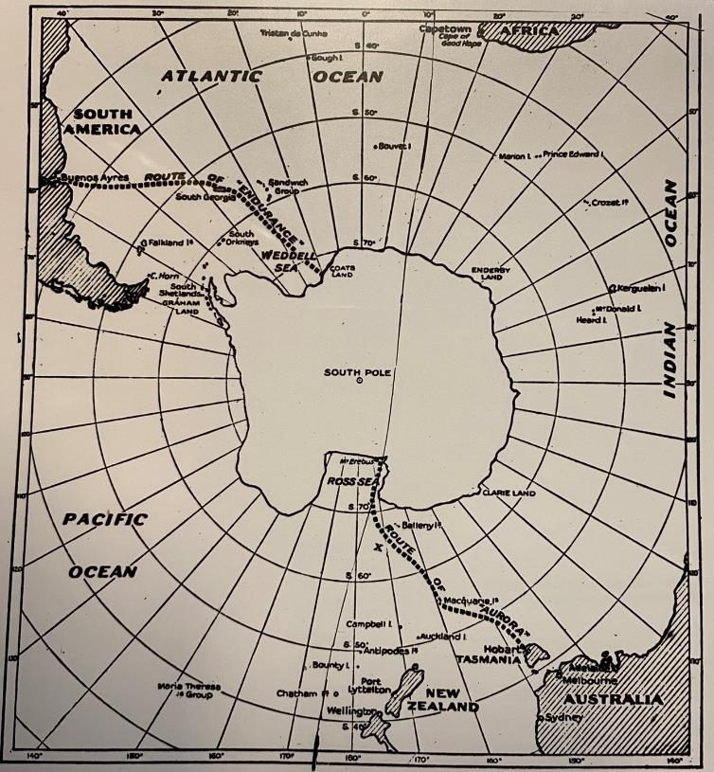
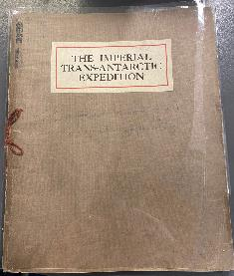
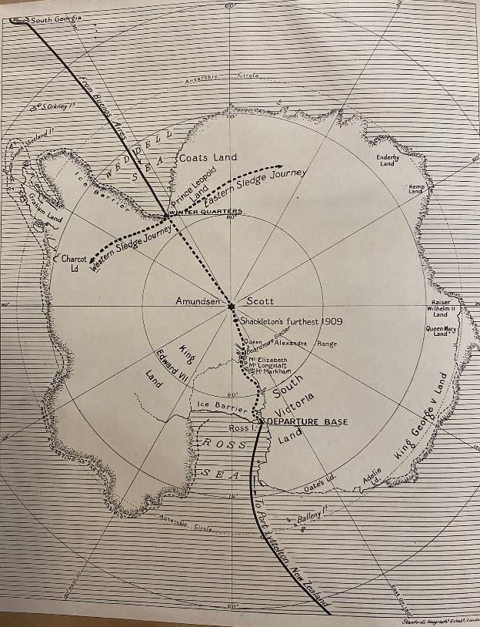
Maps showing Shackleton’s planned route across Antarctica
Map of South Pole Frank Hurley
Map from the book ‘The Imperial Trans-Antarctic Expedition’
These maps explain the routes of the Trans -Antarctic Expedition led by Sir Ernest Shackleton. The ship Endurance is to sail from South America to the Weddell Sea and the Aurora from Tasmania to the Ross Sea.

Slide 6
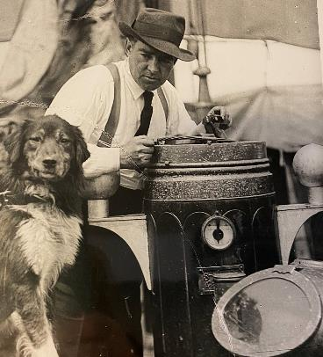
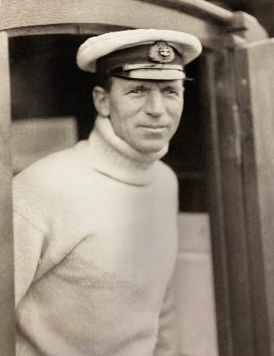
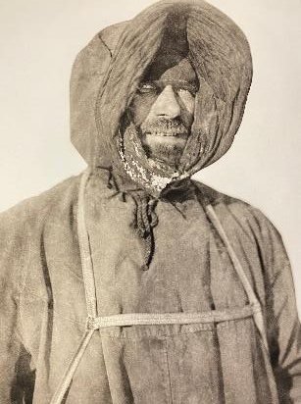
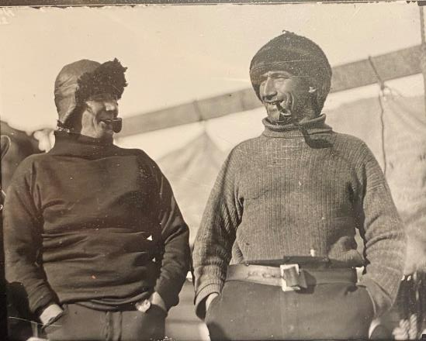
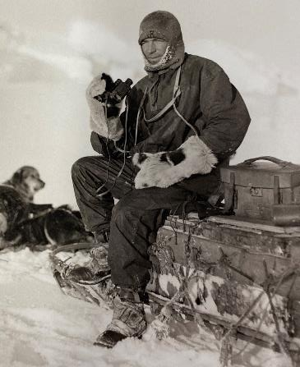
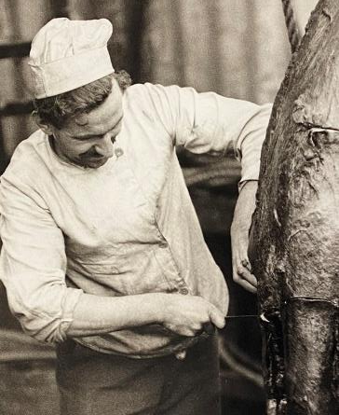
Endurance: who’s who?
Sir Ernest Shackleton
Captain Frank Worsley
Frank Wild
Frank Hurley
Charles Green
Alfred Cheetham
Tom Crean
Some members of the Endurance Crew

Slide 7
Members of the Imperial Trans-Antarctic Expedition on board the Endurance
William Bakewell, Able Seaman
Perce Blackborow, Steward
Alfred Cheetham, Third Officer
Robert Clark, Biologist
Tom Crean, Second Officer
Ernest Holness, Stoker
Walter How, Able Seaman
Charles Green, Cook
Lionel Greenstreet, First Officer
Hubert Hudson, Navigator
Frank Hurley, Photographer
Leonard Hussey, Meteorologist
Reginald James, Physicist
Alexander Kerr, Engineer
Alexander Macklin, Surgeon
George Marston, Artist
Timothy, McCarthy, Able Seaman
James Mcllroy, Surgeon
Thomas McLeod, Able Seaman
Harry ‘Chippy’ McNish, Carpenter
Thomas Orde-Lees, Motor Expert and Storekeeper
Lewis Rickinson, Engineer
Ernest Shackleton, Expedition Leader
William Stephenson, Stoker
John Vincent, Boatswain
Frank Wild, Second-in-Command
James Wordie, Geologist
Frank Worsley, Captain

Slide 8
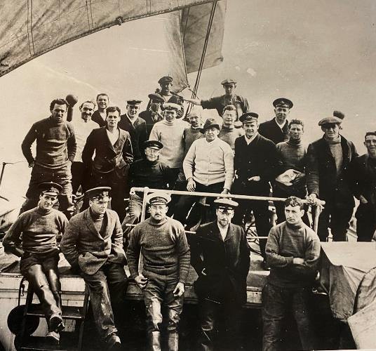
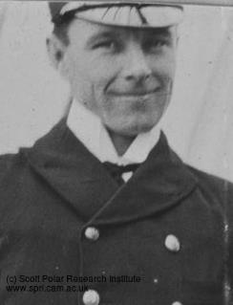
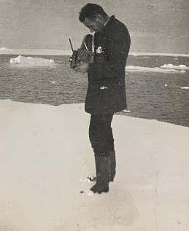
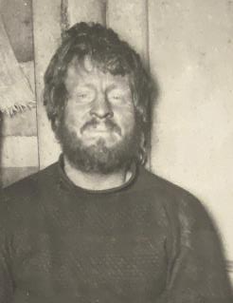
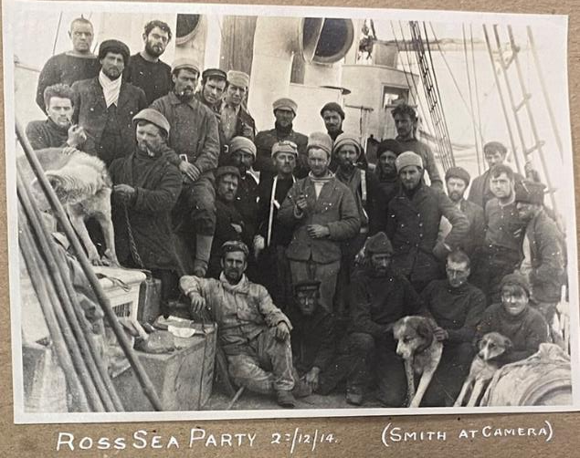
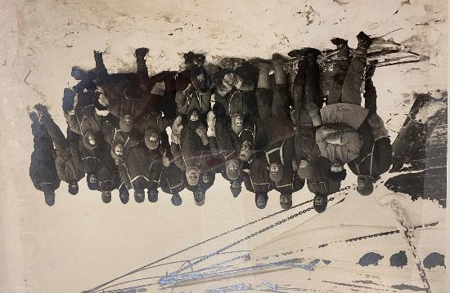
Endurance: crew
Aurora: crew
Captain Aeneas Lionel Acton Mackintosh
A.P. Spencer Smith
Shore party, Padre and Photographer
A.B. Kavanagh
Able-bodied seaman
Shackleton’s Crew on the bow of Endurance
The crew of Endurance on ice beside the ship.
The Ross Sea Party on the Aurora

Slide 9
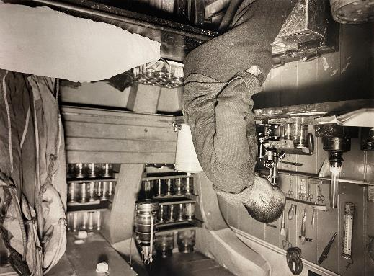
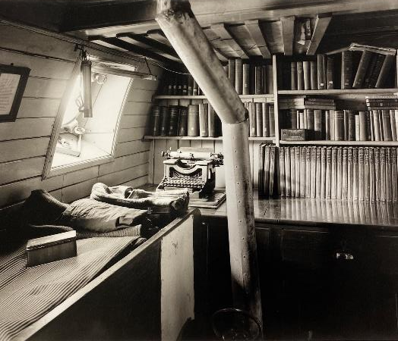
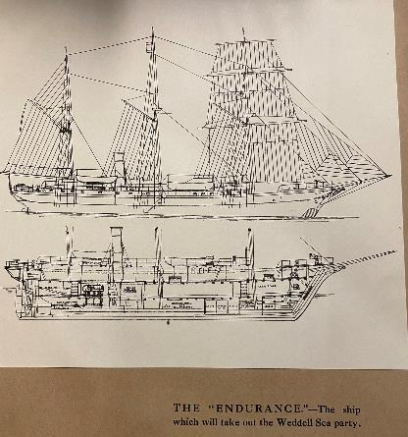
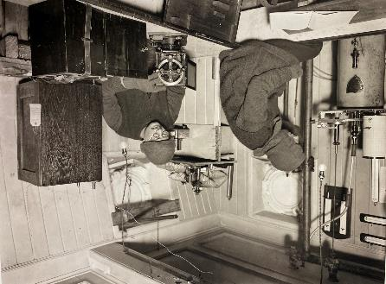
The Endurance
I was proud to sail in Endurance. They told me that Shackleton had bought the ship for £11,600 – a fortune! At that time she was called ‘Polaris’ but Shackleton rechristened her Endurance, after his family motto, "By endurance we conquer“.
The Endurance was built in Norway out of the best and sturdiest oak, pine, and greenheart. She had three masts and a coal-fired steam engine.
Clark in the biological laboratory on the Endurance March 1915
Hussey and James taking observations in ‘The Rookery’ March 1915
Endurance
Shackleton’s cabin was neat and cosy!
Shackleton’s cabin

Slide 10
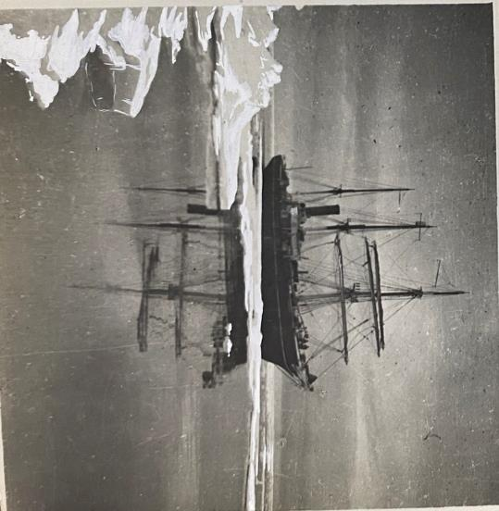
The Ships: Aurora
I never did see The Aurora but the men told me she had started life as a whaler, and had already seen service in Antarctica. Shackleton had recently bought her from the Australian explorer Douglas Mawson. Like Endurance, she was strong. Her bow was solid wood re-enforced with steel-plate armour.
The Aurora was due to leave Tasmania in the Antarctic spring of 2014, for the Ross Sea, on the opposite side of this frozen continent.
It seemed strange to think that another ship, the Aurora, was also headed for Antarctica to join us in our quest. Yet, we had no way of checking with each other how the other was doing.
Would they be successful in meeting us at the South Pole with the all important supplies? Would they be on time?
None of us knew at that time that it would be years before either of us saw home again. None of us knew what lay ahead.
The Aurora, in McMurdo Sound

Slide 11
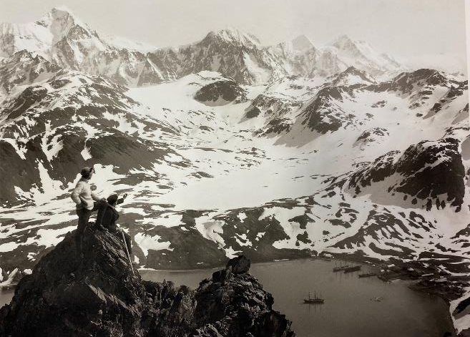
Proceed!
The ship had had left London without Shackleton, as he had business to deal with, but he was able to use a faster ship and meet us on route at Buenos Aires in Argentina.
Shackleton was not pleased at first to find out about a stowaway, and a young one at that! But I had been making myself useful carrying Hurley’s photography equipment and Green the cook said I was always willing to clean the galley. Shackleton let me stay, but also said, "If anyone has to be eaten, then you will be the first!"
It was my dream to go to sea and so I had hidden in a cupboard on board the ship.
No-one found me until we were in the middle of the Atlantic. What could they do?
Little did I know of the experiences that lay ahead.
Perce Blackborow, crewman Endurance
To think this expedition nearly stopped before it got started! World War 1 was breaking out just as Shackleton prepared to set sail from London in August 1914.
Shackleton had immediately offered his boats and crew to the navy when he got the news, but he received a single word in a telegram from the Lord of the Admiralty, Winston Churchill: ‘Proceed!’
So we did.
Worsley and Greenstreet looking over South Georgia Harbour with the Endurance and Grytviken below. 13th November 1914

Slide 12
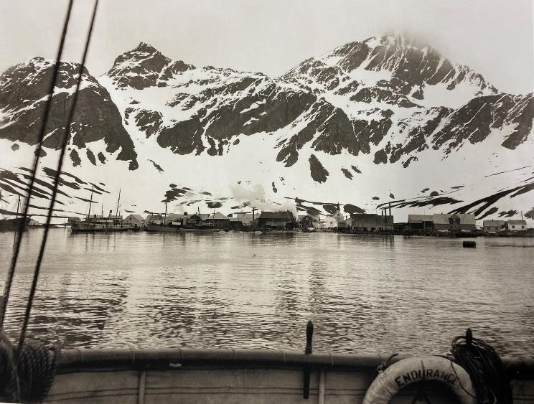
Leaving South Georgia 5th December 1914
Ship of Fools
We are those fools who could not rest In the dull earth we left behind, But burned with passion for the South And drank a frenzy from its wind; The world where small men live at ease Fades from our unregretful eyes, And blind across uncharted seas We stagger on our enterprise.
St. John Lucas
Grytviken Whaling Station from the Endurance November 1914
We left South Georgia early on the morning of December 5th 1914, for the Weddell Sea. The wind was biting and snow flurries danced about our heads. The whalers had warned Shackleton that the ice was unusually far north that season but he didn’t seem worried. He read the Ship of Fools, one of his favourite poems, as we left - changing the word ‘West’ to ‘South’ to make it better suit our plans.

Slide 13
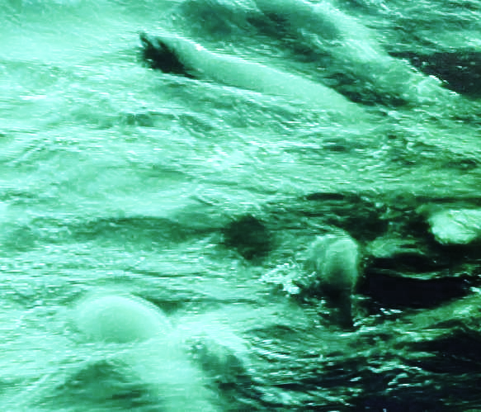
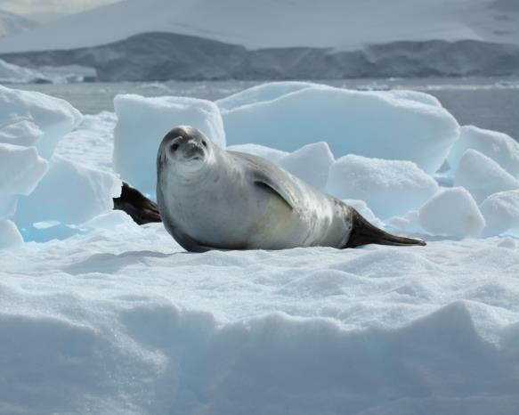
Seals!
Leaving South Georgia behind, we noticed the dip in temperatures. It was colder than I was expecting but the crew didn’t seem concerned, just watchful. Today we had unexpected excitement. The sea seemed alive with movement! Crab-eater seals were migrating north - to warmer waters, the men said.
What did the seals know that we didn’t?
Hurley had his camera set up and was filming them as they surged past us. I heard Clark, the biologist, tell him they liked to eat krill rather than crabs and there was laughter. Their appearance made us all smile, but it was unusual too. I wondered secretly if it was a portent, a sign of danger ahead.
Crab eater Seal. There are about 8 million Crab eater seals and they live for about 40 years. They can swim up to 25km/hour and are about 2 to 2.5 metres long.
https://www.flickr.com/photos/liamq
Crabeater Seal - Facts, Diet, Habitat & Pictures on Animalia.bio

Slide 14
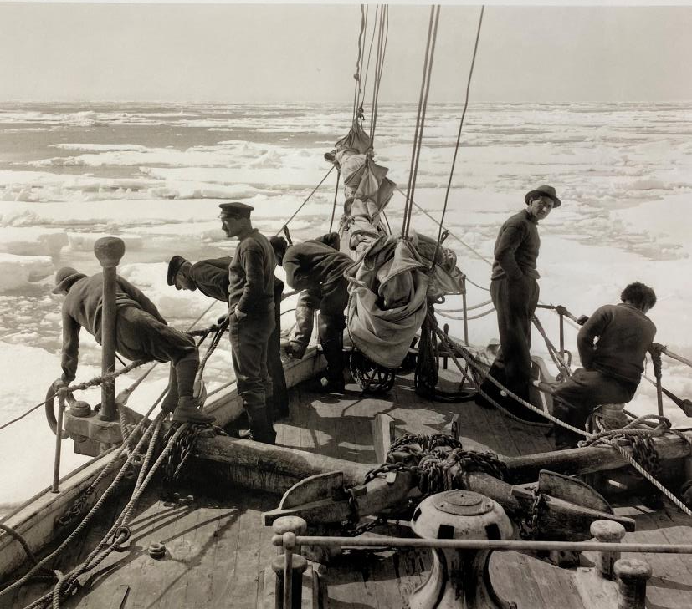
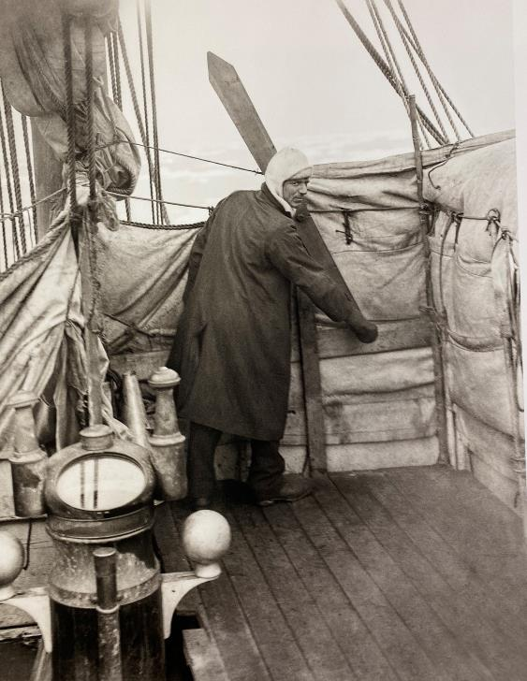
Pack Ice
On the bow of the Endurance entering the polar sea 11th December 1914
Worsley directing helmsmen through ice December 1914
The whalers were right. There was more ice than we expected to find at this time of year. We were in the Antarctic summer. Our progress in the Weddell Sea became slower and slower. Shackleton himself would get up in the crows’ nest, giving directions with Worsley, who would use semaphore to tell the helmsman where to steer.

Slide 15
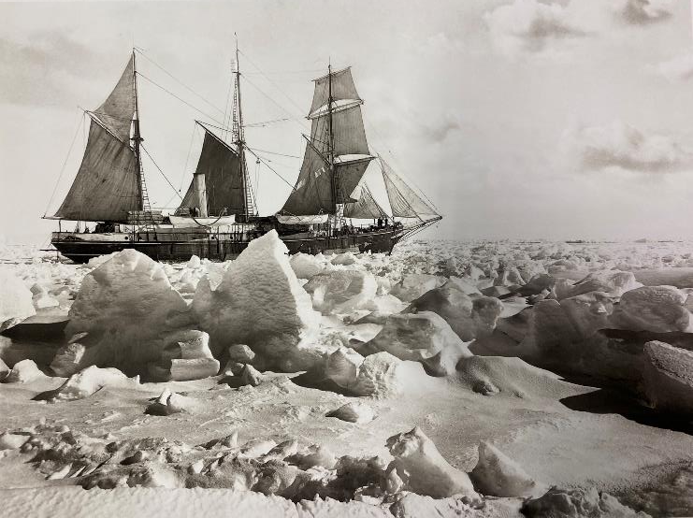
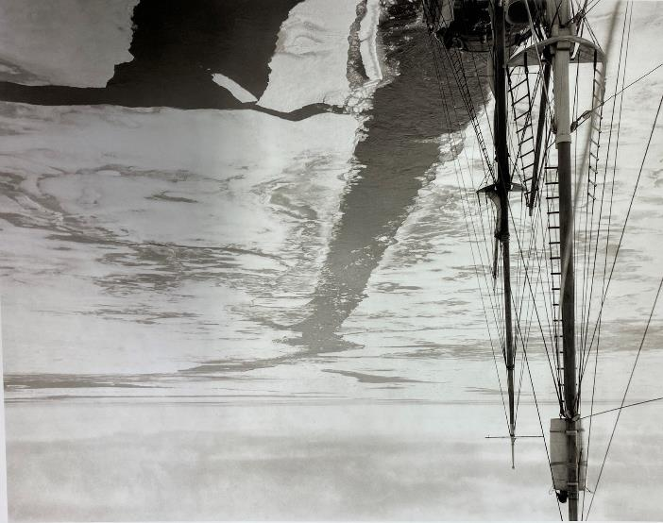
Trapped!
Mast of the Endurance with the wake of the ship through a field of young ice 24th January 1915
Endurance in full sail in the ice, 25th January 1915
By January 1915 we had slowed nearly to a halt, despite the best navigational efforts of Captain Worsley. Winter was not far away, and we knew we had long hours of darkness ahead to prepare for. Everyway we looked there was sea ice and the Boss, that’s what we called Shackleton, was worried about growlers too. These were tiny icebergs that could still do lots of damage to our ship. The wind blew the frozen ice relentlessly towards Endurance. We were trapped!

Slide 16
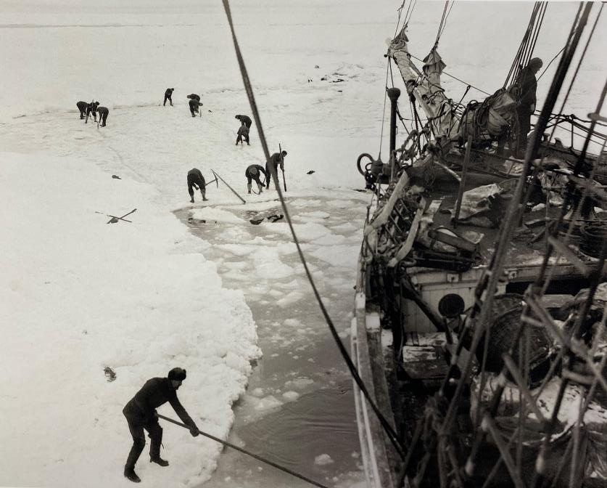
Shackleton’s Birthday
15th February was Shackleton’s birthday but there was little to celebrate. We all worked around the clock for nearly 48 hours battling with a ‘lead’ or open channel in the ice, using saws and poles to try and free Endurance. But it was in vain the ship was not going anywhere. Shackleton had a plan. He said we should just turn Endurance into a winter station until the spring returned. We started to prepare for the winter months ahead.
The floating ice that surrounds Antarctica grows and shrinks with the seasons.
The ice grows most in the height of the Antarctic winter between July and September.
The ice shrinks during the Antarctic summer, reaching its smallest size by January to March.
Cutting the ice around Endurance 14th – 15th February 1915

Slide 17
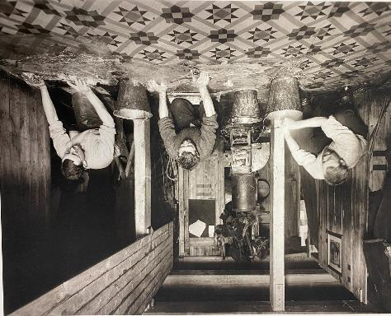
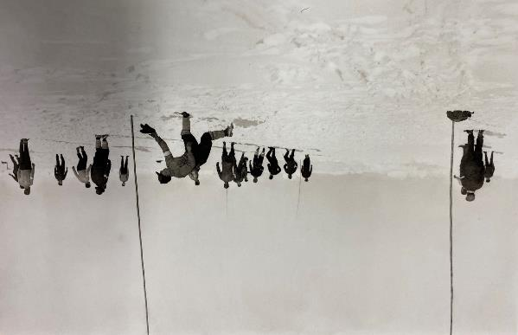
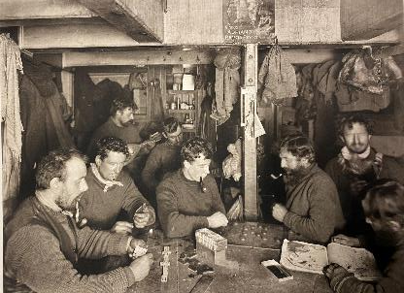
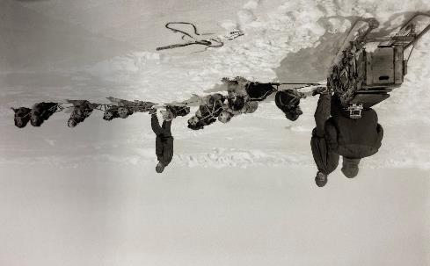
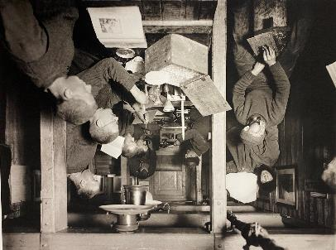
Keeping Busy
Always something to do!
Wordie Cheetham and Macklin washing the galley floor of ‘The Ritz’ March 1915
Soccer game during a ‘hold up’ Worsley in goal.
16 February 1915
Scrubbing floors
Playing soccer
A full dog team 11th April 1915
Men playing games and reading an atlas. Winter 1915.
A morning in ‘The Ritz’ on board Endurance in midwinter June 1915
Exercising dogs
Playing Board Games
Cleaning equipment

Slide 18
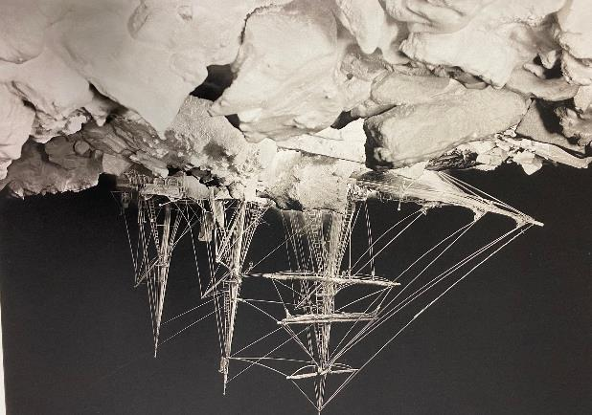
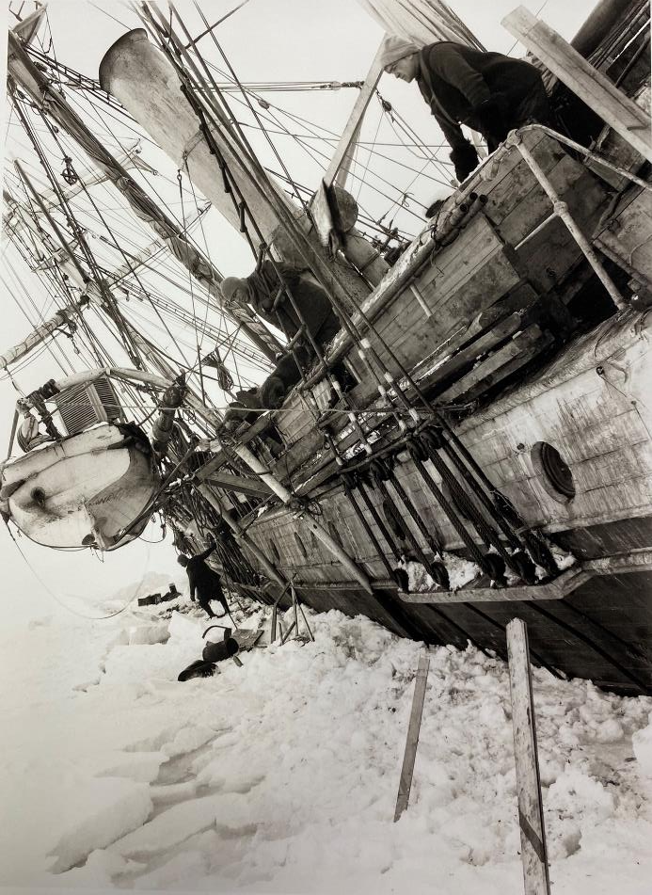
Abandon Ship! 27th October 1915
Endurance beset by pack ice during the polar night 27th August 1915
Slowly, we began to realise that Endurance might not survive the ordeal of being crushed by the ice. As that terrible ice pushed inwards, it splintered the boat’s sides, and pierced the hull with noises I never wish to hear again. It sent shivers down my spine.
One night it was all too much for Endurance. Water began to seep in and flood the lower decks. It was time to abandon ship!
Shackleton leaning over the side of the Endurance, keeled over by ice pressure between 13th and 18th October 1915

Slide 19
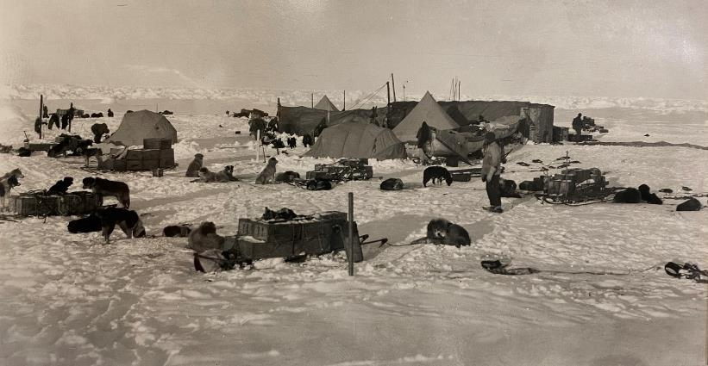
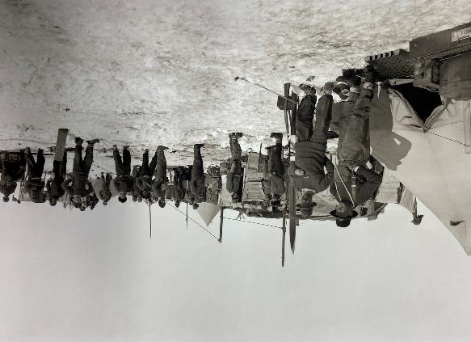
Dump Camp to Ocean Camp
We had to move quickly. The groans and creaks from our dying ship meant our supplies were at risk. First, we got the dogs off to the safety of the ice floe, sliding them down large tarpaulin sheets that we stretched over the side. Then came the food and boxes of equipment, including canvas tents, and the all important life boats. What a mess!
We called this ‘Dump Camp’ for obvious reasons but the floe was unstable. Shackleton made us march further to find ice that was safe enough to make a longer lasting camp. We dragged the heavy lifeboats on top of adapted sledges.
We were on ice that was drifting at the mercy of the wind and currents. We were exhausted. We were also about 500 miles away from the nearest possibility of help. This new base was named ‘Ocean Camp’.

Slide 20
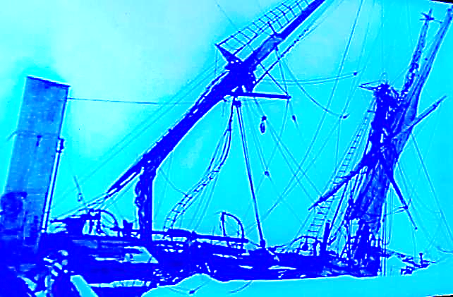
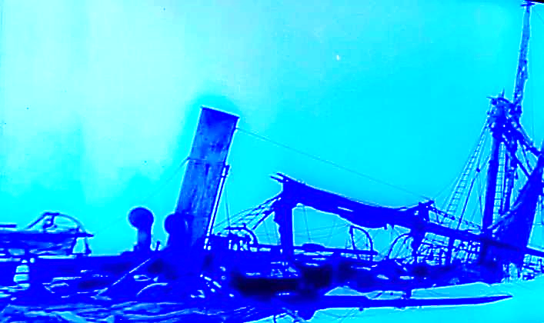
Endurance Lost! 21st November 1915
Today we watched with a terrible sadness and disbelief as, with a last wretched crack and groan, our beloved ship Endurance was swallowed up into the icy, ocean depths. I watched the awful spectacle with Hurley as he spent hours filming the collapse with his camera. He had even dived into the icy depths of the ship to rescue some of his film canisters.
I wondered if I would ever see home again! It was scary to think we were stuck and no idea how we would ever find a way out. Shackleton was busy giving orders and already planning what to do next. He was calm and this gave us hope.

Slide 21
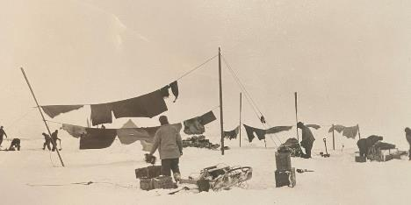
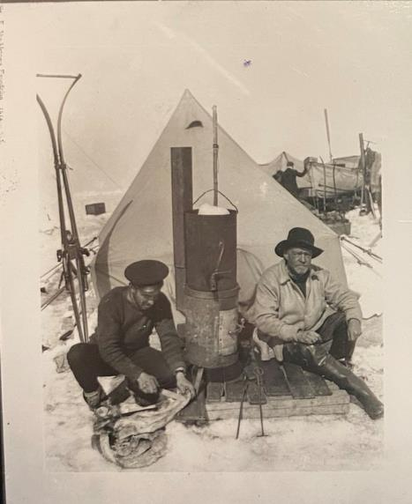
Patience Camp
At Ocean camp, we had hunted seal or penguin everyday, eating the dried dog food or ‘pemmican’ ourselves and giving the dogs seal meat. The seal blubber was used as fuel for our stoves. The dogs had three hours of exercise every day and there were always jobs to be done. The days passed and Shackleton kept us all busy.
But as Christmas Day got closer, the ice began to melt and Shackleton said we should drag the boats further west, as far as we could manage on the ice, ready to put them into the water when the ice disappeared.
After a painful, seven day march covering only about seven miles, we set up Patience Camp.
The sea current was still gradually taking us eastward towards Elephant island. This would be where we would try to get to when the ice melted.
Washing day at Patience camp
Shackleton and Hurley Patience Camp

Slide 22
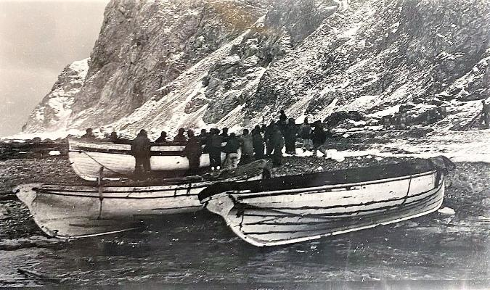
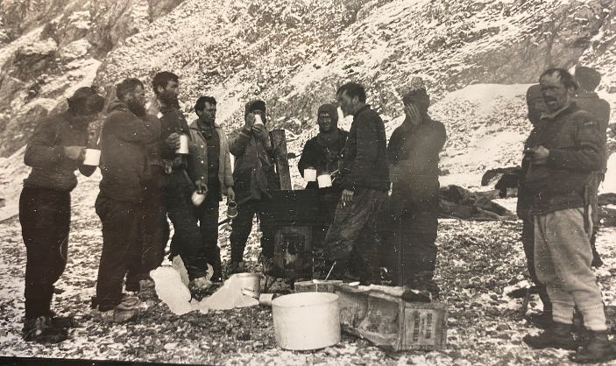
To the Lifeboats! 9th April 1916
The ice floes began to split up and it was time to risk putting the tiny lifeboats into the dangerous waters of the Weddell Sea again.
I can’t put into words what an ordeal that was. I didn’t know that things could get even worse.
Five days adrift in temperatures of -30 degrees.
Terrible winds and monster waves.
Thirsty, hungry, cold and scared.
Getting to Elephant island in these conditions seemed madness. But we made it. All of us. We had solid ground beneath our feet again for the first time since leaving South Georgia on December 5th 1914. But it wasn’t home.
Crew unloading the James Caird, Dudley Docker and Stancomb Wills at Cape Valentine, Elephant island.
First hot food and drink for three and a half days

Slide 23
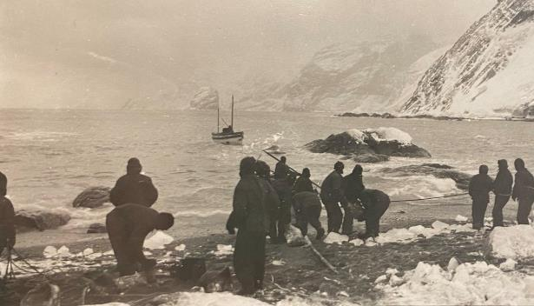
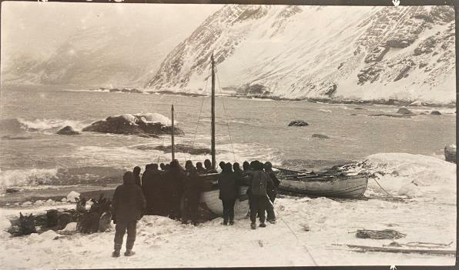
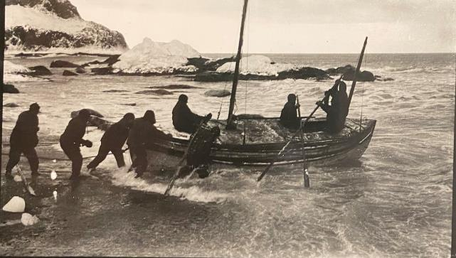
The James Caird 24th April 1916
Loading the James Caird with shingles and boulders for ballast.
Loading the James Caird
Shackleton knew some of us had to try and leave the island to get help. Could we navigate nearly 800 miles to find the island of South Georgia in an enormous ocean? Captain Worsley would need all his navigational skills.
So, Shackleton and five others us prepared to set sail against the odds, in one of the tiny 22 foot long lifeboats. The weather and visibility was atrocious. The sleeping bags were mouldy and they would to sleep on rock used as ballast.
Launching the James Caird

Slide 24
Elephant Island
Lifeboats used as shelter on Elephant Island
The 20 Members of the crew of the Endurance left behind on Elephant Island.
With Shackleton and the rest of the crew gone to find South Georgia, we built a shelter from the two lifeboats left behind.
We watched, hoping to see a rescue ship on the horizon, praying that hope would come.
Penguins

Slide 25
‘Boat at Sea’ A painting by George Marsden

Slide 26
The journey to South Georgia 24th April 2016
Winter was in the air and the light was fading as Shackleton put to sea in the James Caird with supplies for just four weeks.
The crew of the James Caird took it in turn to do shifts at the helm, battling enormous waves and freezing seas. When the clouds parted, which they seldom did, Worsley used the navigational skill called ‘dead reckoning’ using the stars and calculating how much distance and time had passed.
They were thirsty, frostbitten, hungry and so exhausted.
Painting by George Marston of the James Caird landing at South Georgia.
After two terrible weeks at sea South Georgia came into sight: rocky, dangerous, and with towering glaciers. They needed the safety of the harbour at the other end of the island but had to make land as soon as possible. Any hope of safety was 32 miles over uncharted mountains and glaciers.

Slide 27
Uncharted Glaciers
The last leg of our journey. Shackleton urged his companion on though they needed more sleep.
They had no map and were tired to the bone but Shackleton kept them going, and allowed us only a few minutes sleep in 24 hours.
At last! They heard the sirens and sounds before they spotted the people and buildings of Stromness, a whaling station. Shackleton paused to shake the hands of his crewmen before they made their final descent to safety.
Grytviken Harbour, South Georgia. 13th November 1914

Slide 28
Rescue! 30th August 1916
Shackleton returned to Elephant Island on ‘The Yelcho’. Was it too late? Would the rest of his 24 men still be alive?
As Elephant island came into view, there were lots of waving hands. We broke into big grins the Boss and arrived to cheers. He called out "Are you all well?" Wild replied "We are all well, Boss"
Cheering the relief boat, Elephant Island
The crew leave Elephant Island
After more than two years, we were going home! Every man returned safely. We had followed Shackleton to the ends of the earth and he had led us back.
About to rescue the crew from Elephant Island

Slide 29
After the rescue
January 10th 1917
More than four months after Ernest Shackleton had rescued the Endurance’s crew from Elephant Island, Shackleton arrived at Cape Royds, Antarctica, to save the stranded men of the Aurora.
September 1921
Shackleton set sail again four years later as Commander of a new Antarctic expedition. But a few months later he had a fatal heart attack at sea and was then buried at Grytviken, South Georgia.
Shackleton’s leadership and his feat of getting all his crew home safely, made him a legend.
On the 5th February 2022, expedition ‘Endurance22’ set out from Cape Town aboard the SA Agulhas II to search for the final resting place of the wreck of Shackleton’s ship ‘Endurance’.

Slide 30
Antarctic Circle | The parallel of latitude 66° 33ʹ south of the equator. It marks the southernmost point at which the sun is visible on the southern winter solstice and the northernmost point at which the midnight sun can be seen on the southern summer solstice.
astern | towards the rear of a ship.
bow | the front end of a ship.
continent | a large block of land, sometimes made up of several countries.
crow’s nest | a structure in the upper part of a ship and used as a lookout point.
endurance | being able to withstand hardship.
galley | the part of a ship where food is prepared and cooked.
glacier | a large amount of ice that moves down a slope under its own weight.
growler | a mini-iceberg.
gyre | a system of rotating ocean currents.
helmsman | the person who steers a boat or ship.
hull | the watertight enclosure of a ship.
hummock | a small mound above the ground.
ice floe | a usually large, flat piece of floating sea-ice.
ice shelf | a large floating platform of ice that forms where a glacier or ice sheet flows down to a coastline and onto the ocean surface.
iceberg | a large piece of freshwater ice that has broken off a glacier or ice-shelf and is floating in open water.
mast | a vertical pole that rises from a ship and supports the sails.
pemmican | a mixture of dried meat and sometimes berries.
port | left side of the ship when looking forward towards the bow.
portent | a sign or omen that something is going to happen
semaphore | a way of signalling, sometimes with flags or lights
starboard | right side of a ship when looking forward towards the bow.
stowaway | someone who hides on a ship in order to travel.
whaler | a ship or sailor engaged in whaling, fishing for whales.

Slide 31
Ernest Shackleton 15.2.1874 – 5.1.1922
“For scientific leadership, give me Scott. For swift and efficient travel, Amundsen. But when you are in a hopeless situation, when there seems no way out, get on your knees and pray for Shackleton.”
Raymond Priestley, Arctic explorer and scientist
The story is true and is taken from the evidence of diaries and journals as well as the accounts from the crew on their return.
Frank Hurley documented the journey with his photographs and films and all the above photographs are his work unless otherwise stated.
There was a stowaway discovered during the journey, Perce Blackborow and Shackleton allowed him to stay on board and become a steward during the voyage.
The first person narration of the voyage of Endurance has been provided to allow primary pupils to more easily access the expedition’s events.

