Slide 1
Matthew Williams – Old Swinford Hospital School.
Ethical-Global-Issues-English.pdf (mmu.ac.uk)

Slide 2
Context
HEADSUP aims to “support people with the on-going wrestling with concepts and contexts, choices and implications, that we face every day as teachers and learners working towards deeper and more ethical ways of relating to others and to the world” (Andreotti, 2012, p. 3).
Ethical-Global-Issues-English.pdf (mmu.ac.uk)

Slide 3
Resource Development
Ethical-Global-Issues-English.pdf (mmu.ac.uk)

Slide 4
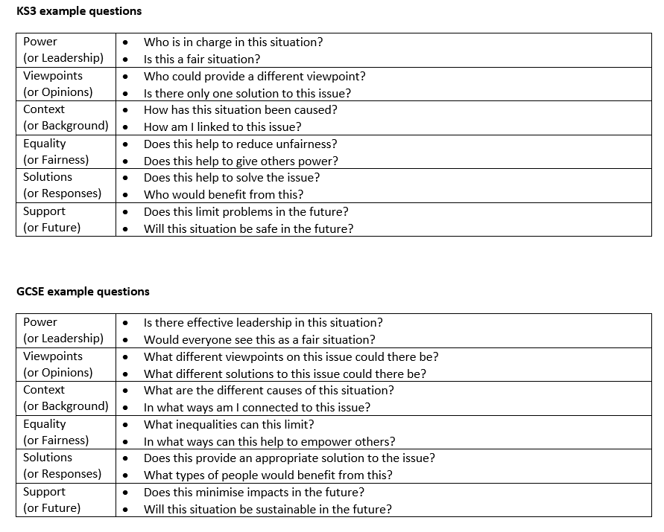
Resource Development
Ethical-Global-Issues-English.pdf (mmu.ac.uk)

Slide 5
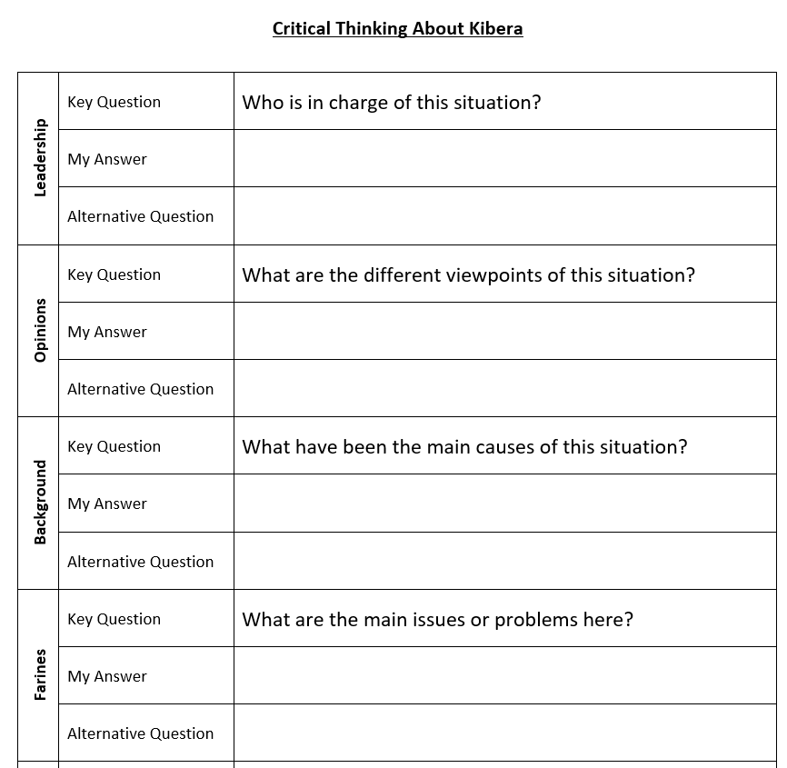
Resource Development
Ethical-Global-Issues-English.pdf (mmu.ac.uk)

Slide 6
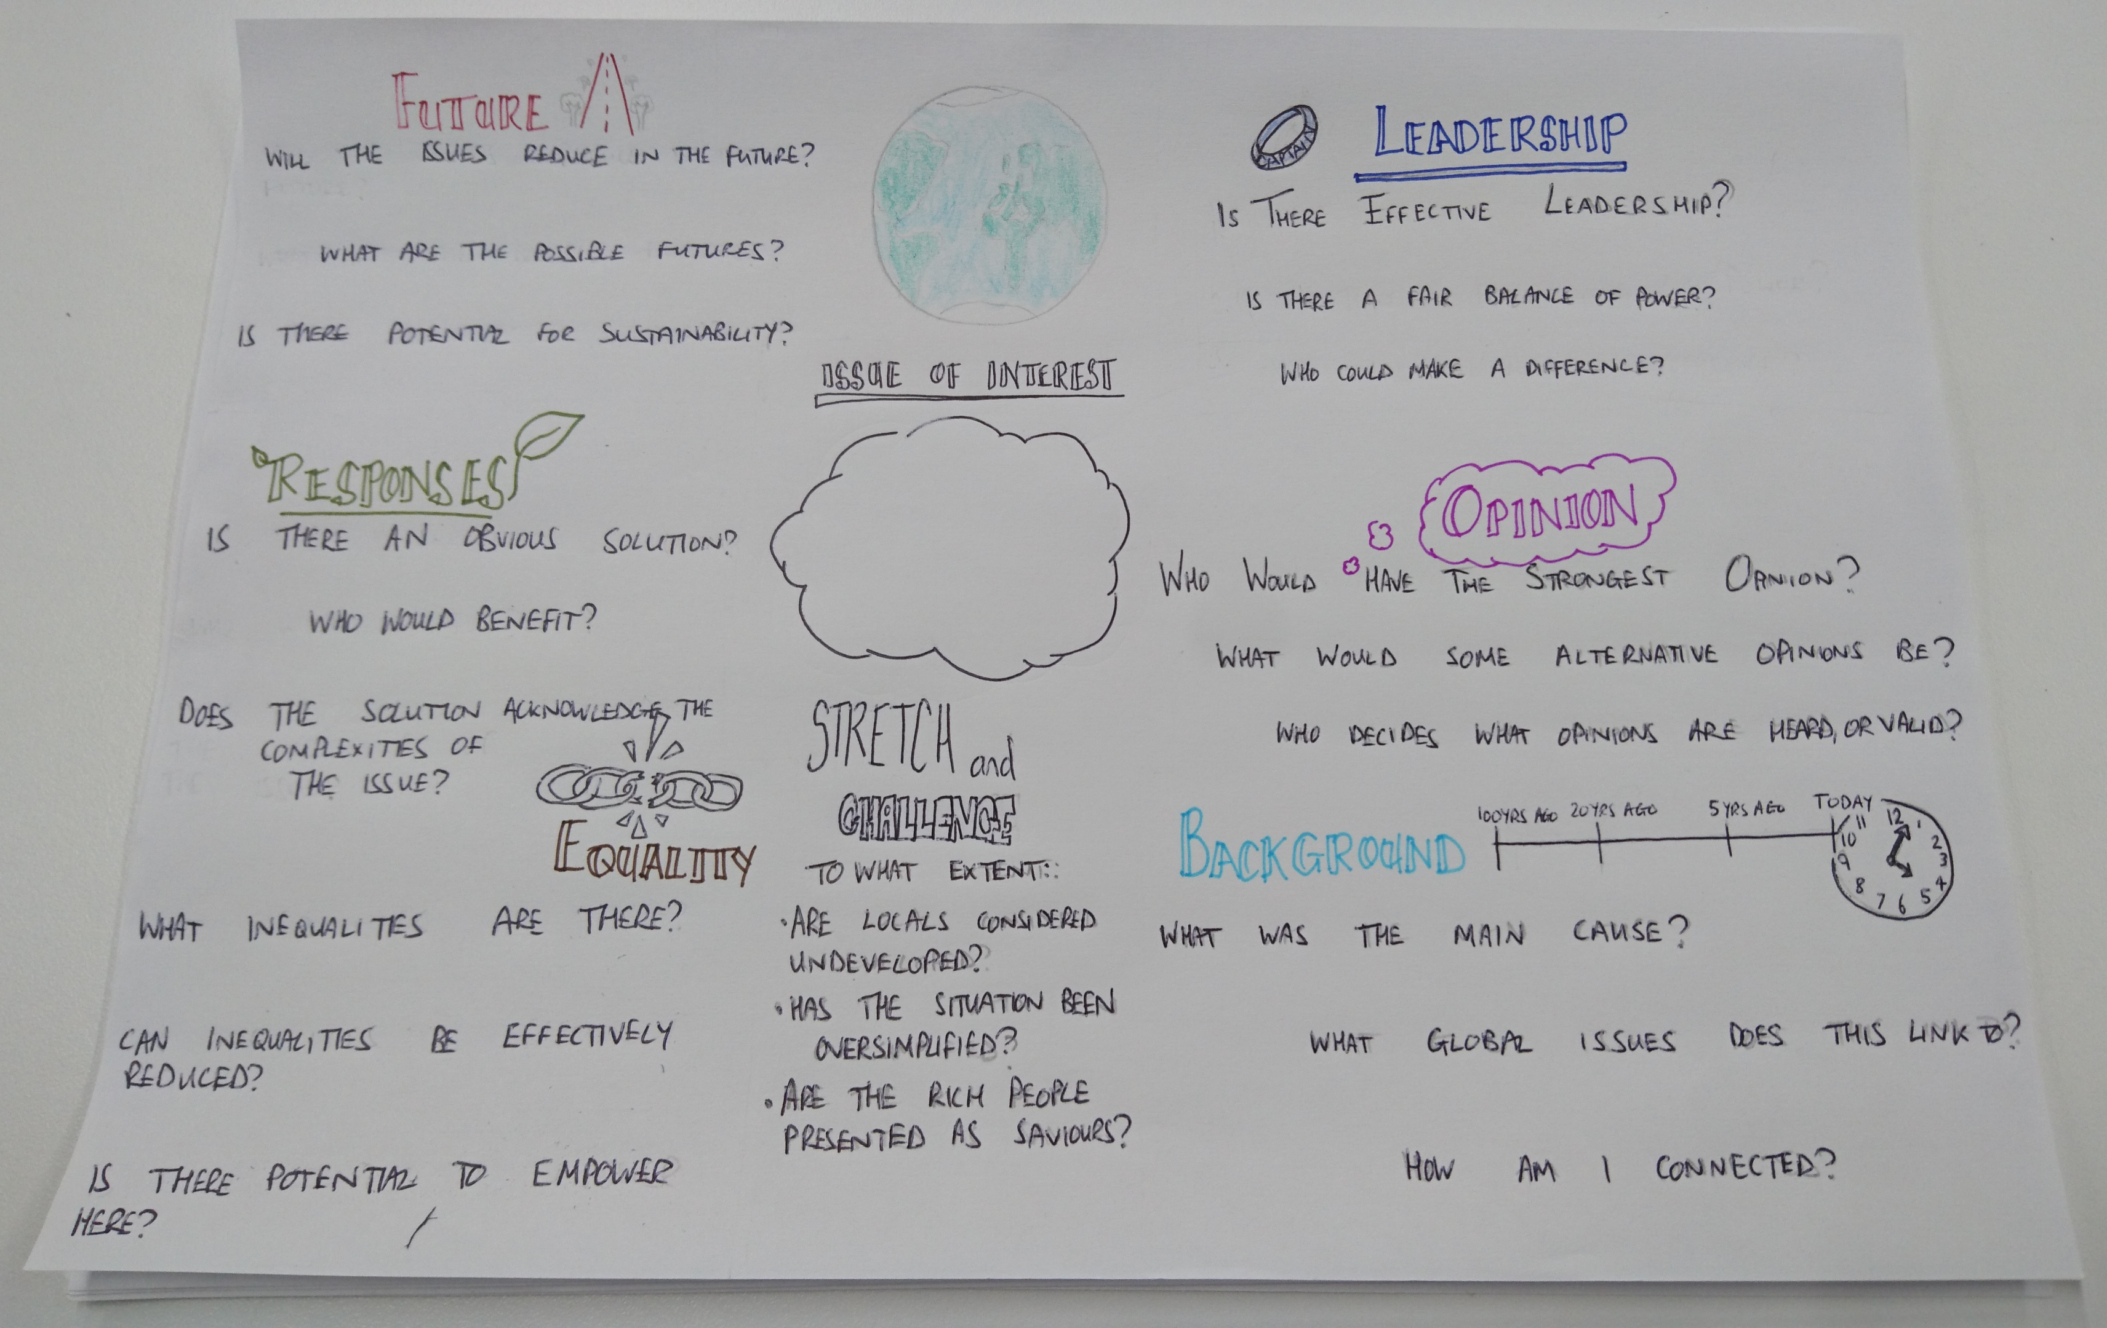
Resource Development
Ethical-Global-Issues-English.pdf (mmu.ac.uk)

Slide 7
Resource Access and Use
Ethical-Global-Issues-English.pdf (mmu.ac.uk)

Slide 8
Resource Access and Use
Ethical-Global-Issues-English.pdf (mmu.ac.uk)

Slide 9
Resource Application Examples
Applied examples
Squatter settlements (KS3)
Migration in the Mediterranean (A level)
LIC debt and aid (GCSE)
Sweatshops (KS3)
Rio urban issues (GCSE)
Skills developed
Critical thinking and problem solving.
Empathy.
Speaking and Listening.
An enhanced understanding of globalisation, interdependence, equality, justice and sustainability.
Ethical-Global-Issues-English.pdf (mmu.ac.uk)

Slide 10
Ongoing Work
International trials are being run in Canada, Finland, Sweden and England.
The project is being refined and developed based on ongoing feedback, as well as application of examples.
Get in contact with Dr Karen Pashby if you would like further information (K.Pashby@mmu.ac.uk)
Ethical-Global-Issues-English.pdf (mmu.ac.uk)

