Slide 1
Colouring London
Sense of place
KS5
Lesson

Slide 2
Colouring London
Colouring London aims to collect information on every building in London, to help make the city more sustainable.
It provides information about your local area
https://colouringlondon.org/

Slide 3
Colouring London data collection
Colouring London would like to collect
Location
Land use
Type
Age
Size & Shape
Construction
Streetscape
Team
https://www.pages.colouring.london/buildingcategories
Notes:
Detailed information about how to collect information is available on https://www.pages.colouring.london/buildingcategories

Slide 4
Sense of place
There is a wide range of data publicly available that geographers can use to gain an understanding or sense of place.
For example:
The population characteristics of a ward https://www.nomisweb.co.uk/
The age of the existing housing stock
https://maps.cdrc.ac.uk/#/metrics/dwellingage/default/
Crime rates
https://www.police.uk/ Find your neighbourhood

Slide 5
How can Colouring London be used?
Colouring London is a free knowledge exchange platform, designed by
University College London to collate, collect, generate, visualise, and make accessible, around fifty categories of statistical data, for every building in London.
These can help to gain a sense of place for an area.

Slide 6
Representing place
Geo-located data can be used to examine changes through time or can be used to represent place. Mapping the building age, type and its use can offer an immediate sense of place and allow a place to be represented.

Slide 7
Comparing data
It could also provide an opportunity for data comparison.
For example, do the buildings in a local area meet the needs of the local population?
Mapping the building age, type and use and whether that building is being used as a community asset could be compared with interview/questionnaire data about whether the community feel that they are well provided for.

Slide 8
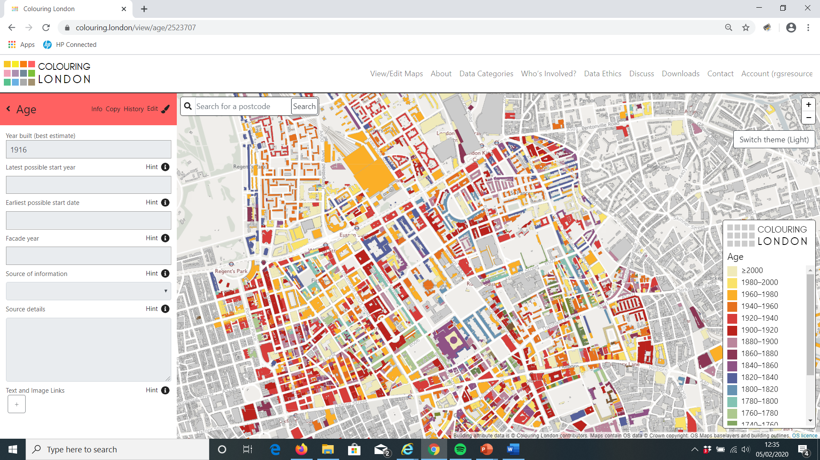
Example – Euston Square, London

Slide 9
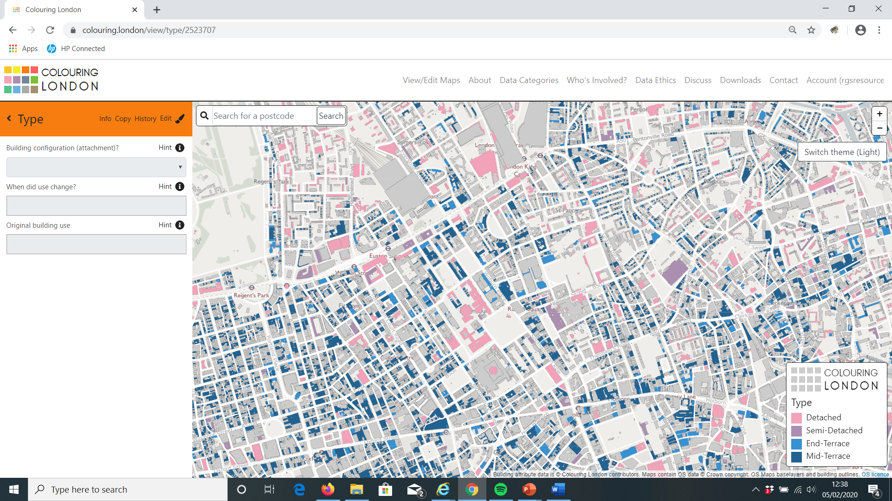
Example – Euston Square, London

Slide 10
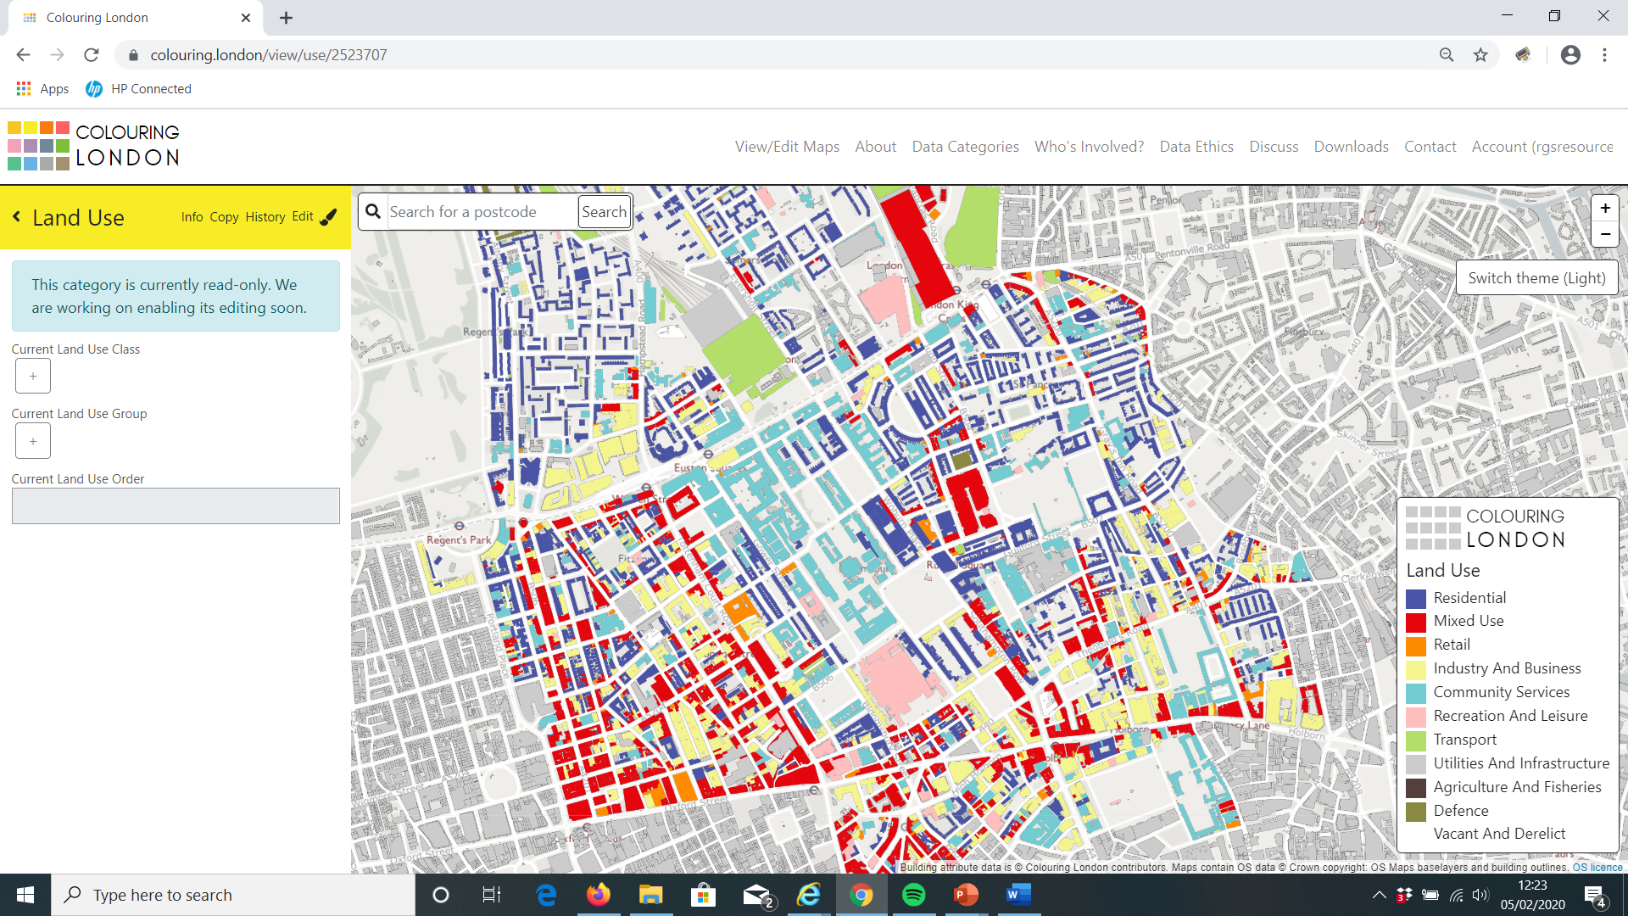
Example – Euston Square, London

Slide 11
Example – Euston Square, London
The maps can then be compared with data collected from interviews/questionnaires where semi-structured questions such as ‘How many times have you visited the British Museum in the last year? Never, once or more than once.
Data could be compared with distance travelled to use the community asset. For example, many of the buildings coloured turquoise are University College London buildings and may not be used by the local community.
Census data obtained from https://www.nomisweb.co.uk/ could be used to show how that sense of place has changed over time.
It is possible to calculate the percentage of buildings being used as community assets by counting the number of buildings in a fixed area.

Slide 12
Change over time
Observing how a place has changed over time using Colouring London data compared with historical map data.
Map of local area in 1900
https://maps.nls.uk/geo/find
Layer of London early modern maps https://www.layersoflondon.org/map

Slide 13
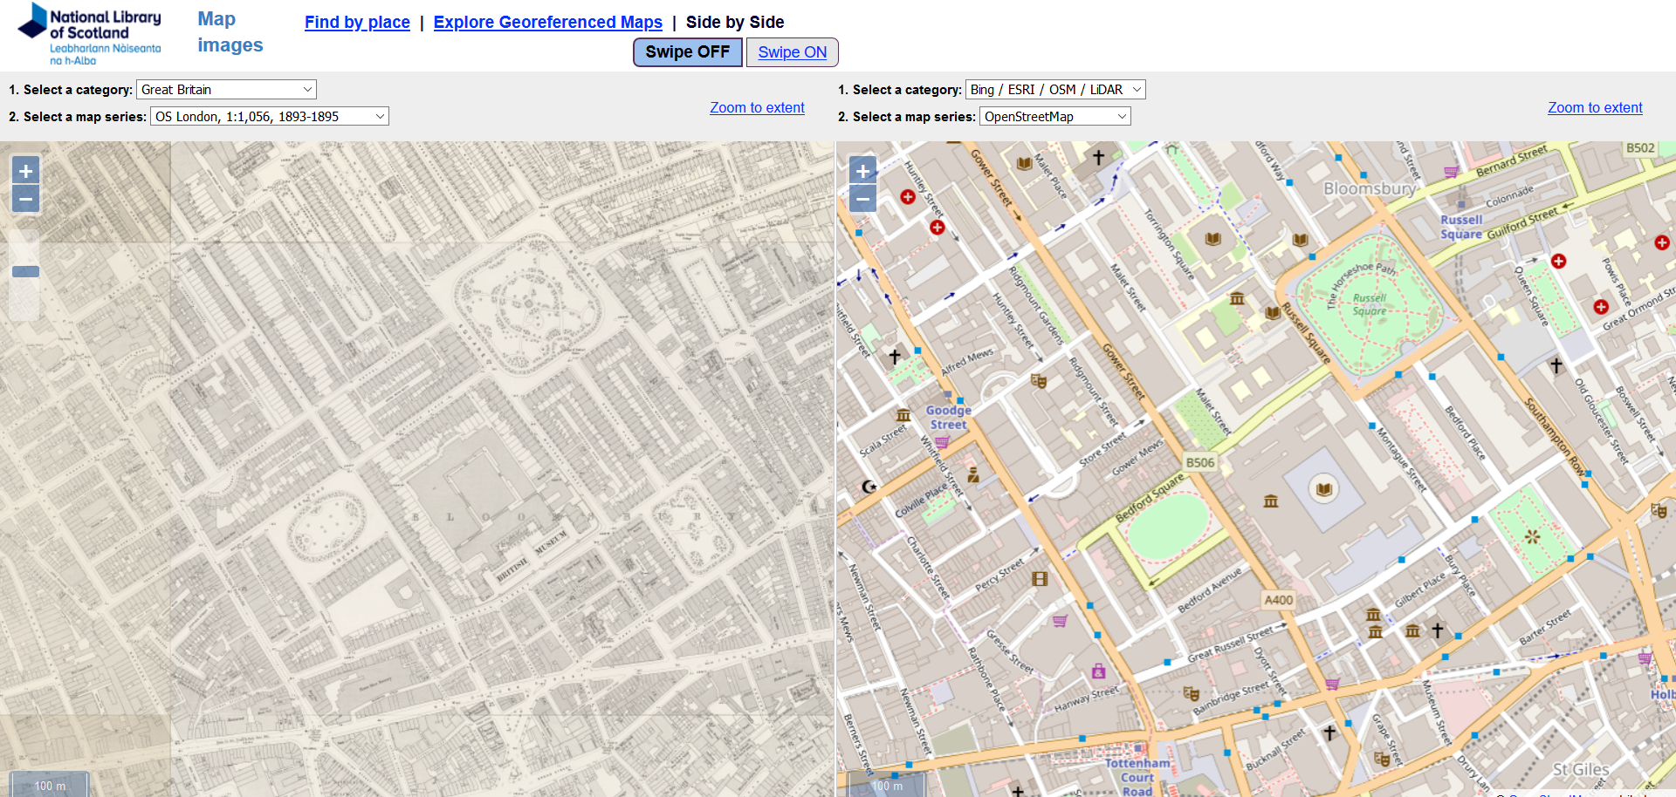
Example – Euston Square, London

