Slide 1
Analysing, contextualising and processing geographical data
David Holmes, Catherine Van Sarloos, and Tom Rainbow
November 2020

Slide 2
Structure for our session
Todays Session:
Seeing the issue as relevant
Unpacking the science and terminology
Looking at impacts
Looking to the future……
Data and information – getting into it
Types of data – challenges ahead!
Data in GCSE and GCE geography Assessment
Exploring rich sources and asking questions
Using Desmos and other online tools to process data

Slide 3
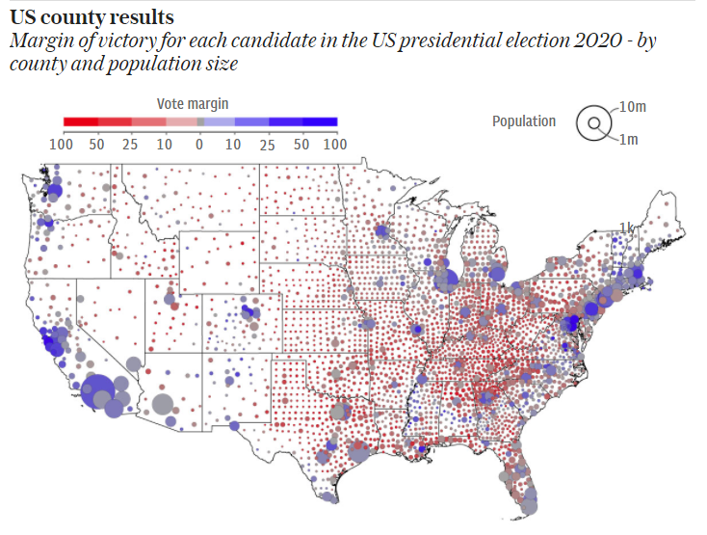
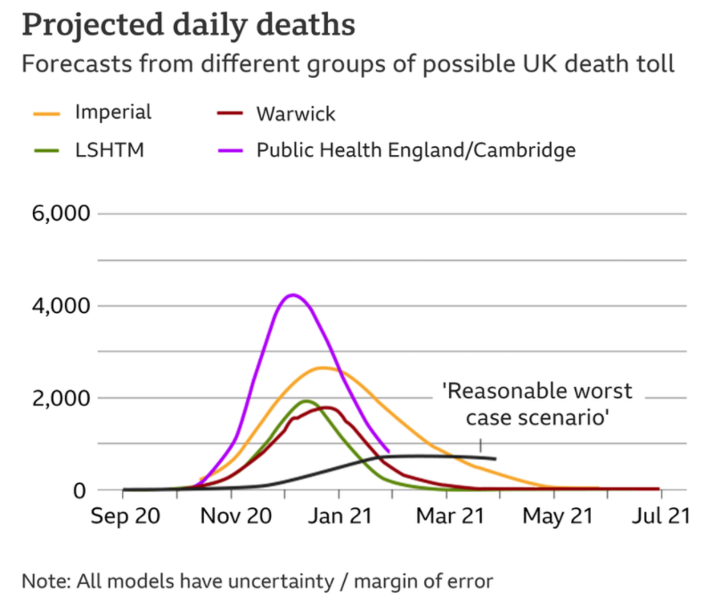
Data and information – getting into it
Todays Session:
Seeing the issue as relevant
Unpacking the science and terminology
Looking at impacts
Looking to the future……
https://www.bbc.co.uk/news/health-54831334
https://www.telegraph.co.uk/news/2020/11/09/election-results-2020-map-us-who-won-state-trump-biden-winner/

Slide 4
Different types of data:
Simple answers?
ACTIVITY 1a
How old are you?
How old are the people who live in Manchester?
Do dogs run faster than cats?
Does Cromer get less sunshine than Brighton?
What was the difference in rainfall between Swanage and Taunton in 2019?
Do you get paid more working as a teacher or as a fireman?

Slide 5
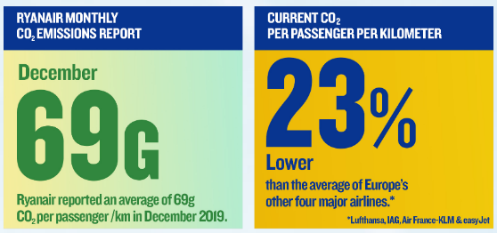
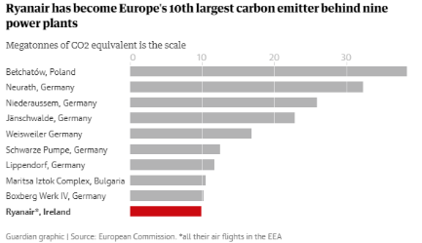
Complex….and misleading
Relative claims?
Background reading is going to help you keep up to date
This is a fast changing topic, scientifically and politically
Often information, news are views conflicting
Especially be careful with relative vs absolute.
Always question the provenance of evidence – who, why, what, what is not shown?
Claims and counter-claims!
https://corporate.ryanair.com/environment/
Absolute evidence?

Slide 6
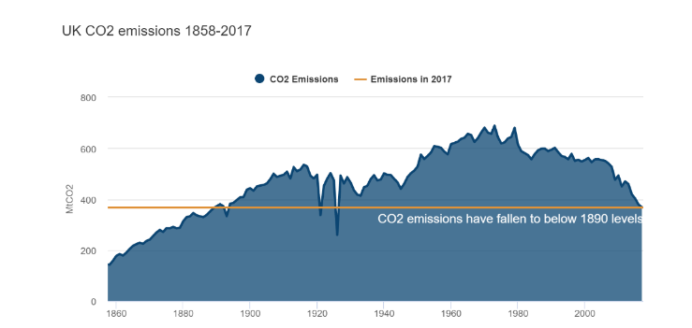
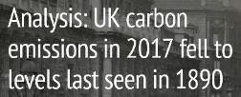
The evidence can be complex…
https://www.carbonbrief.org/analysis-uk-cuts-carbon-record-coal-drop
Good to dispel myths
Need to keep up to date on the evidence
Understand the complex reasons for changes such as this

Slide 7
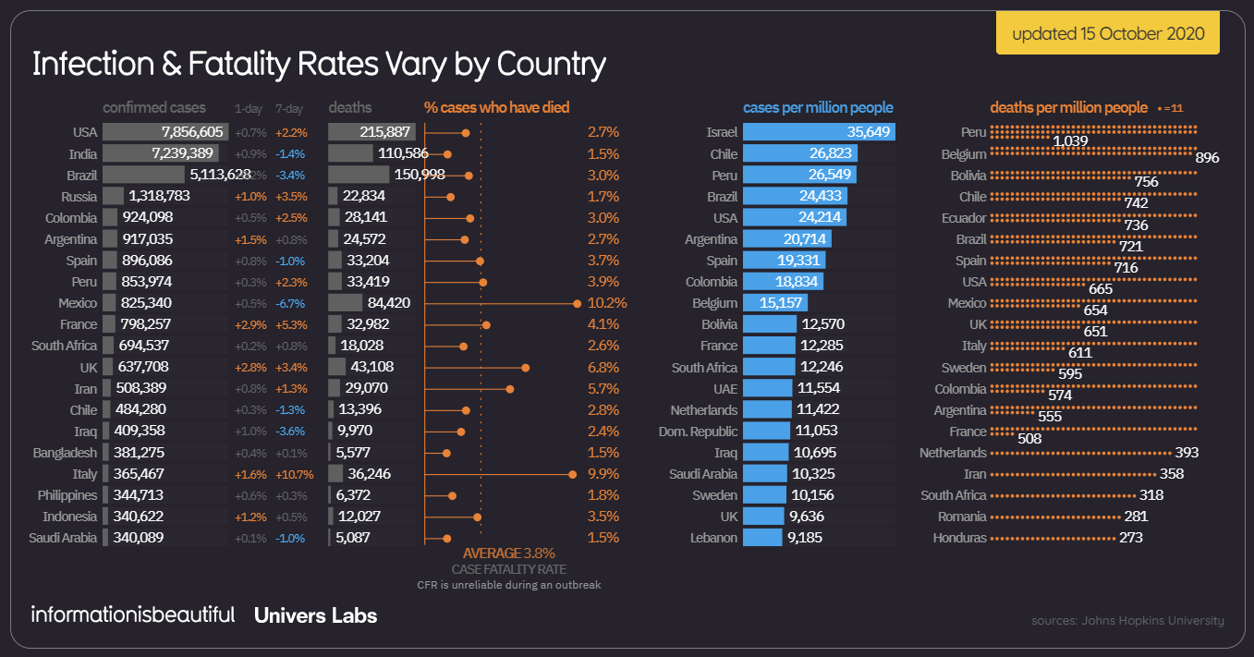
What questions show we ask?
Todays Session:
Seeing the issue as relevant
Unpacking the science and terminology
Looking at impacts
Looking to the future……
https://informationisbeautiful.net/visualizations/covid-19-coronavirus-infographic-datapack/

Slide 8
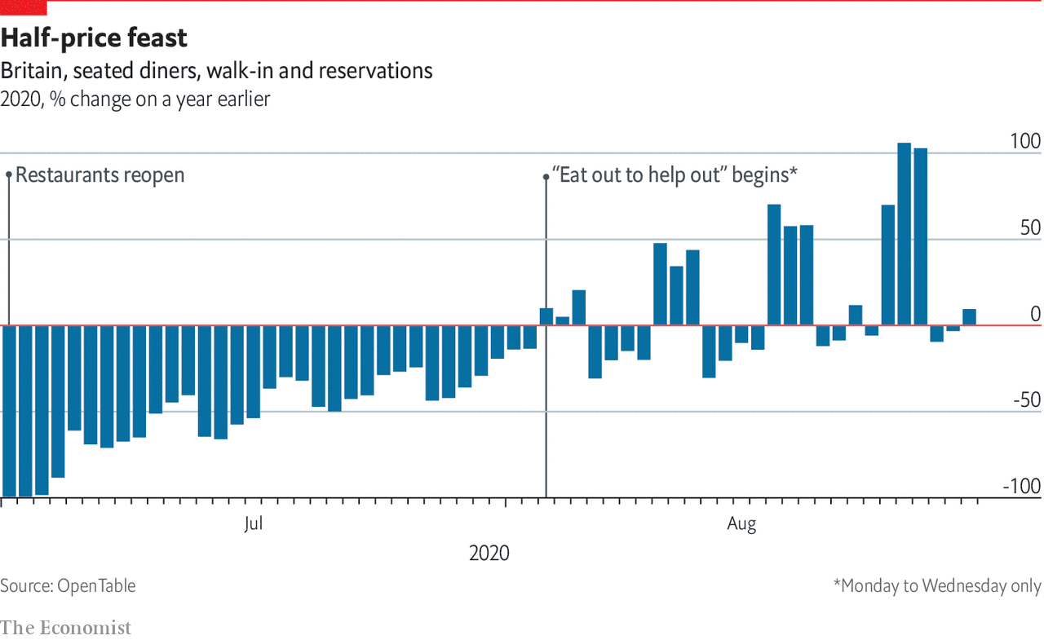
Starter: how much should we trust the data?
Todays Session:
Seeing the issue as relevant
Unpacking the science and terminology
Looking at impacts
Looking to the future……
ACTIVITY 1c
https://www.economist.com/graphic-detail/2020/08/31/as-eat-out-to-help-out-ends-britains-eateries-remain-at-risk

Slide 9
Data in GCSE and GCE Geography Assessment
Todays Session:
Seeing the issue as relevant
Unpacking the science and terminology
Looking at impacts
Looking to the future……

Slide 10
Assessment profiles
Source: AQA 2020 – 2019 GCSE Geography Exam Feedback

Slide 11
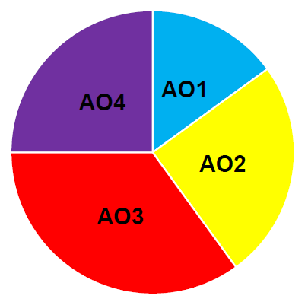
Proportions: GCSE
Do you match your teaching to the weighted importance of these exam skills? i.e. it’s not all about knowledge –spend more time practicing application of understanding, skills based questions etc.

Slide 12
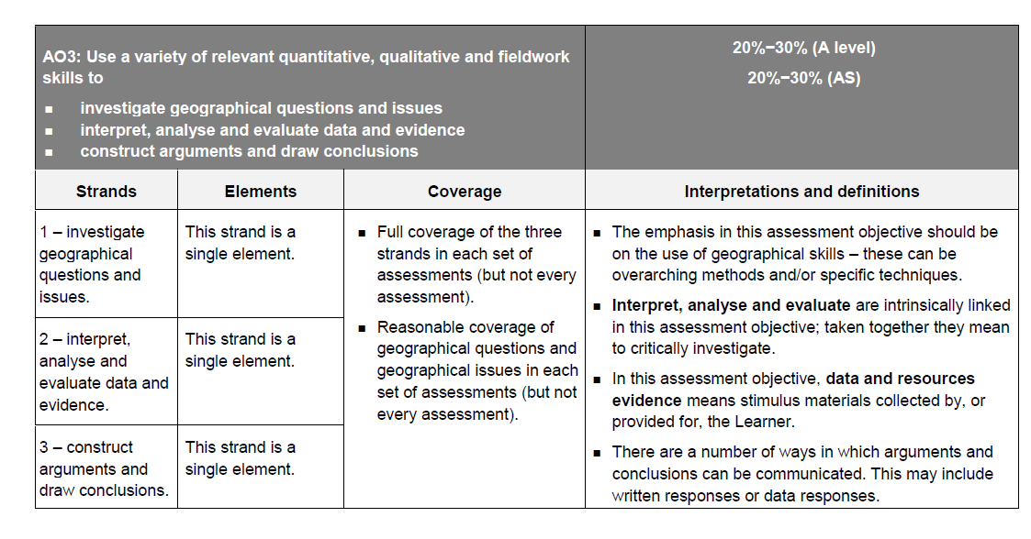
AO3 @ GCE
Source: QFQUAL 2015 A level and AS Geography: Consultation on Conditions and Guidance

Slide 13
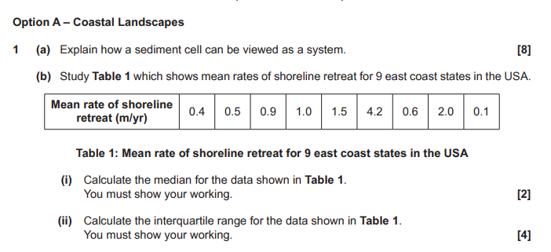
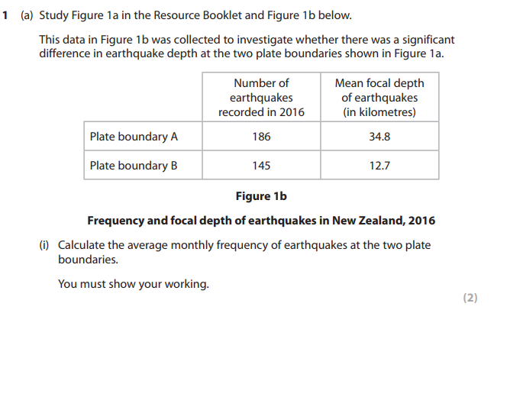
Example Questions – Number Test: Procedural
Source: OCR GCE 2018 (Paper 1)
Source: Pearson / Edexcel GCE 2019 (Paper 1)

Slide 14
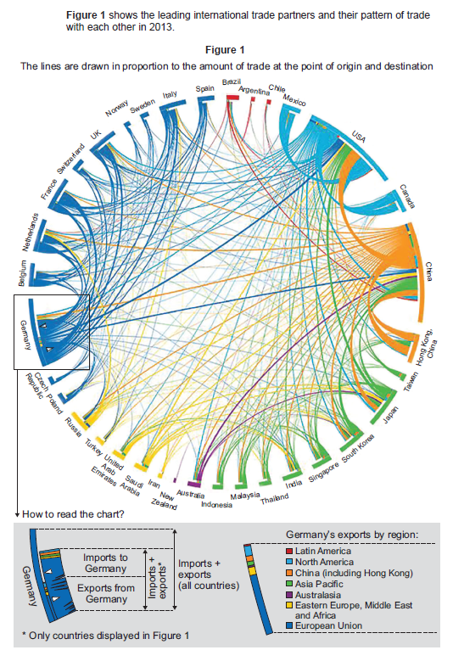
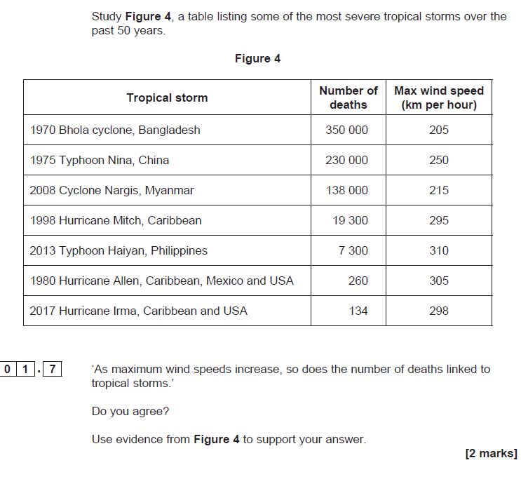
Example Questions – Number Test: Application
Source: AQA GCSE 2019 (Paper 1)
Source: AQA GCE 2019 (Paper 2)

Slide 15
Super-skill “Analyse”
A difficult command word.
It means more than “describe” but is also more than “explain”
The Edexcel definition does include an explanatory element ➔
The key is to do something with the data given.
“say what you see” doesn’t quite cut it
It might be useful to think of analyse as:
“Describe what you have discovered, then explain it.”
A paragraph of analysis, followed by a paragraph of explanation is a possible approach.
The analysis and reasons can be combined of course.
Edexcel / Pearson
Analyse: “Use geographical skills to investigate an issue by systematically breaking it down into individual components and making logical, evidence-based connections about the causes and effects or interrelationships between the components.”
AO1 = 4
AO3 = 4

Slide 16
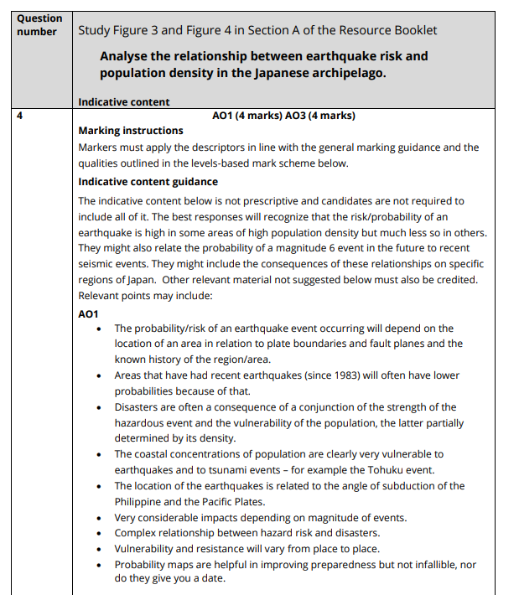
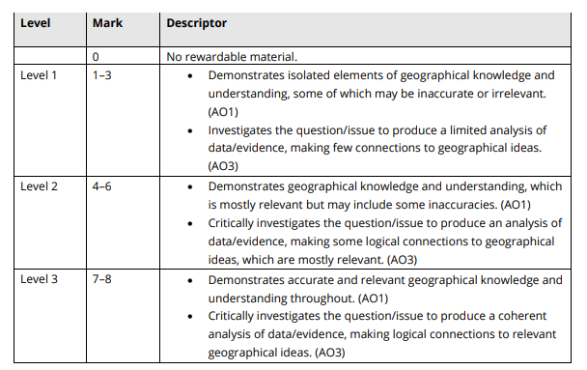
Example MS
Source: EDEXCEL GCE 2019 (Paper 3 - MS)

Slide 17
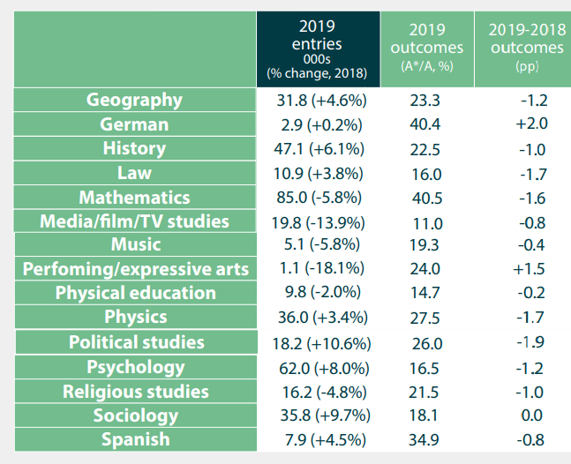
Over to you……analyse this!
ACTIVITY 2
Source: DfE / QFQUAL 2019

Slide 18
Exploring Sources and Asking Questions
Todays Session:
Seeing the issue as relevant
Unpacking the science and terminology
Looking at impacts
Looking to the future……

Slide 19
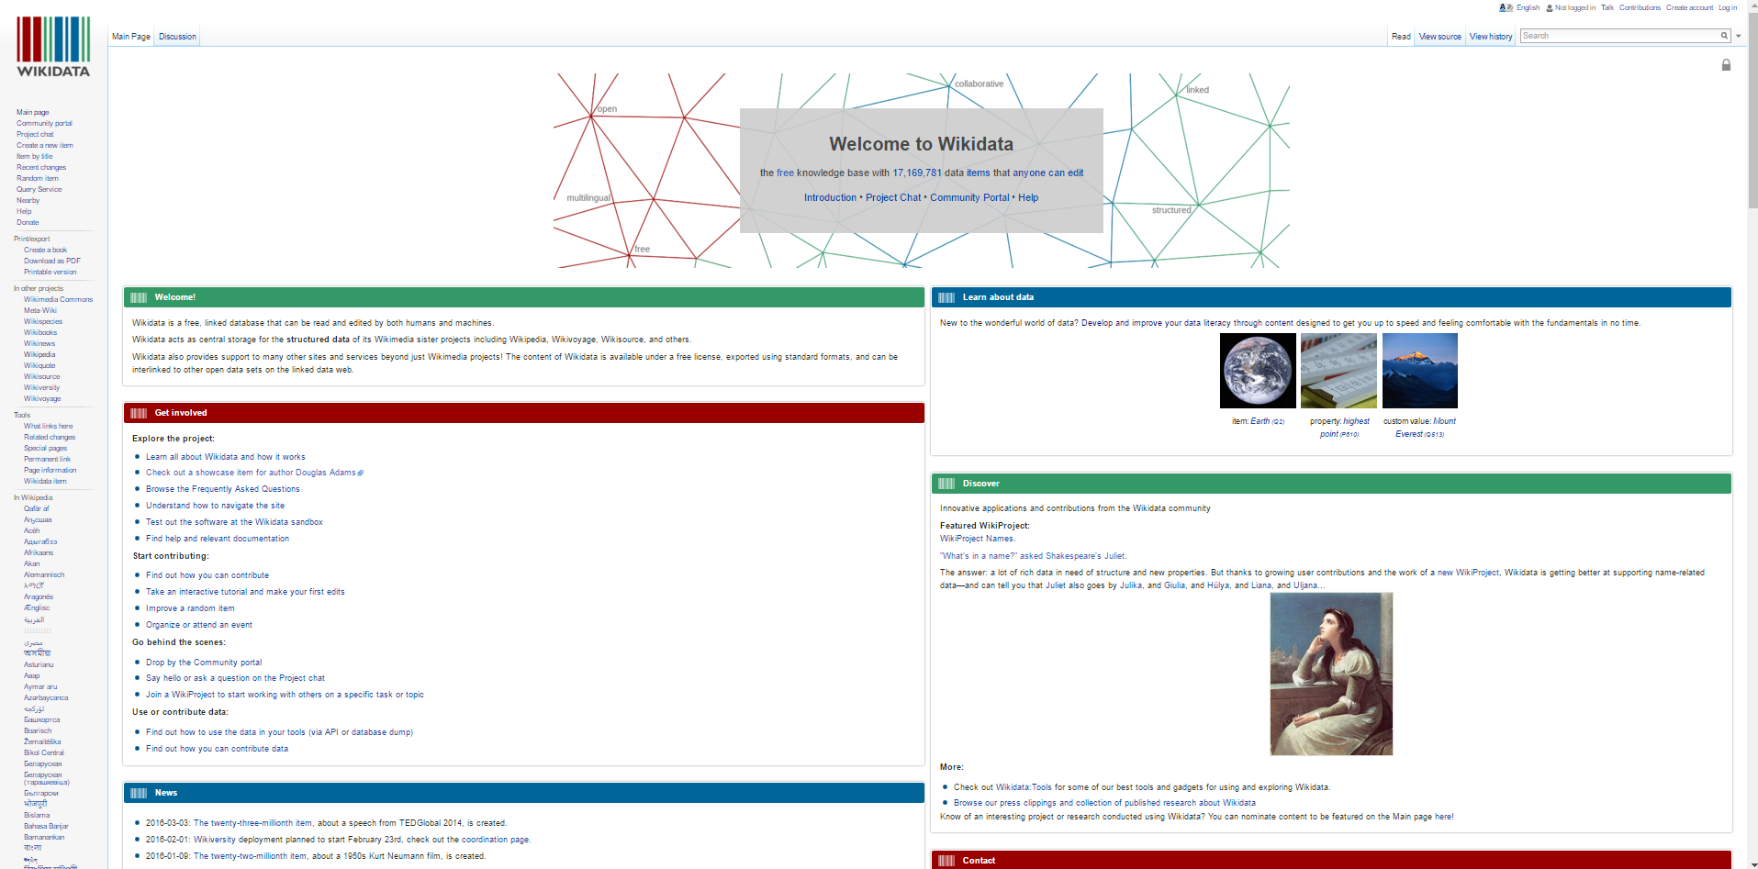
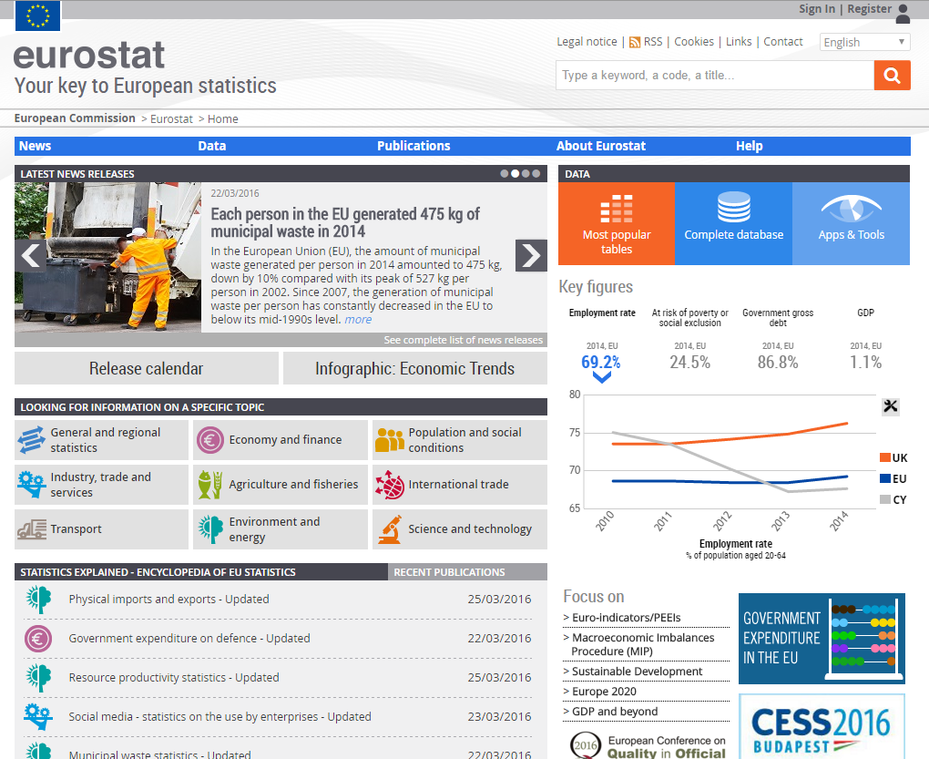
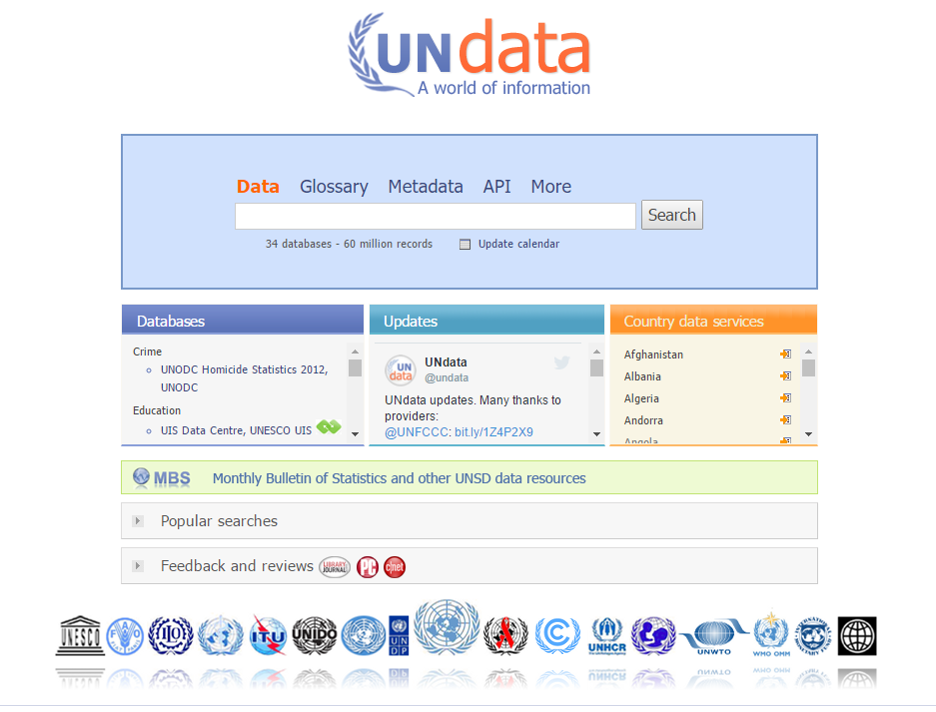
Examples of “Big” data
Data.gov.uk
wikidata
Eurostat
UNdata portal
Notes:
These are just 4 examples of public data. They provide access to some very big data sets. Definitely worth a look, and remember these are just examples, so there are many more places out there to find both real and big data.

Slide 20
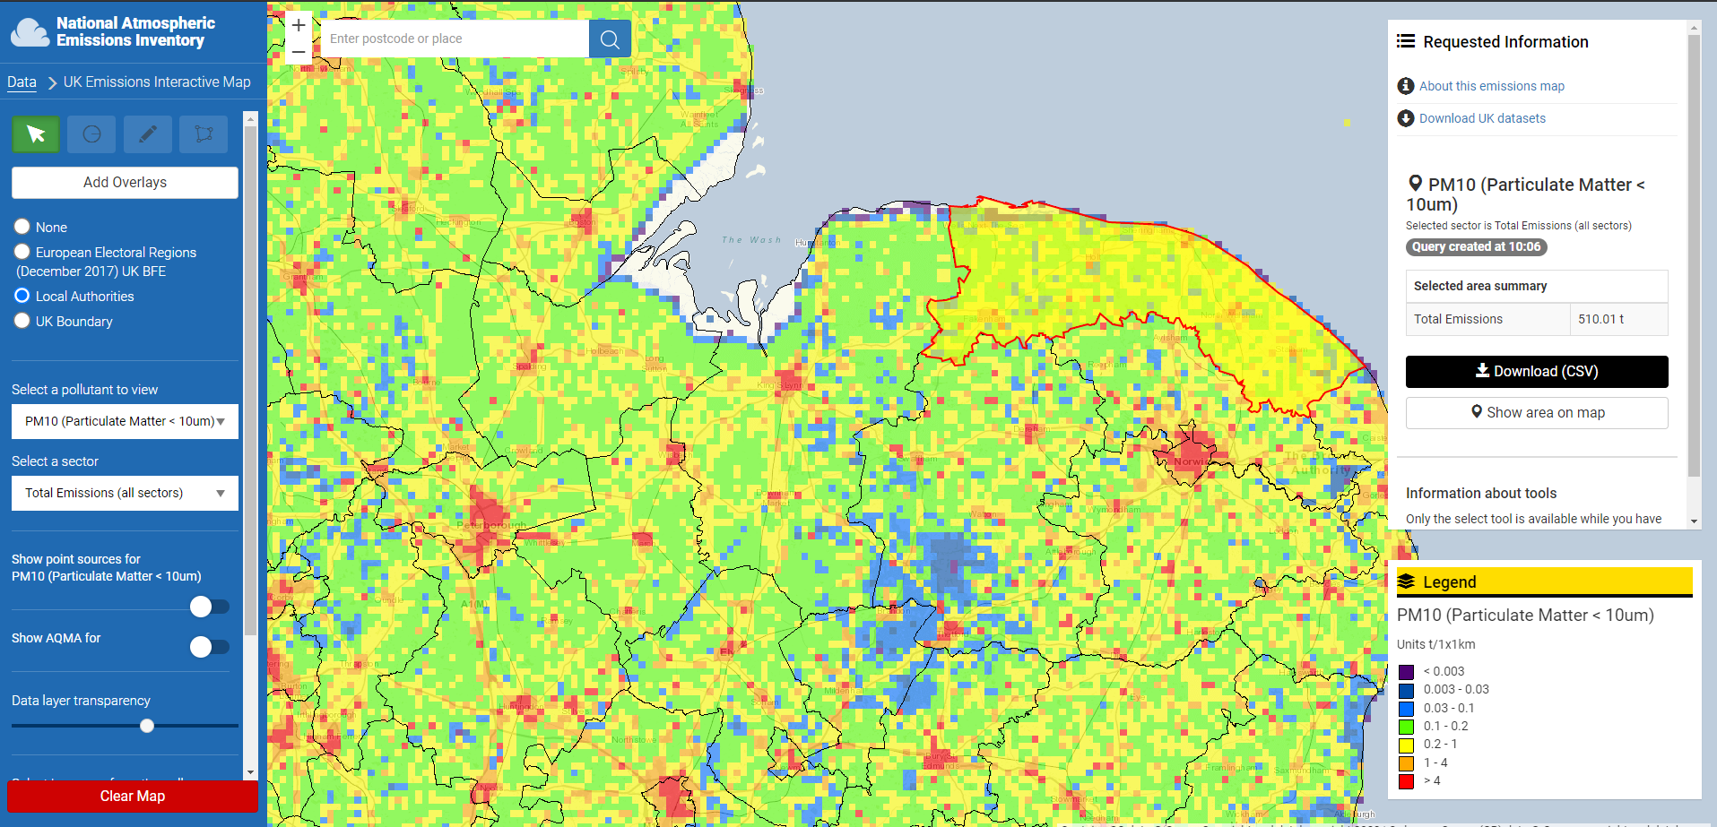
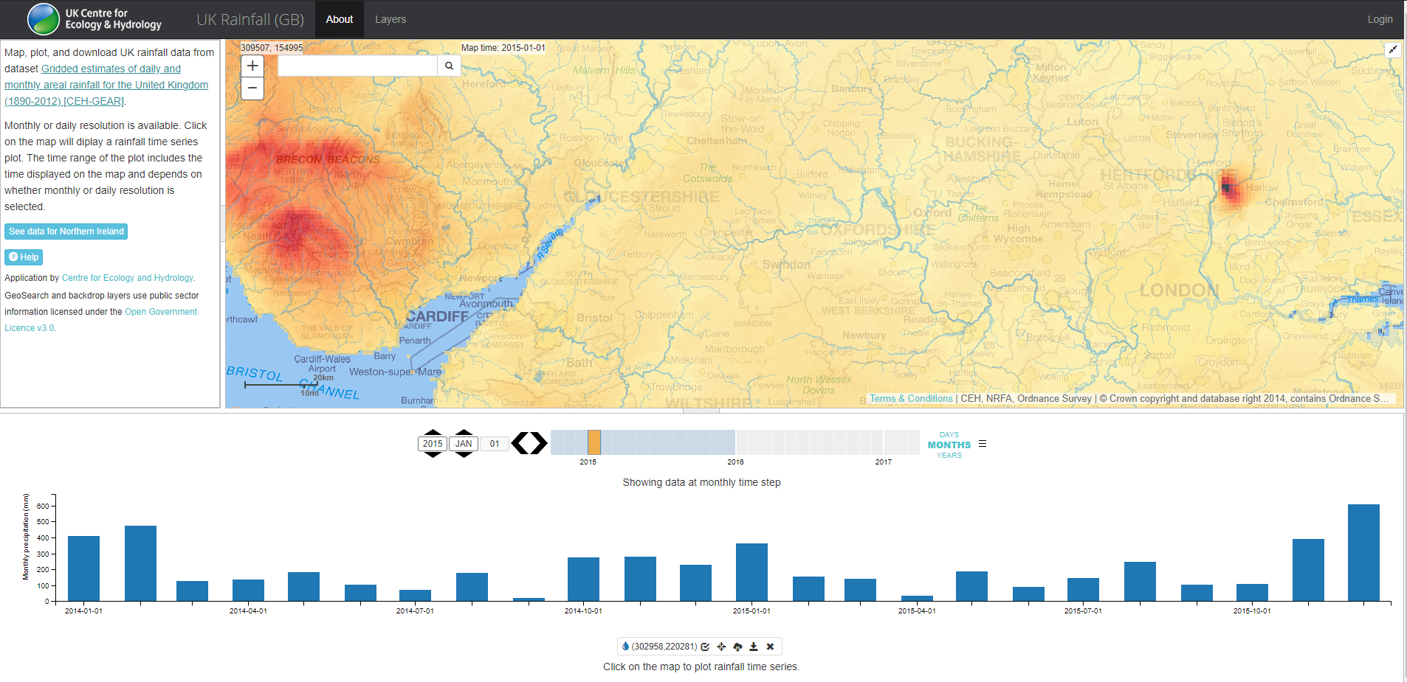
Local Data
Source: https://eip.ceh.ac.uk/apps/rainfall/gb.html
Source: https://naei.beis.gov.uk/emissionsapp/

Slide 21
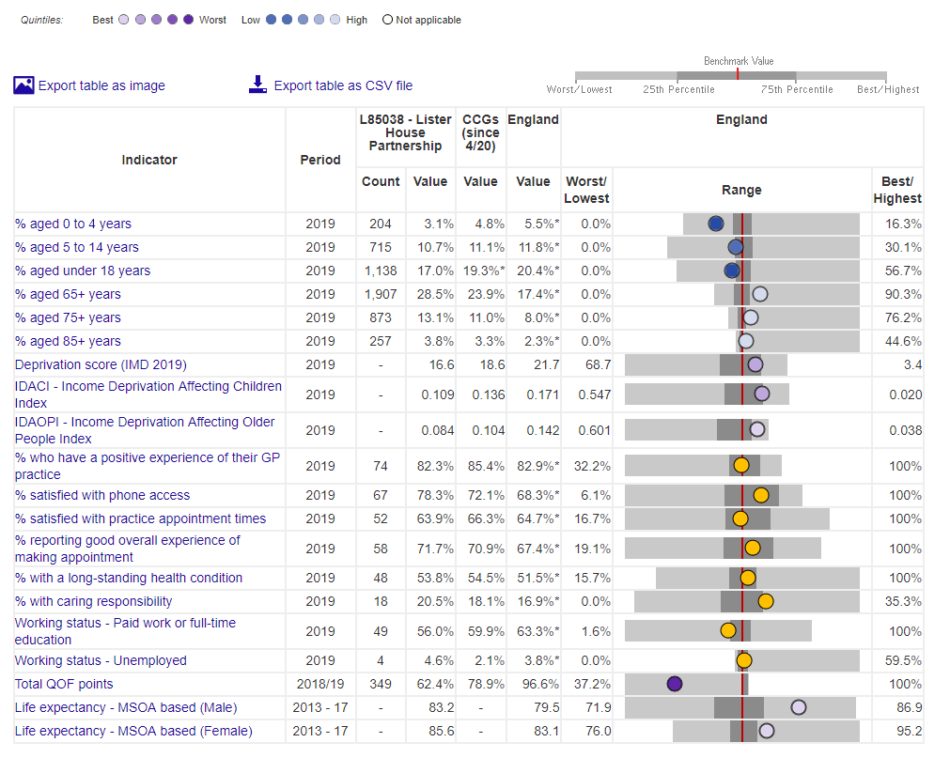
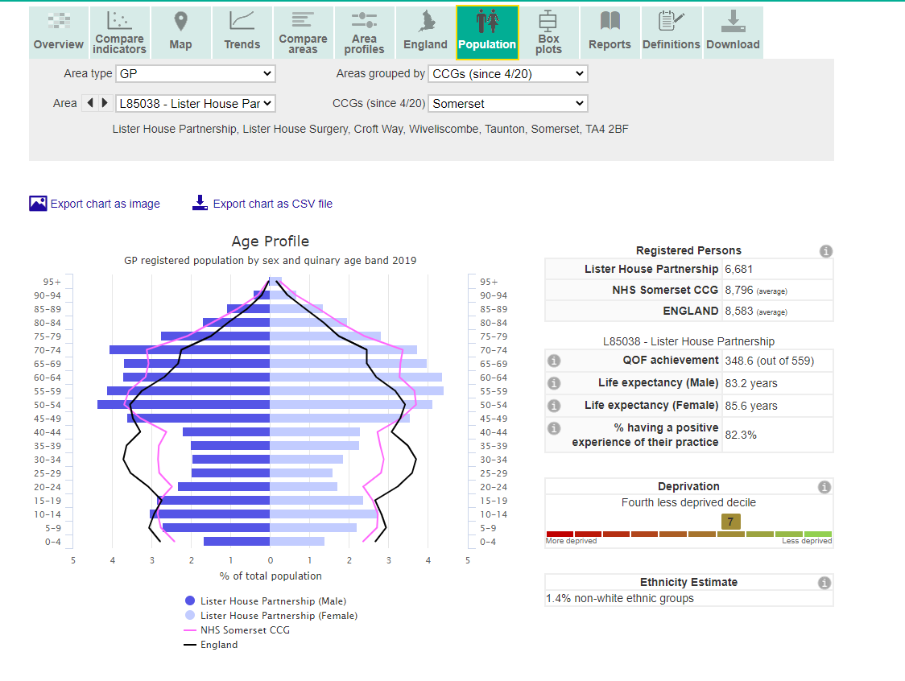
Your turn…….
BREAK: ACTIVITY 3
https://fingertips.phe.org.uk/profile/general-practice
Notes:
These are just 4 examples of public data. They provide access to some very big data sets. Definitely worth a look, and remember these are just examples, so there are many more places out there to find both real and big data.

Slide 22
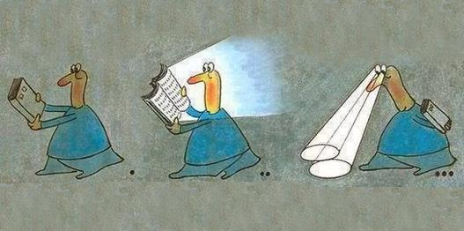
How can you bring data and information into the heart of the geography classroom?
Data compliment teaching and learning by providing information and evidence to challenge and discuss.
Notes:
This is much of the ethos and philosophy that I have been trying to put across. To my mind data and information really are central to the geography debate of the 21st century. We have one of the few subjects that allows us (legitimately) to develop these skills, which are going to be very important for people operating in the next decades.

Slide 23
Summary: joining – up the dots
Geography is much more than the “case-studies” that we are sometimes haunted by….
Students needs recognise the complexities in the data, evidence and understanding.
Be aware that different stories can be told from the same data
Our subject is enriched by critical thinking skills.

Slide 24
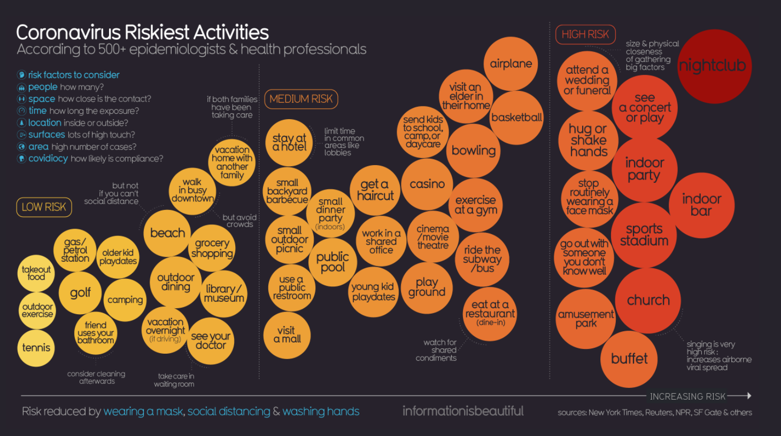
Stay safe!
https://informationisbeautiful.net/visualizations/covid-19-coronavirus-infographic-datapack/

Slide 25
Course Evaluation
Please complete our online course evaluation form
https://Bit.ly/RGSIBGCPD

Slide 26
Find out more and keep in touch
Follow us on Twitter for the latest updates @RGS_IBGschools
www.rgs.org/schools
Encourage pupils to enter our competitions, or submit the best NEA projects to be considered for our Ron Cooke Award
www.rgs.org/competitions
Sign up for e-updates
bit.ly/RGSIBGschools
Contact us for help and support education@rgs.org

